Slide 1
Module 24 Lesson Plan – Content Differentiated Instructional Strategies Formative Assessment
Dr. Mei Zhu
Pacific Lutheran University
Zhuma@plu.edu
January, 2017

Slide 2
Review of Grant Goals
“Teachers will have increased standard-based teaching skills measured by
(1) 3 lesson plans demonstrating
standards-based instructional objectives (Oct., Jan. Modules 17, 20 & 24),
Identification of common developmental approximations or misconceptions related to the learning objectives (Oct., Jan, Modules 17 & 20),
Using research-based instructional strategies (Jan. Modules 11, 17, 20 & 24),
Following the 4-steps formative assessment process (Oct., Jan. Modules 20 & 24),
Differentiating instructional strategies for students with special needs and ELLs at different English language proficiency level (Jan. Modules 11, 17, 20 & 24),
Establishing academic language objectives for English language learners (ELLs) and students in poverty (Jan. Modules 11, 17, 20 & 24),
Connecting with students’ cultural and community assets (Jan. Module 24), and
Designing formative assessment tasks for both language and content instructional objectives (Oct., Jan. Modules 17, 20 & 24).
(2) Peer observations, (3) Self-reflections, and (4) Peer feedback (Jan. Modules 17 & 20).

Slide 3
Review of Grant Goals & Previous Module Goals
October Module
Strengthen CCSS math content knowledge in solving equations (Part 1 – a.m. session)
Discuss instructional strategies and learn the 4-step formative assessment process (Part 2 – p.m. session):
(1) Clarify intended learning;
(2) Elicit evidence;
(3) Interpret evidence; and
(4) Act on evidence.
(Focusing on the three shifts of CCSS – Focus, Coherence, Rigor (understanding, fluency and application). Lesson plan structure was explained.)

Slide 4
Review of January Institute Module Goals
Module 11 - SBAC Digital Library and NCTM Resources
Navigate SBAC digital library and search for resources on
Specific CCSS content area of your choice
Differentiated instructions for intended student populations
Formative Assessment
Review other online resources
Navigate NCTM websites to search for resources on teaching guidelines such as teaching for rigor and teaching minority students and ELLs.
Share interesting findings.
Module 17 & 20 Reasoning and Sense Making
Understand CCSS Math Practice 3 (MP3) and its importance in reasoning and sense making.
Develop various classroom activities to engage students in constructing viable arguments and critiquing others’ reasoning to intensify content learning.
Have a guideline and some examples for guiding students making viable arguments in depth.
Gain in strategies to offer differentiated instruction, including strategies for addressing equity issues and for intervention.
Use Math Practice 3 as a part of the formative assessment in identifying and correcting mistakes.

Slide 5
Module 24 Goal – Building Effective Lesson Plans
Revisit lesson plan requirements.
Zoom in onto differentiated instruction strategies
How cultural minorities learn and how we can use the right teaching styles.
Teaching ELLs beyond vocabulary.
Effective differentiated instruction strategies.
Discussion of lesson plan examples – applying what we learned in action.
A lesson plan from one of our teachers.
A lesson plan from the Digital Library

Slide 6
Core Time Digital Professional Development Lesson Plan
CCSS Standard used:
Lesson Objectives:
LESSON CONTENT
Introduction
Declarative knowledge – Describe the content of the lesson and how it is integrated within the series
Conditional knowledge—Describe why students learn content and the conditions for using it
Development
Procedural knowledge—Describe the steps for guiding students to acquire the strategy/content to show coherence within the lesson
Differentiated instruction—Describe strategies for engaging ELL/SPED students
Formative Assessment—Describe instruments for monitoring learning and forms of intervention (Use the 4 steps of formative assessment: clarify intended learning, elicit evidence, interpret evidence, and act on evidence)
Closure
Summative Assessment—Describe relevant instruments for monitoring and evaluating students learning

Slide 7
Differentiate Math Instruction
“An organized, yet flexible way of proactively adjusting teaching and learning to meet students where they are and help all students achieve maximum growth as learners” (Tomlinson, 1999).
Instruction may be differentiated in content/input, process/sense-making, or product/output according to the students’ readiness, interest, or learning style. (Adams, C. & Pierce, R., 2004)
Differentiated instruction is a process by which teachers adapt their teaching strategies in an attempt to meet the diverse needs of students who possess diverse needs of a variety of academic, socioeconomic, cultural, and racial backgrounds. It implies the use of a variety of teaching techniques and assessment methods to meet the needs of students (NCTM)

Slide 8
Example 1. Working with Minority Students (Hani Morgan, 2010)
Facts about cultural of minorities.
African American and Hispanic students:
The dropout rate exceeded that of white students (NCES 2007).
Students are also less-frequently identified as gifted or talented (Elhoweris et al . 2005).
Students from minority groups who tend to do well academically, such as Asian Pacific American children, can also experience difficulties in American schools and having lower self-esteem (Pang, 2008).

Slide 9
Example 1 (continued) Steps of Helping Minority Students
Step 1. Understanding minority cultures and avoiding conflicts
Example of two Hispanic students. Looking into the eyes is considered disrespectful in Hispanic culture, while Caucasian students are often taught that such behavior is respectful (Norman and Keating 1997) .
Example of talking to an Arab parent. Individuals from Arab, Latin American, and Southern European countries generally stand much closer during conversations than do Americans, who usually remain at least twenty inches apart in such situations (Gollnick and Chinn 2009)

Slide 10
Example 1 (continued) Steps of Helping Minority Students
Step 2. Understanding differences in learning style
African American, Latino and students, and Alaska Native tend to be field-dependent: they prefer working together. They tend to improve academically with cooperative learning methods of teaching (Aronson and Gonzales 1988, Pewewardy 2008).
Anglo-American students tend to be field-independent and prefer to work alone (Banks 2006). They are more likely to be detached, goal oriented, competitive, analytical, and logical (Irvine and York 1995; Pewewardy 2008). It helps the students if we break down a whole subject or topic and understand that its parts added together can reform the whole.

Slide 11
Example 1 (continued) Steps of Helping Minority Students
Step 2. Understanding differences in learning style (continued)
Native American cultures tend to value possessions much less than Anglo culture. Native Americans greatly respect people who share and are more likely to distrust someone with many possessions (Pewewardy 2008). They more likely to help other students and less likely to show that they know an answer if others do not. Judging them as unmotivated or learning disabled because they do not raise their hands in response to a difficult question may unknowingly discriminate against them.
Asian Pacific American cultures’ emphasis on humility and modesty makes them more likely to help one another (Pang 2008). Such cultures often view the teacher as an authority figure. Asian Pacific American parents often expect their children to remain relatively quiet and to avoid discussion, which they regard as challenging the teacher’s knowledge. Likewise, many Asian Pacific American students only reluctantly express themselves. Many of them are stereotyped as nerds, teachers may not realize that some have trouble academically .

Slide 12
Example 1 (continued) Steps of Helping Minority Students
Step 3. Correcting the misconception of treating students identically.
Treating all students the same way avoids discriminating against any group, the practice in itself is discriminatory (Banks 2006; Gollnick and Chinn 2009). Requiring all students to follow one style of teaching can inadvertently favor the students who are most comfortable with the teacher’s style of teaching.
In an NCTM 2000 journal, it was stated that, “equity does not mean that every student should receive identical instruction; instead, it demands that reasonable and appropriate accommodations are made as needed to promote access and attainment for all students.”
America’s tremendous cultural diversity presents another difficulty for the culturally responsive teacher. It is difficult or even impossible to address each adequately. Understanding students’ cultures and learning style and using differentiated instruction will help.

Slide 13
Example 1 (continued) Steps of Helping Minority Students
Step 4. Avoiding misusing research on cultural differences.
Do not use research on cultures of minorities to stereotype individual students within on minority group. Not all African Americans are field-dependent, and not all Asian Pacific Americans are successful academically.
Get to know each of our students.
(e.g. Give choices: participants have options: to work individually, with a partner, with a subset of the group, or with the entire group - Promoting Equity through Reasoning – by Mueller and Mahet.)

Slide 14
Example 1 (continued) Steps of Helping Minority Students
Step 5. Using culturally responsive teaching..
Strategies:
Examine our own teaching styles and understand the learning styles of our students without making generalizations. Teachers tend to teach the way they have learned unless deliberately challenged to teach otherwise (Bennett 2007).
Use as many modes as possible: logical-mathematical, linguistic, musical, spatial, bodily kinesthetic, interpersonal, naturalistic, and intrapersonal (Howard Gardner, 1993).

Slide 15
Example 2. For ELLs: Vocabulary beyond the Definitions (Roberts & Truxaw, 2003)
MP6- Attend to Precision. Mathematically proficient students try to communicate precisely to others. They try to use clear definitions in discussion with others and in their own reasoning.
Challenges of math vocabulary for ELLs.
Definitions are filled with technical vocabulary, symbols, and diagrams (Pimm 1987). Teachers need to explicitly help students make sense of this new language (Schlepegrell 2007).
Many mathematics concepts can be represented in multiple ways. Multiplication can be indicated in many ways: “2 times 3,” “2 multiplied by 3,” and “the product of 2 and 3.”To add to the confusion, some words may have similar connotations but vastly different technical meanings—for example, “3 multiplied by 10”and “3 increased by 10” (Heinze 2005).

Slide 16
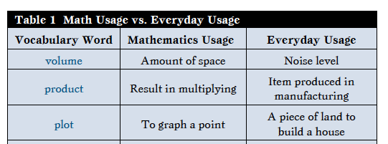
Example 2. For ELLs: Vocabulary beyond the Definitions (Roberts & Truxaw, 2003) (continued)
Challenges of math vocabulary for ELLs (continued).
Many mathematics words have multiple meanings. A quarter may refer to a coin or a fourth of a whole. Students must learn that the same word in different situations has different meanings, such as asking for a quarter while at a vending or a quarter of a foot implying one forth of a foot.
The overlap between mathematics vocabulary and everyday English (Kotsopoulos 2007; Moschkovich 2002) is problematic.

Slide 17
Example 2. For ELLs: Vocabulary beyond the Definitions (Roberts & Truxaw, 2003) (continued)
Challenges of math vocabulary for ELLs (continued).
Homonyms and words that sound similar can confuse (Adams 2003).
Similarity to native language words can add more confusion. For example, the Spanish word for quarter is cuarto, which can mean “a quarter of an hour”; quarter could also mean a room in a house, as in the Englishusage “your living quarters” (Moschkovich 1999, 2002).

Slide 18
Example 2. For ELLs: Vocabulary beyond the Definitions (Roberts & Truxaw, 2003) (continued)
Strategies of helping ELLs to learn math vocabulary.
Techniques: word wall, graphic organizer, Frayer model
Better examples:
2x-y=5
2x>6

Slide 19
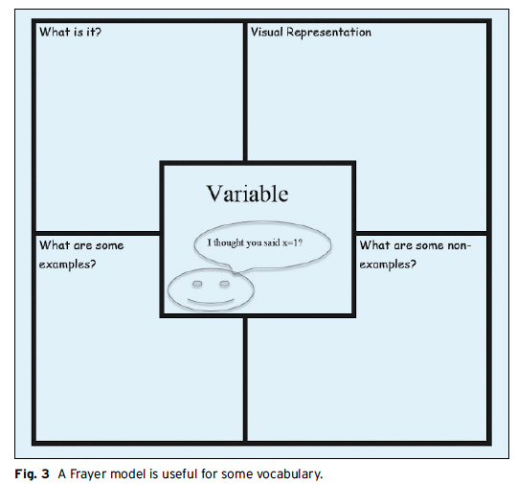
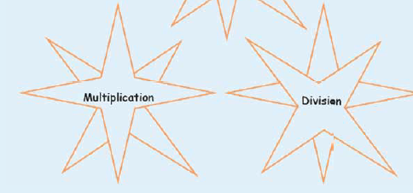
Example 2. For ELLs: Vocabulary beyond the Definitions (Roberts & Truxaw, 2003) (continued)
Strategies of learning math vocabulary.
Word wall, graphic organizer, Frayer model

Slide 20
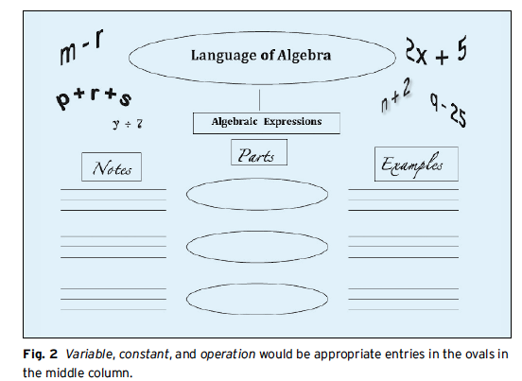

Slide 21
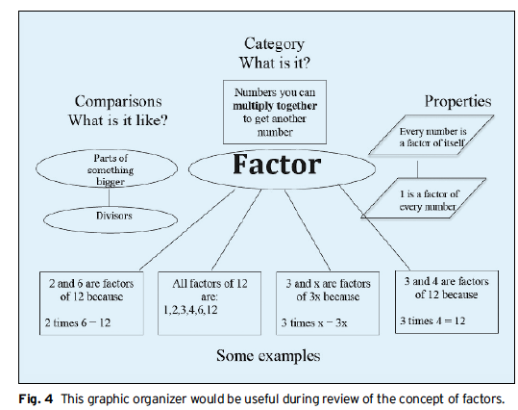

Slide 22
Example 2. For ELLs: Vocabulary beyond the Definitions (Roberts & Truxaw, 2003) (continued)
Strategies of helping ELLs to learn math vocabulary (continued).
Instructional steps:
Develop a vocabulary list
Pre-teach and assess
Teach and reteach
Provide repetition and support long-term retention

Slide 23
NCTM Suggested Differentiated Instructional Strategies 5-8
Use a variety of teaching techniques
Emphasize critical thinking
Use a variety of assessment strategies
Use active teaching techniques that allow students to explore and draw their own conclusions
Have students work in cooperative groups
Use multiple representations to illustrate problem-solving strategies
Differentiate tasks and assignments
Provide extra assistance to those who need it
Provide challenges for those who are high achievers
See Examples from Modules 17 & 20

Slide 24
NCTM Suggested Differentiated Instructional Strategies 5-8 (continued)
Do not simply ask students to solve additional problems, do an extra report, or play computer games when they finish early
Play into students interests
Encourage individual research
Provide challenges for those who are high achievers

Slide 25
NCTM Suggested Differentiated Instructional Strategies: HS
Teach vocabulary
Make use of cooperative learning and group activities
Explore worthwhile, relevant tasks
Use multiple representations
Emphasize dialogue over lecture
Use various presentation styles
Communicate high expectations and have students set goals for themselves
Vary assessment strategies
See Examples from Modules 17 & 20

Slide 26
NCTM Suggested Differentiated Instructional Strategies: HS (continued)
Integrate technology
Make content connections between math and across subjects
Involve parents and community members

Slide 27
Core Differentiated Instruction Strategy Example 1. Open Questions
Open questions – allow variety responses and approaches.
Closed question v.s. open question
Benefits: Students are encouraged to express different points of views. It allows independent and critical thinking. It allows teacher to observe students and come up the next step of instruction.
(Why and How to Differentiate.
https://www.nctm.org/Handlers/AttachmentHandler.ashx?attachmentID=NV%2BmKCl3nM8%3D)

Slide 28
Core Differentiated Instruction Strategy Example 1. Open Questions (continued)
Creating an open question
Turning around a question
Asking for similarities and differences
Replacing a number, shape, measurement unit, and so forth with a blank
Asking for a number sentence

Slide 29
Core Differentiated Instruction Strategy Example 2. Tiered Lessons
Types of tiers we can use: readiness, interest, or learning profile.
Readiness: under the same content goals choose different levels and numbers of problems.
Interest: create problems/projects relevant to their interests.
Learning style: e.g. tier on all levels of Gardner’s multiple intelligences or Bloom’s Taxonomy in one lesson may not be a good place to start, so choose only a few, such as logical-mathematical intelligence, spatial intelligence, and linguistic intelligence. Use of directive teaching, sense making group work, algebraic steps, sense making, reading, graphs, and interactive technology whenever possible.
(Cathy Weselby, 2016. Adams, C. & Pierce, R. 2004)

Slide 30
Core Differentiated Instruction Strategy Example 2. Tiered Lessons (continued)
Detailed steps and lesson plan examples:
Marcia B. Imbeau, Ph.D. Teachers at Work: Designing Tiered Assignments/Lessons.
http://iag-online.org/resources/2014_handouts/Imbeau_tiered.pdf

Slide 31
Imbeau. Teachers at Work: Designing Tiered Assignments/Lessons

Slide 32
Imbeau. Teachers at Work: Designing Tiered Assignments/Lessons – Blue Group

Slide 33
Imbeau. Teachers at Work: Designing Tiered Assignments/Lessons – Red Group

Slide 34
Imbeau. Teachers at Work: Designing Tiered Assignments/Lessons – Green Group

Slide 35
Ten Ways to Sustain Your Efforts
Identify Where You Already Do Differentiation
Understand and Recognize Where You Are
Start Small (Task that are chewable) and Build Up
Think Ahead- Anticipation
Expect Surprises – So What if it does not always go as planned? Did they learn?
Students Can Help
Involve Parents
Professional Development
Reflect
Keep Trying
(Dacey & Lynch, 2007)

Slide 36
Lesson Plan Discussion
BIG THANKS to the Teacher Who Has Turned in a Lesson Plan.
For detailed explanation of the lesson plan requirements, see my presentation in the October Institute.
Review of the lesson plan:
What can you learn from it?
What could be added to the LP?

Slide 37
Core Time Digital Professional Development Lesson Plan Feedback Form
CCSS Standard used:
A. Coherence:
B. Progression: (Does the lesson plan reflect the 4 steps of formative assessment: Clarify intended learning, Elicit evidence, Interpret evidence, and Act on evidence?)
C. Use of Assessment:
D. Additional comments

Slide 38
Lesson Plan (1)
?6.RP.A.1 Understand the concept of a ratio and use ratio language to describe a ratio relationship between two quantities.
?6.RP.A.2 Understand the concept of unit rate a/b associated with a ratio a:b with b≠0, and use rate language in the context of a ratio relationship (and unit rate.
?6.RP.A.3 Use ratio and rate reasoning to solve real-world and mathematical problems, e.g., by reasoning about tables of equivalent ratios, tape diagrams, double number line diagrams, or equations.
Mathematical Practices: ?
Formative Assessment part 1: Define learning goals clearly using student-friendly language as such “I can …”. Provide clear success criteria that defining the evidence for determining how students progressing towards learning goals.
CCSS Standard used: 6RP.1, 6RP.2
Lesson Objectives: Build on the ratio skills to include writing ratios written as fractions (value), and find equivalent ratios written in the simplest form in real world and mathematical problems.

Slide 39
Lesson Plan (2)
LESSON CONTENT
Introduction
Declarative knowledge – Describe the content of the lesson
Equivalent ratios have the same value

Slide 40
Lesson Plan (2)
Expand more. What will the LP cover: definition, examples, table of equivalent ratios, and or applications? How does this lesson connect with the previous and the next lesson.
LESSON CONTENT
Introduction
Declarative knowledge – Describe the content of the lesson and how it is integrated within the series
Equivalent ratios have the same value

Slide 41
Lesson Plan (3)
Provide details of learning target and rubric
Conditional knowledge—Describe why students learn content and the conditions for using it
The target and rubric are introduced. Ratios are useful in many everyday situations. Sometimes a recipe, sometimes an exercise program, sometimes—and most important to them right now—time spent at something and the grade or improved skill (reading, skateboarding, guitar…).

Slide 42
Lesson Plan (4)
Development
Procedural knowledge—Describe the steps for guiding students to acquire the strategy/content
This lesson is built on prior lessons of ratios. There is a review of ratios and settings and the two ways to write a ratio that have been introduced up to this point. Then it is introduced as a fraction form. It begins with a picture representation. It is then written as a simplified fraction, as a reinforcement, for equivalent ratios. The fraction is referred to as a value. This skill is then practiced in a variety contexts.
Each of these steps is introduced by me, practiced by them and checked by them, practiced by them and checked by a buddy, then practiced by them and checked by me (problem set). There is an exit slip and two homework problems

Slide 43
Lesson Plan (4)
Good framework.
Please provide details of math steps/contents (examples, picture presentation, worksheets, problems, …) that shows conherence and progression.
For a detailed example, see the lesson plan provided by Marisa Aoki & Sam Saldivar. Also see Modules 17 & 20.
Development
Procedural knowledge—Describe the steps for guiding students to acquire the strategy/content to show coherence within the lesson
This lesson is built on prior lessons of ratios. There is a review of ratios and settings and the two ways to write a ratio that have been introduced up to this point. Then it is introduced as a fraction form. It begins with a picture representation. It is then written as a simplified fraction, as a reinforcement, for equivalent ratios. The fraction is referred to as a value. This skill is then practiced in a variety contexts.
Each of these steps is introduced by me, practiced by them and checked by them, practiced by them and checked by a buddy, then practiced by them and checked by me (problem set). There is an exit slip and two homework problems

Slide 44
Lesson Plan (5)
Good outline
Please provide detailed problems and examples of different levels of assignments and/or questions.
Consider using strategies introduced here, e.g. used in PBS and Teaching Chanel videos and the article by Roberts & Truxaw (2003), and by Aoki & Saldivar.
Differentiated instruction—Describe strategies for engaging ELL/SPED students
Students who need it are given one-on-one, or small group, by the paraprofessional, some are doing a smaller assignment, some advanced are encouraged to continue on their own finding ratios throughout the period or day that they notice and write their own.

Slide 45
Lesson Plan (6)
Formative Assessment—Describe instruments for monitoring learning and forms of intervention
Formative assessment continues throughout the lesson from the introduction through the exit slip. Children’s explanations often lead to a moment when clarification is required. A child’s written response, coloring response, and/or the ability to move through the skill as the gradual release of responsibility requires, occur throughout the lesson and may require modification.

Slide 46
Lesson Plan (6)
Good idea.
Please provide how you apply the 4 steps in detail, see Oct. module and Module 20.
For example for steps 2, 3, 4, describe what assessment(s) you are using and how you analyze, say, a common misconception, and how you act on it and provide further instruction. (E.g. Teaching Channel videos Module 20)
One possible difficulty for students is not having a good understanding of equivalent fraction (Gr. 3). Discuss the difference and similarity of equivalent fractions and equivalent ratios.
Formative Assessment—Describe instruments for monitoring learning and forms of intervention (Use the 4 steps of formative assessment: clarify intended learning, elicit evidence, interpret evidence, and act on evidence)
Formative assessment continues throughout the lesson from the introduction through the exit slip. Children’s explanations often lead to a moment when clarification is required. A child’s written response, coloring response, and/or the ability to move through the skill as the gradual release of responsibility requires, occur throughout the lesson and may require modification.

Slide 47
Lesson Plan (7)
Good ideas!
Will you provide one or more examples of worksheets, assignments, or exit slips?
Closure
Summative Assessment—Describe relevant instruments for monitoring and evaluating students learning
Final assessments are done throughout the unit of study on ratios, rate, proportion and percentage. There are graded assignments done on a weekly basis as well as an end of the unit basis. Today, there has been adequate practice for an interim independent, teacher created classroom assessment for skills covered up to this point.

Slide 48
Discussion of Lesson Plan from the SBAC Digital Library by Marisa Aoki & Sam Saldivar
This is a very good example of providing detailed development of
procedural knowledge with description of the steps used for guiding students
and for differentiated instructional strategies. See handout materials. It is a good
LP for all students, especially for ELLs and students who need more guidance.

Slide 49
Thank you for your participation. Your hard work and dedication are much appreciated by parents like me!
Please feel free to contact me for further assistance (zhuma@plu.edu).

Slide 50
Additional References
Adams, C. & Pierce, R., 2004. Tiered Lessons: One Way to Differentiate Mathematics Instruction. Gifted Child Today. Prufrock Press Volume Vol. 27, Issue 2, pp. 50-65. http://www.davidsongifted.org/Search-Database/entry/A10513
Hani Morgan 2010. Improving Schooling for Cultural Minorities: The Right Teaching Styles Can Make a Big Difference. Educational Horizons.Winter 2010. pp 114 -120. http://files.eric.ed.gov/fulltext/EJ872489.pdf
Cathy Weselby. 2016. What is Differentiated Instruction? Examples of How to Differentiate Instruction in the Classroom. http://education.cu-portland.edu/blog/teaching-strategies/examples-of-differentiated-instruction/

