Slide 1
Module 11 Using Online Resources to Enhance Lesson Plans Contents, Differentiated Instructions and Formative Assessment
Dr. Mei Zhu
Pacific Lutheran University
zhuma@plu.edu
January, 2017

Slide 2
Review of Grant Goals
“Teachers will have increased standard-based teaching skills measured by
(1) 3 lesson plans demonstrating
standards-based instructional objectives (Oct., Jan. Modules 17, 20 & 24),
Identification of common developmental approximations or misconceptions related to the learning objectives (Oct., Jan, Modules 17 & 20),
Using research-based instructional strategies (Jan. Modules 11, 17, 20 & 24),
Following the 4-steps formative assessment process (Oct., Jan. Modules 20 & 24),

Slide 3
Review of Grant Goals (continued)
Differentiating instructional strategies for students with special needs and ELLs at different English language proficiency level (Jan. Modules 11, 17, 20 & 24),
Establishing academic language objectives for English language learners (ELLs) and students in poverty (Jan. Modules 11, 17, 20 & 24),
Connecting with students’ cultural and community assets (Jan. Module 24), and
Designing formative assessment tasks for both language and content instructional objectives (Oct., Jan. Modules 17, 20 & 24).
(2) Peer observations, (3) Self-reflections, and (4) Peer feedback (Jan. Modules 17 & 20).
Notes:
3:35

Slide 4
Module 11 - Goals
Navigate SBAC digital library and search for resources on
Specific CCSS content area of your choice
Differentiated instructions for intended student populations
Formative Assessment
Review other online resources
Navigate NCTM websites to search for resources on teaching guidelines such as teaching for rigor and teaching minority students and ELLs.
Share interesting findings.

Slide 5
CCSS v.s. NCTM - resources
Common Core State Standards (CCSS)
CCSS Math Content Standards.
CCSS Math Practices.
SBAC – Testing and evaluation system.
SBAC Digital Library – shared open resources, some received peered reviews, some did not.
(Applications)
National Council of Teachers of Mathematics (NCTM)
Position statements and guidelines.
National Math Content Standards.
Peer reviewed and research based publications.
(Principles and applications).

Slide 6
NCTM Principles for School Mathematics
Equity
Excellence in mathematics education requires high expectations and strong support for ALL students.
Curriculum
More than a collection of activities; it must be coherent, focused on important mathematics, and well articulated across the grades.
Teaching
Requires what students know and need to learn, and then challenging and supporting them to learn it well.

Slide 7
NCTM Principles (continued)
Learning
Students must learn with understanding, actively building new knowledge from experience and prior knowledge.
Assessment
Assessment should support the learning of mathematics and furnish students and teachers with useful information.
Technology
Essential in the teaching and learning of mathematics.

Slide 8
Equity Issues in Math Education
The NCTM specifies that “all students” refers to:
Students who have been denied access in any way to educational opportunities as well as those who have not;
Students who are African Americans. Hispanic/Latino, Native Americans, Alaskan Natives, Pacific Islanders, Asian Americans, First Nations people, and other minorities, as well as those who are considered to be a part of the majority;
Students who are female as well as those who are male;

Slide 9
Students who are from any socioeconomic background;
Students who are native English speakers and those who are not native English speakers;
Students with disabilities and those without disabilities;
Students who have not been successful in school in mathematics as well as those who have been successful.

Slide 10
Research has shown males tend to outperform females and Caucasian students tend to outperform their non-Caucasian peers.
One argument proposes that African American students may learn differently than their white counterparts and these differences, historically, have not been addressed academically.
In an NCTM 2000 journal, it was stated that, “equity does not mean that every student should receive identical instruction; instead, it demands that reasonable and appropriate accommodations are made as needed to promote access and attainment for all students.”
NCTM provides some research findings and instructional materials to quality classrooms teaching for all.
Notes:
Why addressing equity in math education is so important.
What does equity mean in math education.
Research findings and helpful instruction strategies.

Slide 11
Difficulties in Differentiated Instruction
Differentiated instruction in mathematics is a fairly new idea.
The math content requirement is often taught using textbook and most textbooks have a fairly narrow approach in teaching and learning mathematics.
Many teachers have never been trained to understand how differently students learn mathematics.
Because there are so many different ways students learn mathematics in one class, it is difficult to meet everyone’s need.
Notes:
Recognize the difficulty in differentiated instruction and use the series of workshops to provide some training to teacher.
3:45

Slide 12
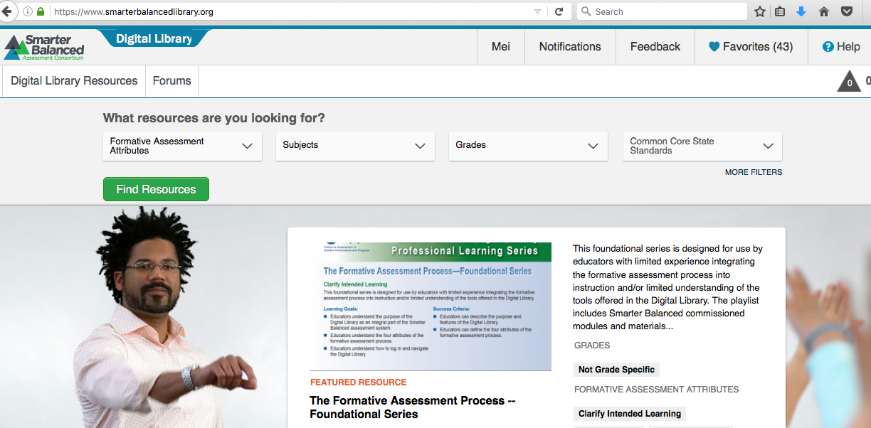
SBAC Digital Library Resources
Website:
https://www.smarterbalancedlibrary.org
Notes:
Now we move onto the goal of this module: finding helpful resources that fits students’ needs.
First we explore the SBAC Digital Library

Slide 13
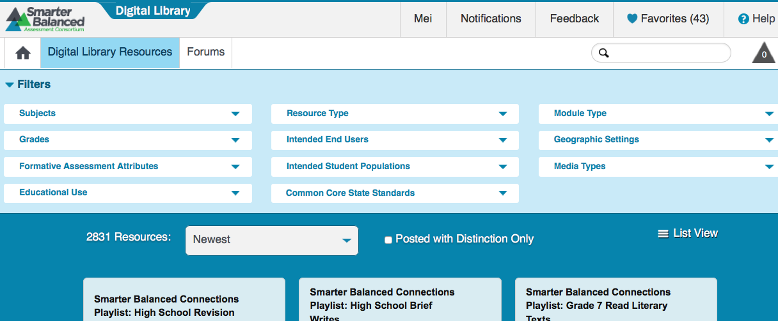
A Quick Review of Filter Types
Tip: the more filters you select, the less resources you will find.
Notes:
3:55

Slide 14
Task 1. Lesson Plan - CCSS Contents
Decide a LP CCSS content area. Click on “Digital Library Resources” at the left top corner. Select the appropriate items from the filters, find one or two resources that are helpful and can be shared with others. To save a resource, you can open it up and click on “Add to Favorite”. Write down the key ideas of resources.

Slide 15
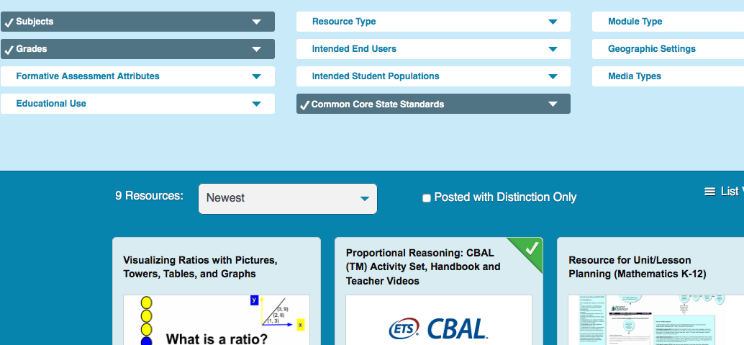
Sharing Our Findings
Subject Math
Grade 6
CCSS
6.RP.A.1,
6.RP.A.2
6.RP.A.3
CCSS Lesson Plans

Slide 16
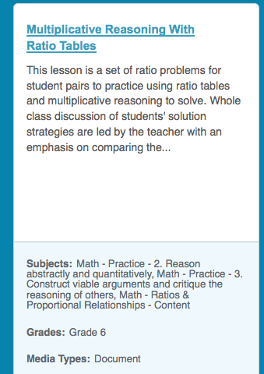
Author: Dennis M. Walclott, Chancellor
Good overall LP resources
Author: Angie Shindelar
Good supplementary problems
Notes:
4:10

Slide 17
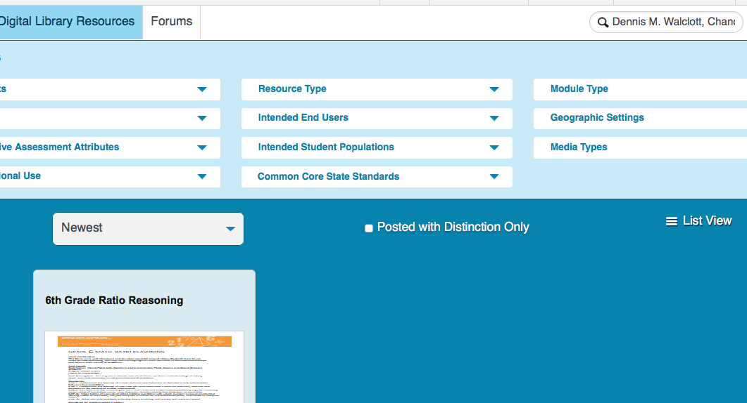
Search for a Resource by Author’s name or the name of the resource
At the search window, enter the information you search

Slide 18
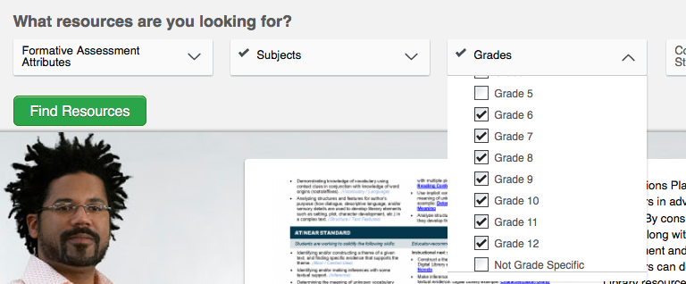
Task 2. Formative Assessment
Click the Home icon. Look for resources under Formative Assessment. Select one or two resources that you find helpful and would like share with others. Write down the key ideas of resource.

Slide 19
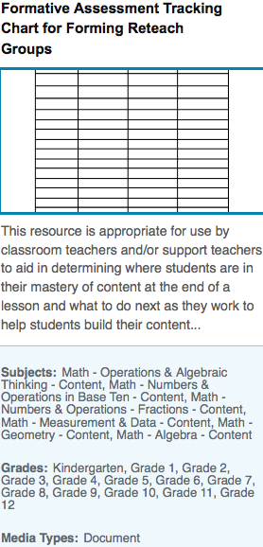
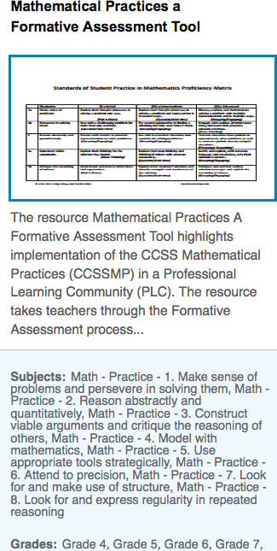
Teaching Channel, Becky Berg. Quality video for instructional ideas
Laura Lowder
A helpful chart to track students performance
Morning Star Williams
Detailed info on F.A.
Notes:
4:20

Slide 20
Task 3. ELL Students
Look for resources in teaching ELL students under “Intended Student Population”. Select two resources that you find helpful and would like share with others. Write down the key words of resource.

Slide 21
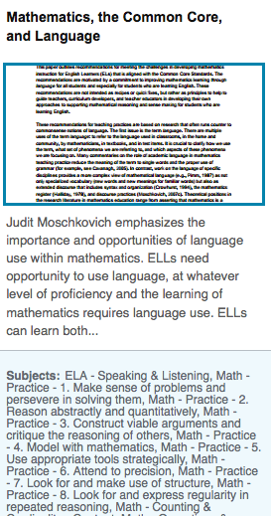
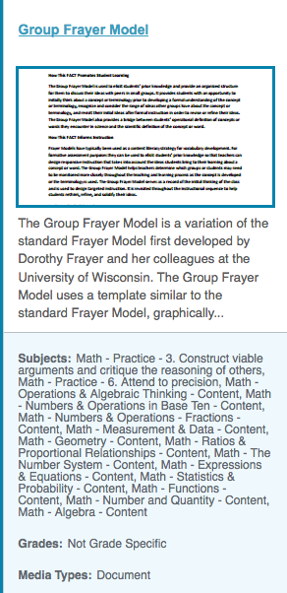
Understanding Language Initiative at Stanford University, Hsiaolin Hsieh
Judit Moschkovich,
well-Known expert on teaching math to ELLS
Stacie Broden
Frayer model

Slide 22
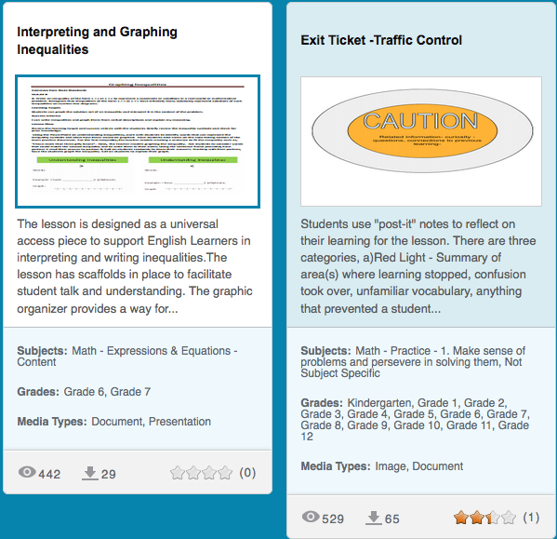
Marisa Aoki;Sam Saldivar
Lesson plan on inequality
Debra Spear
Traffic signs for grading exit tickets
Notes:
4:40

Slide 23
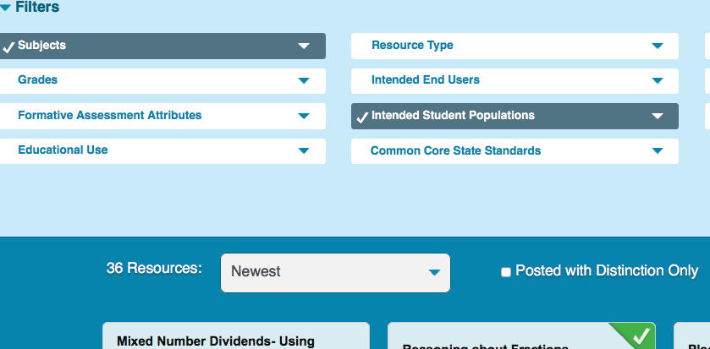
Task 4. Students with Disability
Look for resources in teaching students with disability w/o select grade level. Select one or two resources that you find helpful and would like share with others. Write down the key ideas of resources.

Slide 24
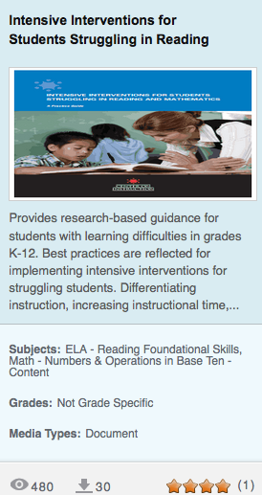
Alan LaDuca
Teaching root, prefix and
suffix of mathematical words
Sharon Vaughn, Jeanne Wanzek, Christy S. Murray, Greg Roberts
Notes:
4:50

Slide 25
Other Resources
The following 4 slides were created by Dr. Mark Roddy from Seattle University for the January Institute, 2016.
Notes:
5 minutes

Slide 26
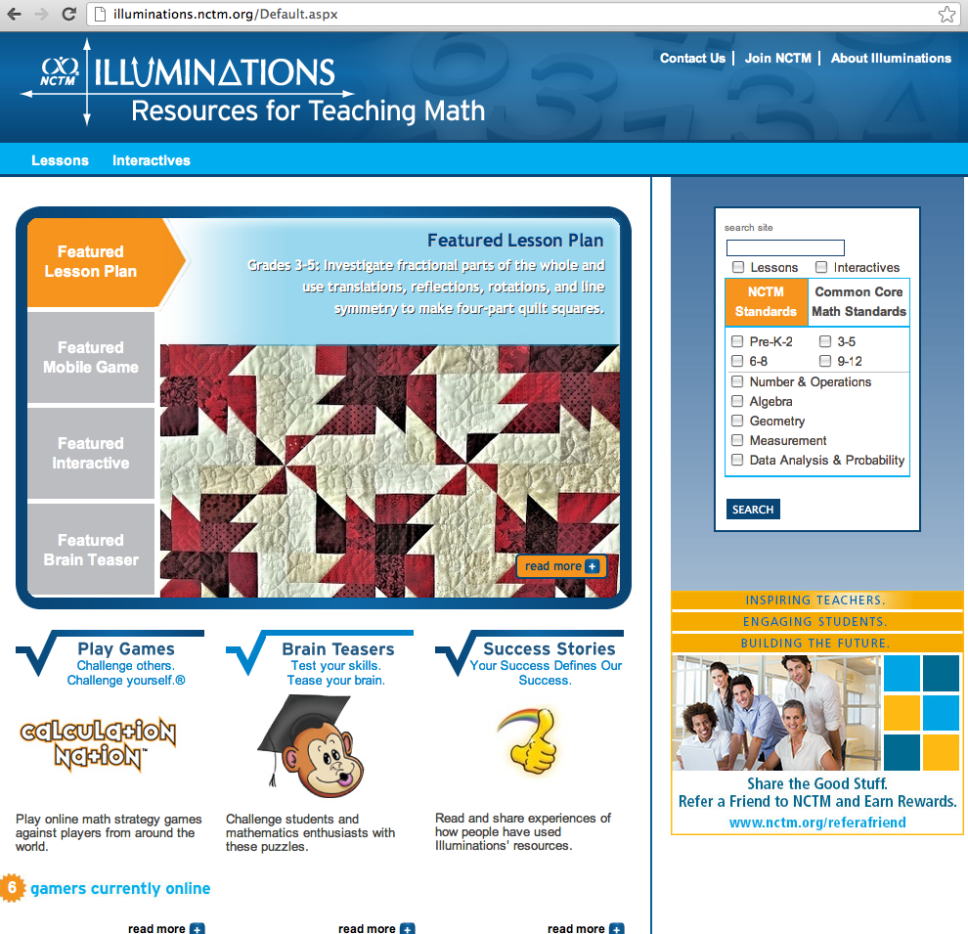
http://illuminations.nctm.org/
This site offers
access to well
tested and vetted
lesson plans
and interactives.
Dr. Mark Roddy

Slide 27
http://www.shodor.org/interactivate/
Dr. Mark Roddy

Slide 28
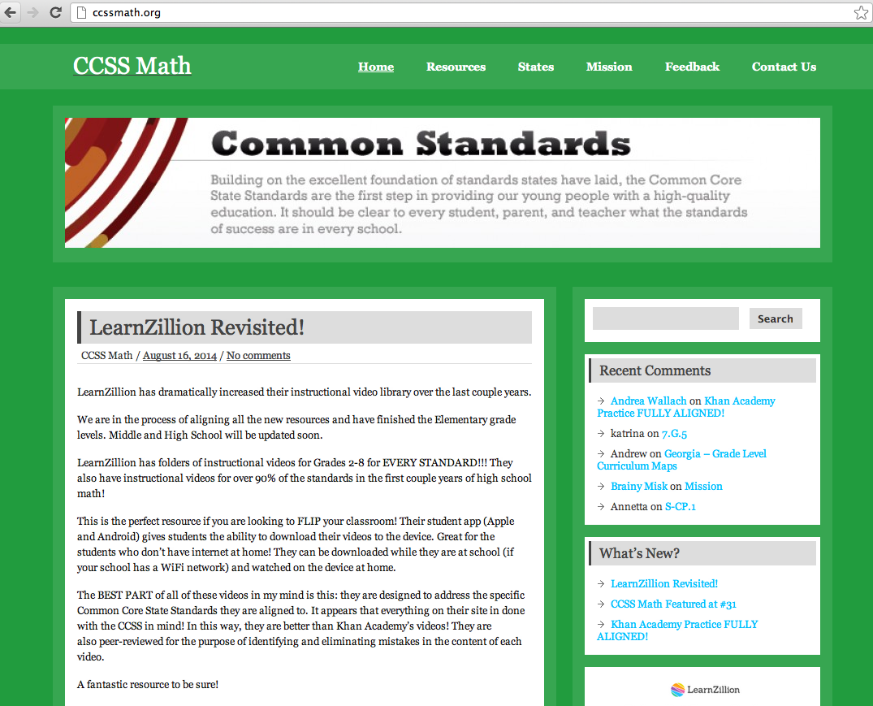
http://ccssmath.org/
Dr. Mark Roddy

Slide 29
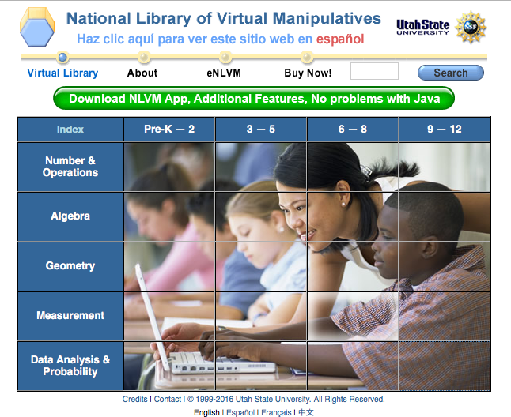
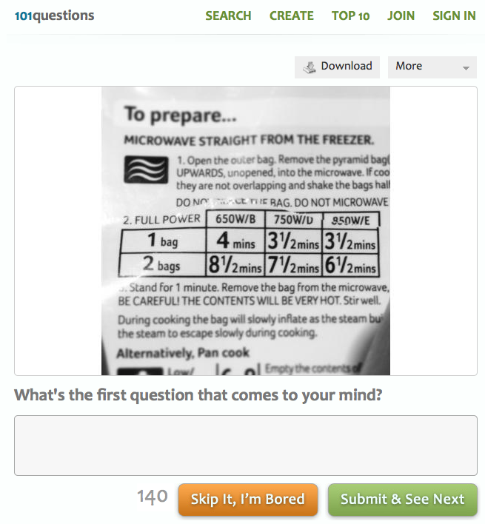
A few more ….
http://www.pbslearningmedia.org/
http://nlvm.usu.edu/
e.g., select 10th gr math and math => 518 resources!
http://www.101qs.com/
http://robertkaplinsky.com/lessons/
Dr. Mark
Roddy
e.g.,
Notes:
4:55

Slide 30
Looking into the NCTM websites
http://illuminations.nctm.org/
Lesson plans and interactive resources
http://www.nctm.org/Default.aspx
Standards, position statements, professional development, pedagogy discussions, and research publications.
Exercises: search - Teaching ELL students;
search – Teaching minority students.
Notes:
Now we spend some time looking into the resources from the NCTM websites.

Slide 31
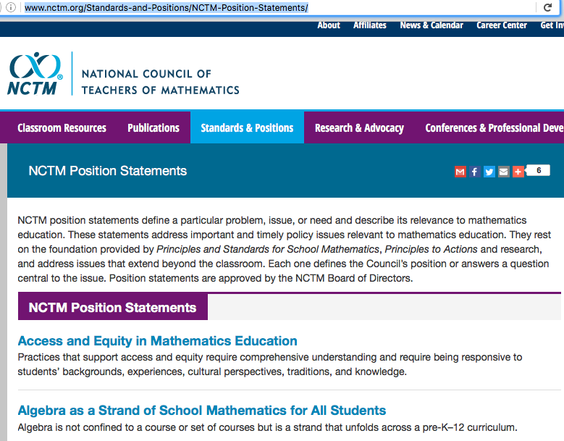
NCTM websites on Principle Statements
http://www.nctm.org/Standards-and-Positions/NCTM-Position-Statements/

Slide 32
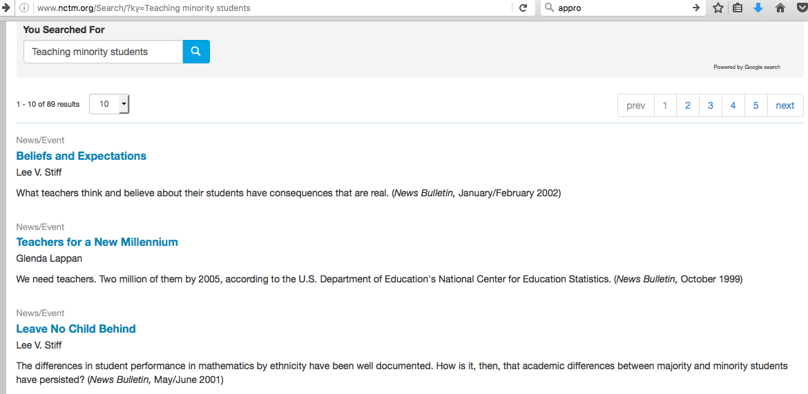
Searching for articles on teaching minority students
Notes:
5:05

Slide 33
Selected NCTM Articles on Teaching Minority Students
NCTM position statement on Closing the Opportunity Gap in Mathematics Education. http://www.nctm.org/Standards-and-Positions/Position-Statements/Closing-the-Opportunity-Gap-in-Mathematics-Education/
Findings and Suggested readings

Slide 34
(Discussion in Module 20)
Notes:
5:15

Slide 35
Searching for Articles in Teaching ELLs

Slide 36
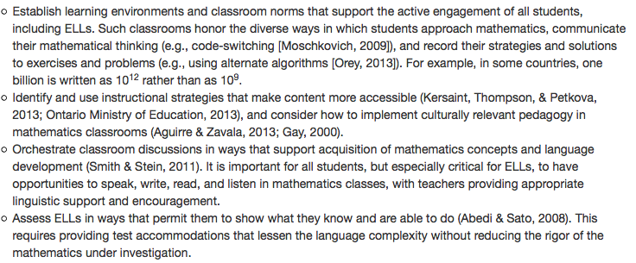
Selected NCTM Articles on Teaching ELL students
NCTM position statement on teaching ELLs. http://www.nctm.org/Standards-and-Positions/Position-Statements/Teaching-Mathematics-to-English-Language-Learners/
Effective strategies and suggested readings

Slide 37
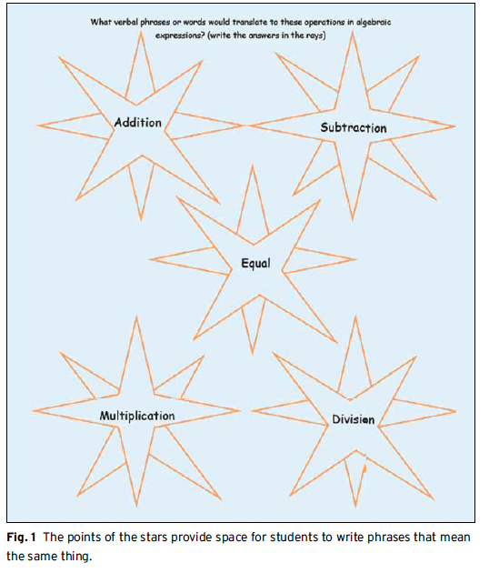
Vocabulary beyond the Definitions Nancy s. roberts and Mary P. Truxaw
Practical strategies: discussions of ambiguities mathematics vocabulary and strategies for ELL students in building understanding.
(More discussion in Module 24.)
Notes:
5:20

Slide 38
CCSS - Rigor
In major topics, pursue with equal intensity:
Conceptual understanding
Procedural skill and fluency
Application

Slide 39
NCTM Position Statement on Procedural Fluency
Procedural fluency is a critical component of mathematical proficiency. Procedural fluency is the ability to apply procedures accurately, efficiently, and flexibly; to transfer procedures to different problems and contexts; to build or modify procedures from other procedures; and to recognize when one strategy or procedure is more appropriate to apply than another. To develop procedural fluency, students need experience in integrating concepts and procedures and building on familiar procedures as they create their own informal strategies and procedures. Students need opportunities to justify both informal strategies and commonly used procedures mathematically, to support and justify their choices of appropriate procedures, and to strengthen their understanding and skill through distributed http://www.nctm.org/Standards-and-Positions/Position-Statements/Procedural-Fluency-in-Mathematics/
Detailed discussion and examples were provided in the
October Institute.
Notes:
5:25

Slide 40
NCTM Article on Reasoning
Executive Summary - Focus in High School Mathematics: Reasoning and Sense Making http://www.nctm.org/uploadedFiles/Research_and_Advocacy/Advocacy_Toolkit/FHSM%20Executive%20Summay.pdf
More discussion in
Modules 17 & 20.
Notes:
5:25

Slide 41
Modules for Friday 01/27/2017
Modules 17 and 20: Math Practice 3 in Action - Reasoning and Sense Making
Integrating reasoning and sense making in teaching/learning and in formative assessment - why and how.

Slide 42
Modules for Saturday 01/28/2017
Module 24: Lesson Plan – Content, Differentiated Instructional Strategies, and Formative Assessment
Discussion of effective lesson plans. Zooming in onto differentiated instructions for students with different kinds of levels, backgrounds or needs including ELLs and minority students.
Notes:
5:30

Slide 43
Additional References
Jerry Mihelic, Jana Peterson, Shawna Lyle. Differentiating Mathematics Instruction. http://www.opsu.edu/www/education/MATH-ESE%204%20ALL/Differentiating%20Mathematics%20Instruction.pdf
Why and how to differentiate math instruction http://www.nctm.org/Search/?ky=Why%20and%20How%20to%20Differentiated%20math%20instruction

