Slide 1
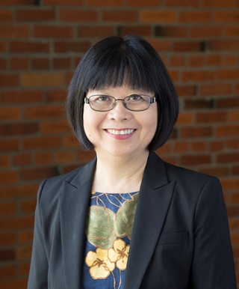
Module 7: Secondary ELA Funds of Knowledge Application
Belinda Louie, PhD, PI
Professor of Education
UW Tacoma
Project Core/Time/Digital
January 24-27, 2017

Slide 2
Project Goals: Goal 1.1b Improve teachers’ standard-based teaching skills by (i) Using research-based instructional strategies, (v) Differentiating instructional strategies for students with special needs and ELLs at different English proficiency levels, (vii) Connecting with students’ cultural and community assets. Session Goals: Improve teachers’ standard-based teaching skills by (1) Utilizing students’ Funds of Knowledge to connect with students’ cultural and community assets. (2) Bridging opportunity gap for students of color, ELLs, students in poverty, and special education students by increasing their comprehension of complex texts through personal connections

Slide 3
Review: Module 6a Fall Institute 2016 Funds of Knowledge

Slide 4
Some Research Highlights
González, Moll, & Amanti. (2005).
Families have abundant knowledge that programs can learn and use in their family engagement efforts.
Students bring with them funds of knowledge from their homes and communities that can be used for concept and skill development.
Classroom practices sometimes underestimate and constrain what children are able to display intellectually.
Teachers should focus on helping students find meaning in activities, rather than learn rules and facts.
Group discussions around race and class should promote trust and encourage dialogue.

Slide 7
FUNDS OF KNOWLEDGE
Bring assets from SELF
EMPATHY
Focus attention on OTHERS

Slide 8
PERSONAL ENGAGEMENT
COMPREHENSION OF NEW KNOWLEDGE

Slide 9
Funds of Knowledge
Family
values
Household
chores
Family’s
dreams
Social gatherings

Slide 10
EMPATHY (See Louie 2005)
Cognitive Empathy
Able to articulate others' perspectives by understanding
others' circumstances.
Historical Empathy
Able to reconstruct the attitudes, feelings, and actions of an individual who lived during a historical period.
Parallel emotional Empathy
Able to express emotional responses similar to those the other person is experiencing.
Reactive emotional Empathy
Able to react to the emotional responses of others.
Able to step away from one's self-centered approach of interpretation and work with others' beliefs and values to
explain what others think and do.
Cross-cultural Empathy

Slide 11
Emotional Empathy: Recognizing 2 different worlds
Acceptable &
Legitimate
Acceptable &
Legitimate
Character’s
World
My World

Slide 12
Emotional Empathy: Seeing others’ worlds through others’ eyes
Character’s
World
My World

Slide 13
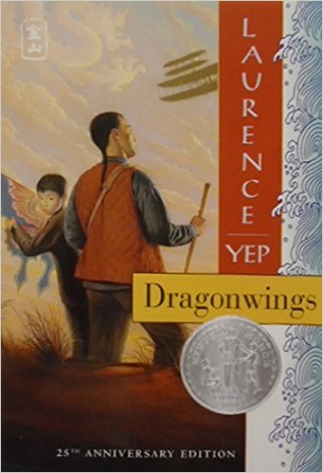
Dragonwings by Laurence Yep

Slide 14
In small groups: - Read the CCSS exemplar of Dragonwings - Complete the Funds of Knowledge chart. - Complete the Empath chart. - Share out your insights on the text. - Reflect on the combination of Funds of - -- Knowledge and Empathy as an …comprehension framework reaching diverse learners.

Slide 15
Project Goals: Goal 1.1b Improve teachers’ standard-based teaching skills by (i) Using research-based instructional strategies, (v) Differentiating instructional strategies for students with special needs and ELLs at different English proficiency levels, (vii) Connecting with students’ cultural and community assets. Session Goals: Improve teachers’ standard-based teaching skills by (1) Utilizing students’ Funds of Knowledge to connect with students’ cultural and community assets. (2) Bridging opportunity gap for students of color, ELLs, students in poverty, and special education students by increasing their comprehension of complex texts through personal connections

