Slide 1
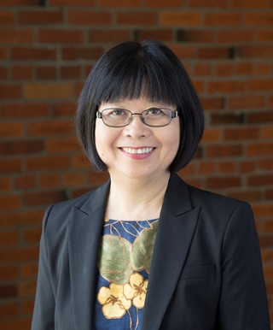
Module 19: Elem ELA Equity Pedagogy for All Learners: Differentiation for Linguistic/Cognitive Accommodations
Belinda Louie, PhD, PI
Professor of Education
UW Tacoma
Project Core/Time/Digital
January 24-27, 2017

Slide 2
Project Goals: Goal 1.1b Improve teachers’ standard-based teaching skills by (i) Using research-based instructional strategies, (v) Differentiating instructional strategies for students with special needs and ELLs at different English proficiency levels, (vii) Connecting with students’ cultural and community assets. Session Goals: Improve teachers’ standard-based teaching skills by (1) Utilizing students’ Funds of Knowledge to connect with students’ cultural and community assets. (2) Bridging opportunity gap for students of color, ELLs, students in poverty, and special education students by increasing their comprehension of complex texts through personal connections

Slide 3
Depth of Knowledge
DOK3: Strategic Thinking
DOK1: Recall
DOK4: Extended Thinking
DOK2: Skill/Concept

Slide 4
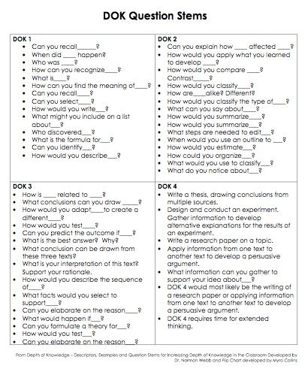

Slide 5
Key Words describing DOK

Slide 6
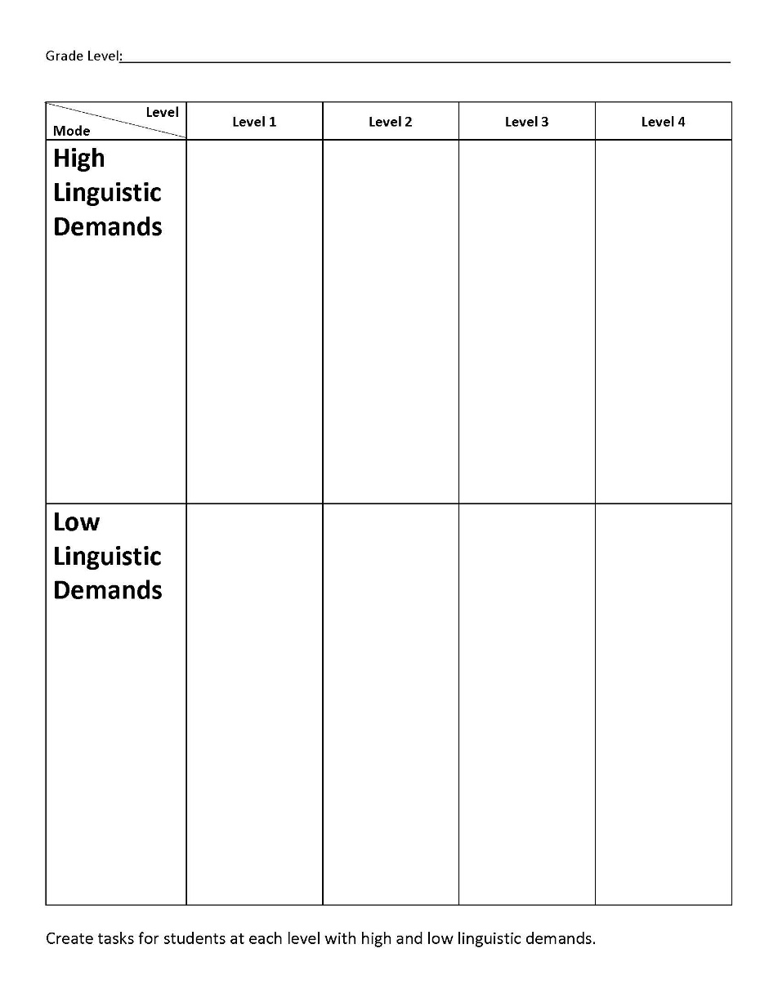
Accommodations for Special Education Students: Content Objectives

Slide 7
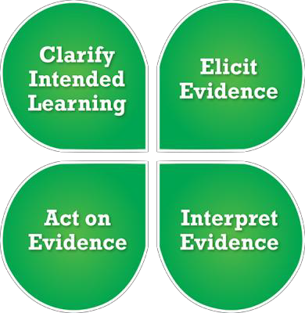
Formative Assessment

Slide 8
Accommodation students’ language needs 1. Clarify Intended Learning: Identify language and content instructional objectives in specific content area;

Slide 9
2. Identify academic language demands - language features - discourse: text structure - syntax: sentence structure - vocabulary: general academic vocabulary content specific academic vocabulary

Slide 10
3. Elicit Evidence: Integrate instruction and assessment: Provide (1) low language demand tasks to focus on content and (2) language proficiency appropriate tasks to nourish and to monitor language growth;

Slide 11
4. Interpret Evidence: Develop scoring guides for the assessment tasks to facilitate teachers’ and students’ reflection on student learning ;

Slide 12
Books recommended Mosquito Bite by Alexendra Siy & Dennis Kunkel The Arrival by Shaun Tan Locomotive by Brian Floca Parrots over Puerto Rico by Susan L. Roth & Cindy Trumbore Separate is Never Equal by Duncan Tonatiuh She’s Wearing a Dead Bird on her Head by Kathryn Lasky

Slide 13
Project Goals: Goal 1.1b Improve teachers’ standard-based teaching skills by (i) Using research-based instructional strategies, (v) Differentiating instructional strategies for students with special needs and ELLs at different English proficiency levels, (vii) Connecting with students’ cultural and community assets. Session Goals: Improve teachers’ standard-based teaching skills by (1) Utilizing students’ Funds of Knowledge to connect with students’ cultural and community assets. (2) Bridging opportunity gap for students of color, ELLs, students in poverty, and special education students by increasing their comprehension of complex texts through personal connections

