Slide 1
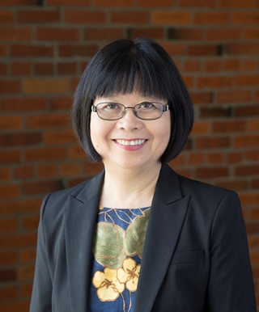
Module 16: Elem ELA
Equity Pedagogy for All Learners:
Differentiation for Linguistic/Cognitive Accommodations
Belinda Louie, PhD, PI
Professor of Education
UW Tacoma
Project Core/Time/Digital
January 24-27, 2017

Slide 2
Project Goals:
Goal 1.1b Improve teachers’ standard-based teaching skills by
(i) Using research-based instructional strategies,
(v) Differentiating instructional strategies for students with special needs and ELLs at different English proficiency levels,
(vii) Connecting with students’ cultural and community assets.
Session Goals:
Improve teachers’ standard-based teaching skills by
(1) Utilizing students’ Funds of Knowledge to connect with students’ cultural and community assets.
(2) Bridging opportunity gap for students of color, ELLs, students in poverty, and special education students by increasing their comprehension of complex texts through personal connections

Slide 3
KEY PRINCIPLES FOR ELL INSTRUCTION
Instruction focuses on providing ELLs with opportunities to engage in discipline- specific practices which are designed to build conceptual understanding and language competence in tandem. Learning is a social process that requires teachers to intentionally design learning opportunities that integrate reading, writing, speaking, and listening with the practices of each discipline.

Slide 4
Instruction leverages ELLs’ home language(s), cultural assets, and prior knowledge. ELLs’ home language(s) and culture(s) are regarded as assets and are used by the teacher in bridging prior knowledge to new knowledge, and in making content meaningful and comprehensible.

Slide 5
Standards-aligned instruction for ELLs is rigorous, grade-level appropriate, and provides deliberate and appropriate scaffolds. Instruction that is rigorous and standards-aligned reflects the key shifts in the CCSS and NGSS. Such shifts require that teachers provide students with opportunities to describe their reasoning, share explanations, make conjectures, justify conclusions, argue from evidence, and negotiate meaning from complex texts. Students with developing levels of English proficiency will require instruction that carefully supports their understanding and use of emerging language as they participate in these activities.

Slide 6
Instruction moves ELLs forward by taking into account their English proficiency level(s) and prior schooling experiences. ELLs within a single classroom can be heterogeneous in terms of home language(s) proficiency, proficiency in English, literacy levels in English and student's home language(s), previous experiences in schools, and time in the U.S. Teachers must be attentive to these differences and design instruction accordingly.

Slide 7
Instruction fosters ELLs’ autonomy by equipping them with the strategies necessary to comprehend and use language in a variety of academic settings. ELLs must learn to use a broad repertoire of strategies to construct meaning from academic talk and complex text, to participate in academic discussions, and to express themselves in writing across a variety of academic situations. Tasks must be designed to ultimately foster student independence.

Slide 8
Diagnostic tools and formative assessment practices are employed to measure students’ content knowledge, academic language competence, and participation in disciplinary practices. These assessment practices allow teachers to monitor students’ learning so that they may adjust instruction accordingly, provide students with timely and useful feedback, and encourage students to reflect on their own thinking and learning.

Slide 11
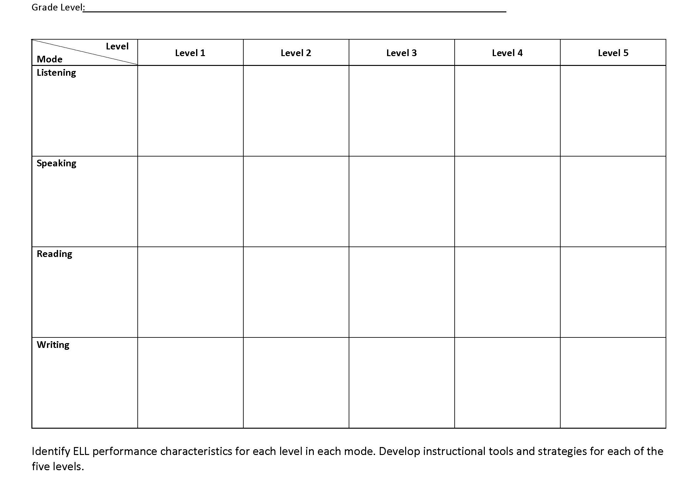
Accommodations for ELLs:
Language objectives

Slide 12
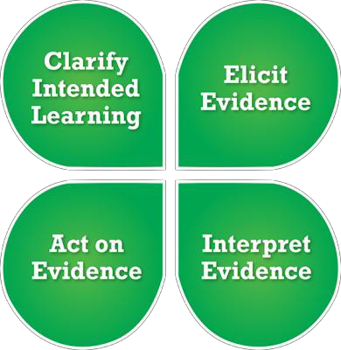
Formative Assessment

Slide 13
Accommodation students’ language needs
1. Clarify Intended Learning:
Identify language and content instructional objectives in specific content area;

Slide 14
2. Identify academic language demands
- language features
- discourse: text structure
- syntax: sentence structure
- vocabulary: general academic vocabulary content specific academic vocabulary

Slide 15
3. Elicit Evidence:
Integrate instruction and assessment: Provide
(1) low language demand tasks to focus on content and
(2) language proficiency appropriate tasks to nourish and to monitor language growth;

Slide 16
4. Interpret Evidence:
Develop scoring guides for the assessment tasks to facilitate teachers’ and students’ reflection on student learning ;

Slide 17
5. Act on Evidence:
To develop the next level of language and content instructional objectives

Slide 18
Project Goals:
Goal 1.1b Improve teachers’ standard-based teaching skills by
(i) Using research-based instructional strategies,
(v) Differentiating instructional strategies for students with special needs and ELLs at different English proficiency levels,
(vii) Connecting with students’ cultural and community assets.
Session Goals:
Improve teachers’ standard-based teaching skills by
(1) Utilizing students’ Funds of Knowledge to connect with students’ cultural and community assets.
(2) Bridging opportunity gap for students of color, ELLs, students in poverty, and special education students by increasing their comprehension of complex texts through personal connections

