Slide 1
Digital library
Module #14 (secondary)
Karlyn Davis-Welton, M ED
Project Core/Time/Digital Grant
Winter Institute 2017

Slide 2
Project Goal
To increase the subject matter knowledge and standards-based teaching skills necessary to use the Smarter Balanced Digital Library’s (SBDL) four-step formative assessment process and instructional resources to improve instructional practices and student achievement for all students.

Slide 3
Learning Goals
Participants understand…
Accessing Connection Playlist to assist them in advancing student learning and growth.
Providing educator-recommended Digital Library resources may be used to support their instruction.

Slide 4
Success criteria
Participants can…
Explain how the Connection Playlists may be used to support teaching and learning.
Identify potential Digital Library Connections to advance student learning and growth.

Slide 5
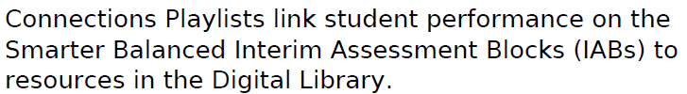
Connection playlists

Slide 6
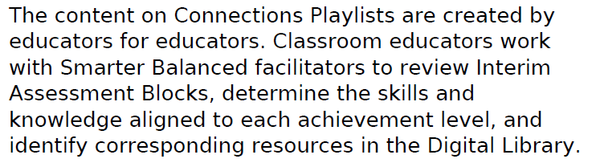
Connection playlists

Slide 7
Connection playlists
What’s available for elementary & secondary?
https://www.smarterbalanced.org/assessments/#playlists

Slide 8
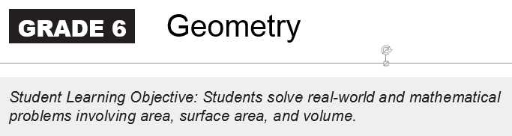
Connection Playlist

Slide 9
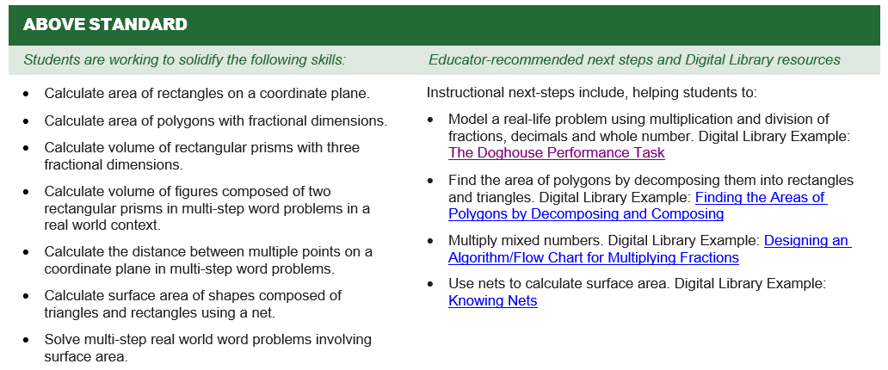
6 Grade Geometry

Slide 10
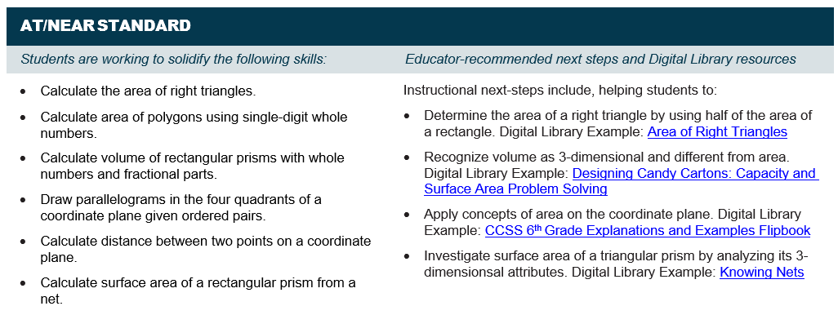
6 grade geometry

Slide 11
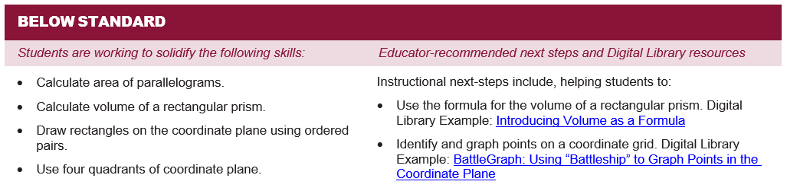
6 grade geometry

Slide 12
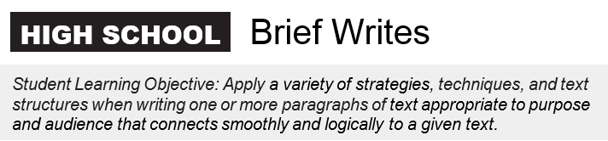
Connection Playlist

Slide 13
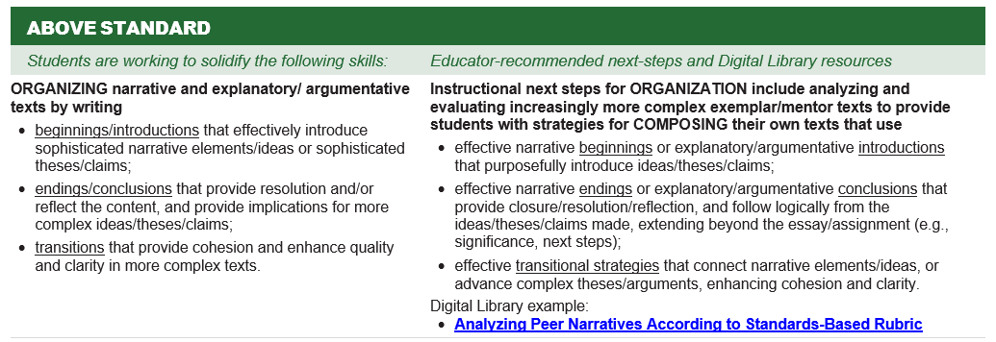
High school brief writes

Slide 14
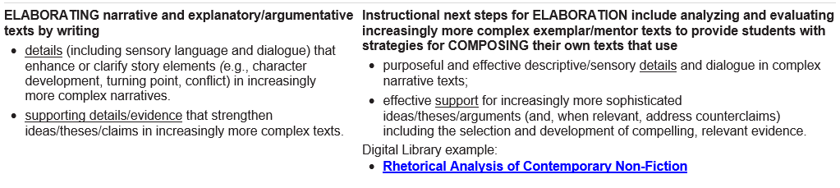
High school brief writes

Slide 15
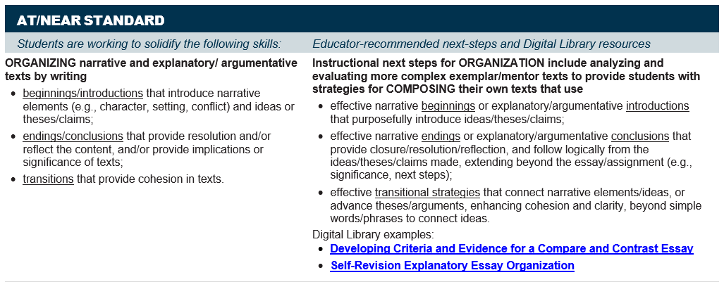
High school brief writes

Slide 16
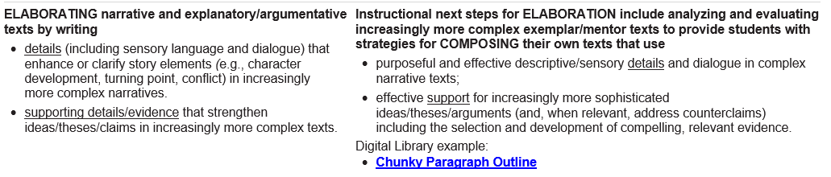
High school brief write

Slide 17
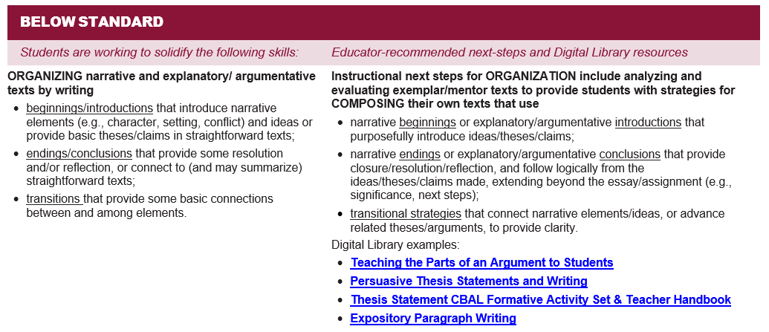
High school brief write

Slide 18
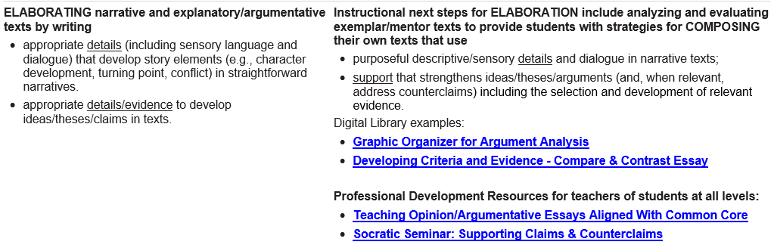
High school brief write

Slide 19
reflections
How might you use these resources at your school?

