Slide 1
Smarter Balanced Digital Library
Karlyn Davis-Welton, M Ed
Winter Institute 2017
Elementary

Slide 2
Project Goal
Smarter Balanced Digital Library and Formative Assessment:
To increase the subject matter knowledge and standards-based
teaching skills.

Slide 3
Learning goals
Participants will…
Tryout the various filters to narrow their search of specific
resources.
Review select professional development and instructional
materials to share with others.

Slide 4
Success Criteria
Participants can…
Become familiar with the resources available on Smarter
Balanced Digital Library.
Identify some potential instructional materials and/or
professional development resources to share with others.

Slide 6
Digital Library

Slide 7
Digital Library
Online collection of high-quality instructional and professional learning resources contributed by educators for educators.
Resources are aligned with the intent of the Common Core State Standards and help educators implement the formative assessment process to improve teaching and learning.
Incorporates collaboration features to provide educators opportunities to comment on and rate resources and share their expertise with colleagues across the country in online discussion forums

Slide 8
Website: log in access
https://www.smarterbalancedlibrary.org/

Slide 9
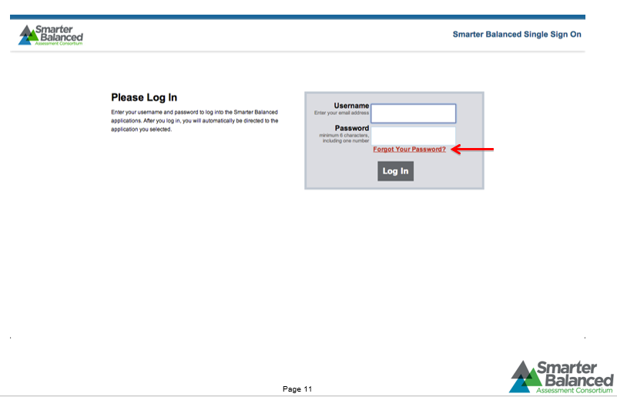

Slide 10
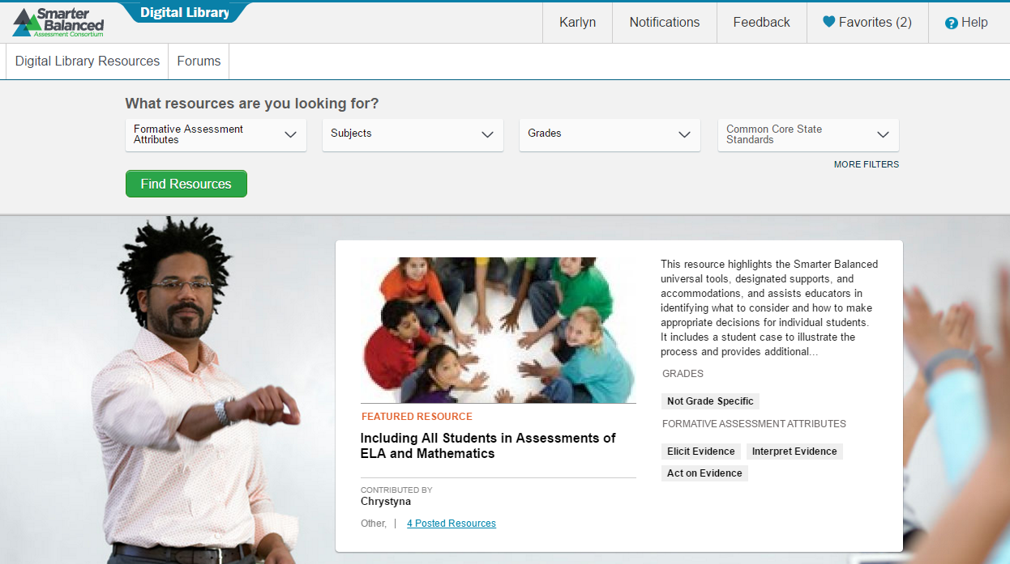
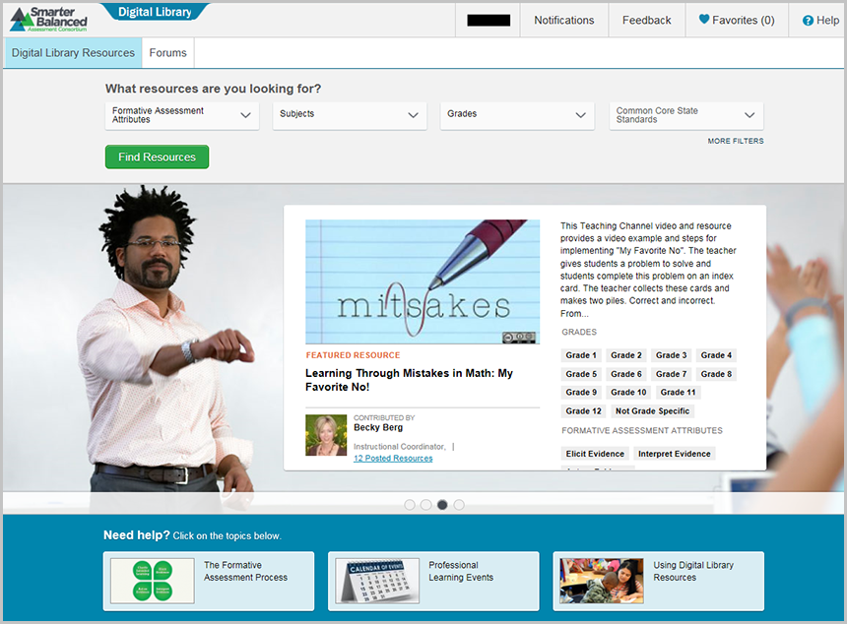

Slide 11
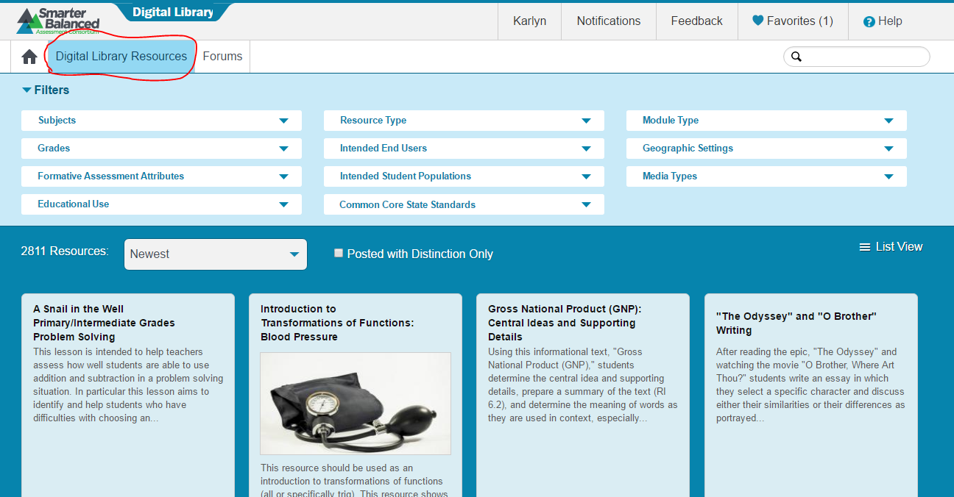
How do I view resource materials?
What information will I find in the About This Resource tab?
How do I write a review for a resource and rate it?
How do I share a resource?
How do I locate similar resources in the Digital Library?
How do I flag an issue with a resource in the Digital Library?
Notes:
Let’s start with viewing resource materials.

Slide 12
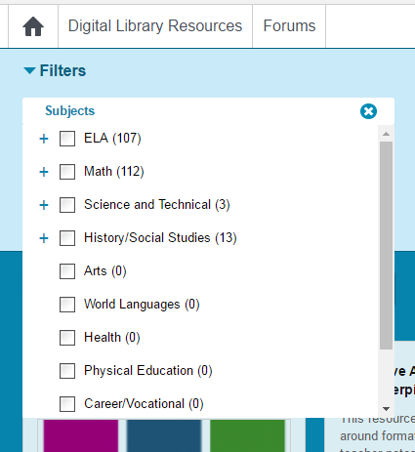
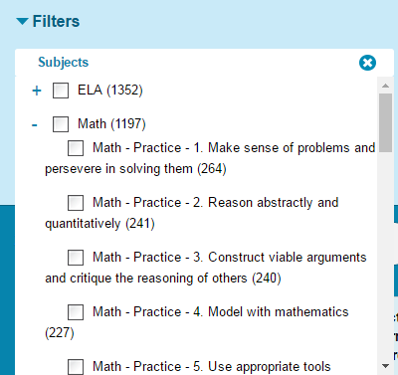
Filters: Subjects

Slide 13
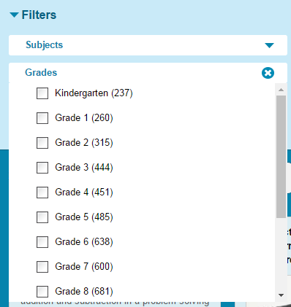
Filters: grades

Slide 14
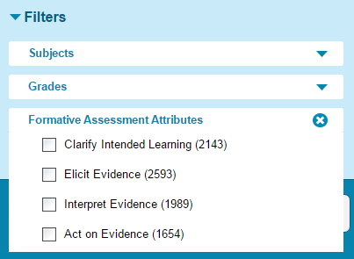
Filters: Formative Assessment Attributes

Slide 15
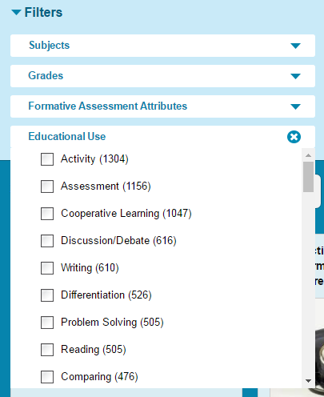
Filters: Educational use

Slide 16
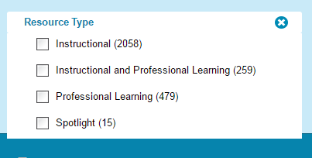
Filters: resource type

Slide 17
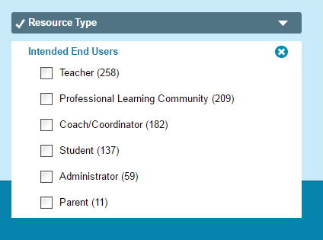
Filters: intended end users

Slide 18
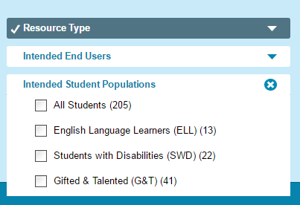
Filters: intended student populations

Slide 19
Filters: Select common core standards

Slide 20
Filters: Module type

Slide 21
Filters: module type

Slide 22
Filters: media types

Slide 23
Filters: to clear all & favorites

Slide 24
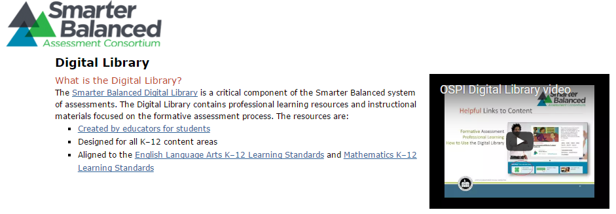
Web Links & Resources
http://www.k12.wa.us/SMARTER/DigitalLibrary.aspx
Additional resources and information are available on the OSPI website

