Slide 1
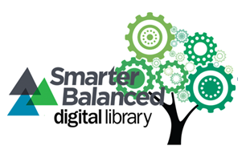
The Formative Assessment Process Module #12 (Elem. & Sec.)
Karlyn Davis-Welton, M Ed
Project Core/time/digital grant
WINTER Institute 2017

Slide 2
Project Goal
To increase the subject matter knowledge and standards-based teaching skills necessary to use the Smarter Balanced Digital Library’s (SBDL) four-step formative assessment process and instructional resources to improve instructional practices and student achievement for all students.

Slide 3
Learning Goals
Participants understand…
Using the 4-Step Formative Assessment Process supports both teaching and learning of all students.
Providing differentiated instruction to high-need students (students of color, ELLs, students with special needs, and students in poverty) in developmentally appropriate ways to clarify, elicit, interpret, and act on intended learning moves K-12 students’ learning forward.

Slide 4
Success Criteria
Participants can…
Explain how the Formative Assessment Process supports teaching and learning.
Identify strategies for differentiated instruction to high-need students (students of color, ELLs, students with special needs, and students in poverty)that are implemented in developmentally appropriate ways to clarify, elicit, interpret, and act on intended learning in partnership with K-12 students and describe why those strategies are effective.

Slide 5
What is formative assessment?
Write down your response.

Slide 6
Formative Assessment is defined as …
a deliberate process used by teachers and students during instruction that provides actionable feedback used to adjust ongoing teaching and learning strategies to improve students’ attainment of curricular learning targets/goals

Slide 8
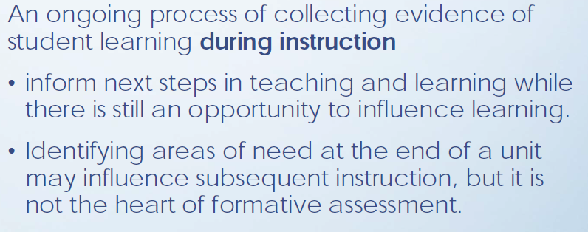
What Formative Assessment is …

Slide 9
When Formative Assessment takes place …

Slide 10
Who’s involved in Formative Assessment …

Slide 11
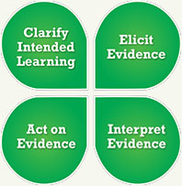
Formative Assessment Process
There are four attributes in the Formative Assessment Process:
Clarify Intended Learning
Elicit Evidence
Interpret Evidence
Act on Evidence

Slide 12
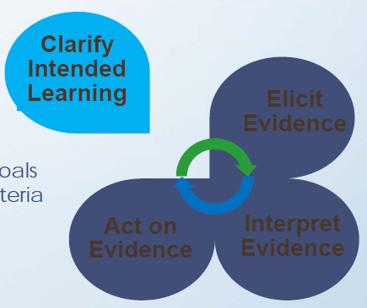
Clarify Intended Learning
Learning Goals
Success Criteria

Slide 13
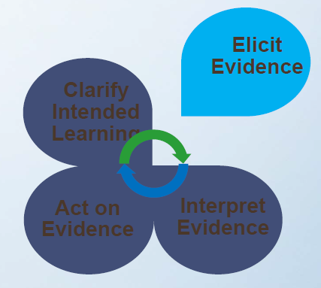
Elicit Evidence
Interactions with students
Observations
Questioning strategies
Focused student observations
Student work
Teachers
Peers
Individual reflection

Slide 14
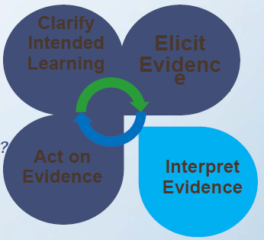
Interpret Evidence
Is there a gap between learning goals
and success criteria?
Misunderstanding?
Procedural error?
Lack of skill(s)?

Slide 15
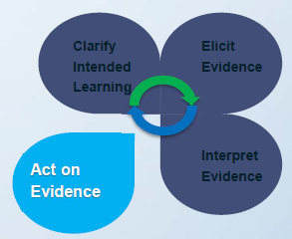
Act on Evidence
Formative assessment is a deliberate process
After educators and students have
interpreted the results, develop a plan
to adjust the teaching and learning.

Slide 16
Elementary Example
In the video segments, you will see teacher and students defining the learning goals and success criteria for the instructional task as part of the 4-Step Process of Formative Assessment
Formative Assessment: Collaborative Discussions
Kelly Bouchard engages her students in creating success criteria using guiding questions about what a collaborative discussion looks like.

Slide 17
Middle School Example
Learn how teachers and students interpret evidence in the segments focusing on this attribute.
Formative Assessment: Proportional Relationships
Seventh grade students in Charles Elsdon’s math class use a rubric to interpret evidence of their own and their peers’ learning. Mr. Elsdon and the students identify the success criteria students meet and those they do not yet meet. They use this interpretation to adjust teaching and learning strategies.

Slide 18
High School Example
The final segments spotlighting acting on evidence demonstrate how teachers and students adjust teaching and learning.
Formative Assessment: Understanding Congruence
April Pforts, high school math teacher, decides when students are ready to apply their learning about congruent figures to real world applications.

Slide 19
Success Criteria
Participants can…
Explain how the Formative Assessment Process supports teaching and learning.
Identify strategies for differentiated instruction to high-need students (students of color, ELLs, students with special needs, and students in poverty)that are implemented in developmentally appropriate ways to clarify, elicit, interpret, and act on intended learning in partnership with K-12 students and describe why those strategies are effective.

Slide 20
How does this module support the work that you do in your classrooms/schools?

