Slide 1
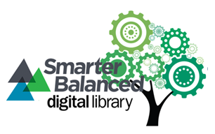
Digital library module #10 (sec. ela)
Presented by Karlyn davis-welton
Project Core/Time/Digital Grant - Winter Institute 2017

Slide 2
Project Goals
To increase the subject matter knowledge and standards-based teaching skills necessary to use the Smarter Balanced Digital Library’s (SBDL) four-step formative assessment process and instructional resources to improve instructional practices and student achievement for all students.

Slide 3
Learning goals
Participants understand…
Using the Digital Library as a resource for lesson ideas to support the teaching and learning of all students.
Providing differentiated instruction to high-need students (students of color, ELLs, students with special needs, and students in poverty) in developmentally appropriate ways to clarify, elicit, interpret, and act on intended learning moves K-12 students’ learning forward.

Slide 4
Success criteria
Participants can…
Explain how the digital library’s resource “Formative Assessment of Written Language” supports your teaching and learning of all students.
Identify strategies for differentiated instruction to high-need students (students of color, ELLs, students with special needs, and students in poverty)that are implemented in developmentally appropriate ways to clarify, elicit, interpret, and act on intended learning in partnership with K-12 students and describe why those strategies are effective.

Slide 5
digital library: Accessing lessons for diverse learners
https://www.smarterbalancedlibrary.org/content/formative-assessment-written-language-grades-6-8

Slide 6
Digital library: setting filters & conducting searches

Slide 7
Resource: understanding language initiative, stanford university

Slide 8
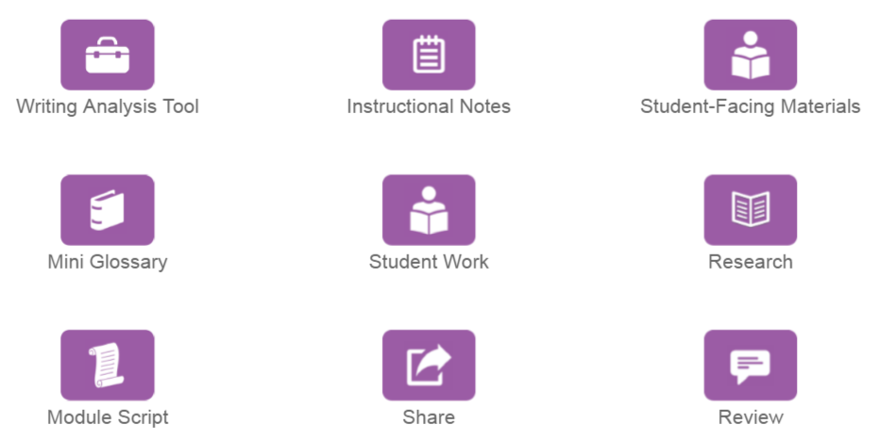
Module toolkit

Slide 9
Our lesson template: Deeping our understanding

Slide 10
Success criteria
Participants can…
Explain how the digital library’s resource “Formative Assessment of Written Language” supports your teaching and learning of all students.
Identify strategies for differentiated instruction to high-need students (students of color, ELLs, students with special needs, and students in poverty)that are implemented in developmentally appropriate ways to clarify, elicit, interpret, and act on intended learning in partnership with K-12 students and describe why those strategies are effective.

Slide 11
Reflection
What was a new learning for you and how may you apply this to your practice?

Slide 12
“Final word” protocol
Purpose: To hear each other’s new learnings by encouraging the emergence of a variety of interests, viewpoints, and voices.
Person A shares their new learning and discusses “how” they may apply this in their practice. (1 min.)
Person B, C – Just listen and then each person is given an opportunity to respond by adding to the discussion, raising a question, etc. (1 min. each)
Person A has the final word and shares what s/he is thinking. (1 min.)
Repeat the process with Person B and C

