Slide 1
Module 26 Differentiating & Connecting ELA-Sec
Washington Student Achievement Council (WSAC)
Project Core/Time/Digital
Winter Institute January 2017
Riki Thompson, PhD
rikitiki@uw.edu
University of Washington Tacoma

Slide 2
Session goals
Work closely with Common Core Standards for ELA
Develop strategies to address gaps and utilize funds of knowledge
Develop strategies to differentiate instruction
Practice using the Smarter Balanced Digital Library

Slide 3
Funds of Knowledge
“To refer to the historically accumulated and culturally developed bodies of knowledge and skills essential for household or individual functioning and well-being”
Luis Moll, Cathy Amanti, Deborah Neff, and Norma Gonzalez (2001)

Slide 4
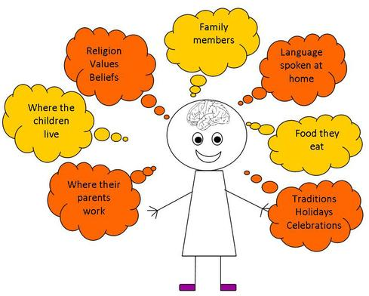
Cultural scaffolding
Utilize students’ funds of knowledge from their cultural & linguistic background
Language
Culture
Customs
Beliefs
Shared History
Food
Ways of being
Image from: http://anderson-craig-firns-green-jennings-kichakov.wikispaces.com/Early+Years+Learners+and+Funds+of+Knowledge

Slide 5
Accessing Funds of Knowledge
Become a research and study household culture
Ask students to bring family artifacts to class
Go on home visits to learn about family and literacy practices
Incorporate parents’ vocations into lesson plans

Slide 6
Implementing funds of knowledge for literacy
Use quick-writes to identify interest and knowledge about a theme
Invite parents and community resource people come to class and serve as a guest speakers on a theme
Students do interviews with family members about experiences (life in the homeland, migration stories, important cultural events)
Arrange field trips to parents’ workplaces and integrate with reading and/or writing lessons
Students discuss and write about family artifacts & culture

Slide 7
Funds of Knowledge Brainstorm
Freewrite for 3 minutes about possible funds of knowledge activities you can integrate into an ELA lesson at your school.

Slide 8
Differentiated Instruction

Slide 9
Differentiated Instruction Strategies
Language scaffolding: Graphic Organizers for visual learning, pictures, real objects
Cognitive scaffolding: More steps and points to rest and check in, laid out explicitly
Learning style scaffolding: Use multiple modes of instruction delivery

Slide 10
Learning Styles and Literacy
Auditory – Talk through writing first, use dictation software to draft
Visual/Spatial – Draw complementary storyboards, create story with toy figures
Kinesthetic – Students act out stories, then describe, then write
Musical – Integrate songs with stories
Reading – Allow students to read along when listening

Slide 11
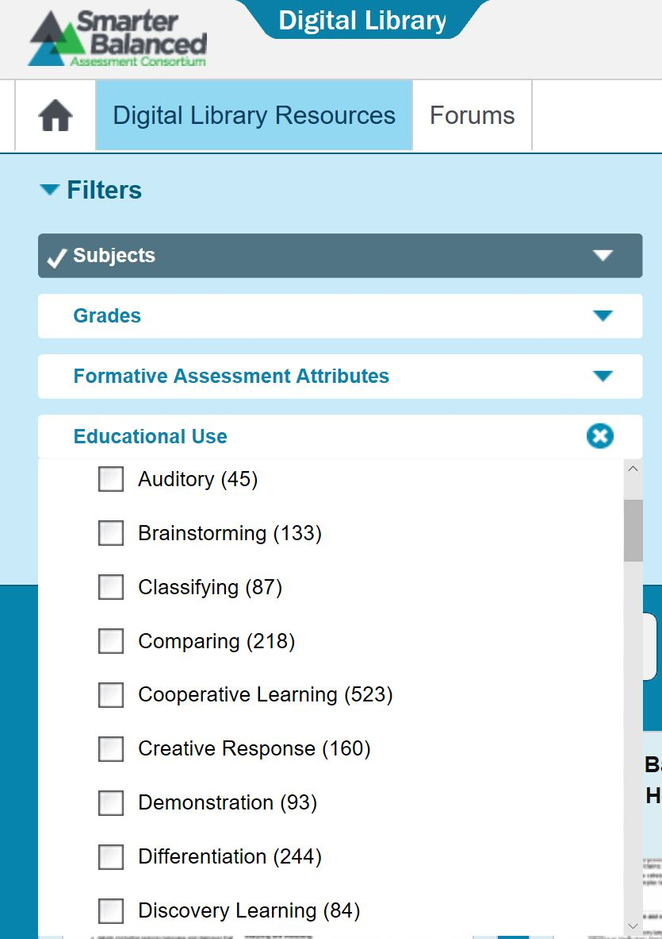
Using Digital Library
Filter by
Subject→ELA
Grades
Formative Assessment Attributes
Educational use
Differentiation
Learning Styles (Auditory, Visual/Spatial, etc)

Slide 12
Differentiated Instruction Pair/Share
Compare the lessons you found in Digital Library with neighbors

Slide 13
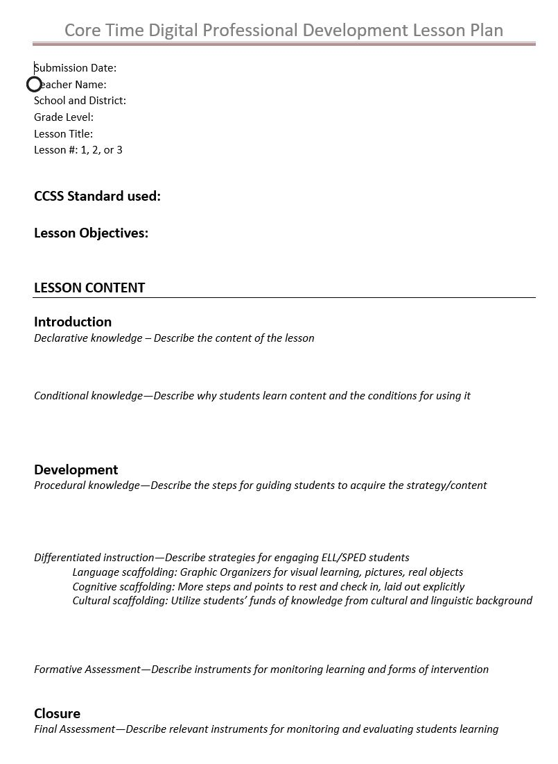
Grade 8 LP1 Kettle Falls
Identify 1 way to differentiate instruction for each of these conditions
Language
Cognitive
Cultural

Slide 14
Before we exit…
Questions, comments, concerns?

