Slide 1
Module 23 Assessing Lesson Plans ELA-secondary
Washington Student Achievement Council (WSAC)
Project Core/Time/Digital
Winter Institute January 2017
Riki Thompson, PhD
rikitiki@uw.edu
University of Washington Tacoma

Slide 2
Session goals
Declarative Knowledge
Use evaluation rubric as formative assessment tool during lesson plan draft stage
Conditional Knowledge
We use evaluation rubric mid-process to assess draft and make revisions
When we asses our own work we gain a deeper understanding of what is being asked for
If we test assessment tools mid-process, we can update tools and materials before completing the final version

Slide 3
Task
Procedural Knowledge
Assess lesson plans using Lesson Plan Evaluation Rubric
Discuss with other trainers
Develop action plan to clarify teaching

Slide 4
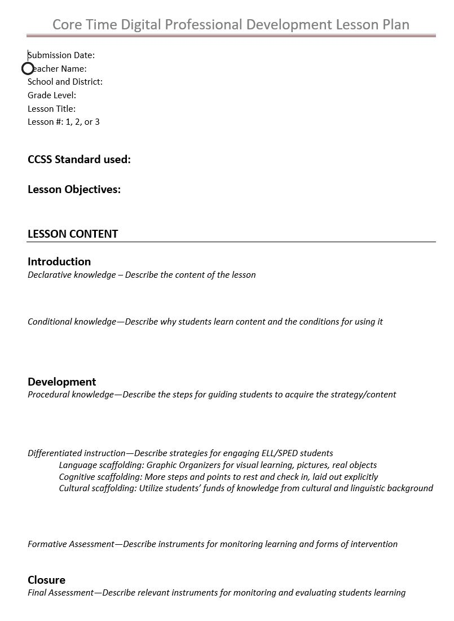
Lesson Plans
Grade 6 LP1 Kettle Falls…
Grade 6 LP2 Kettle Falls…
Grade 7 LP1 Kettle Falls
Grade 7 LP2 Kettle Falls

Slide 5
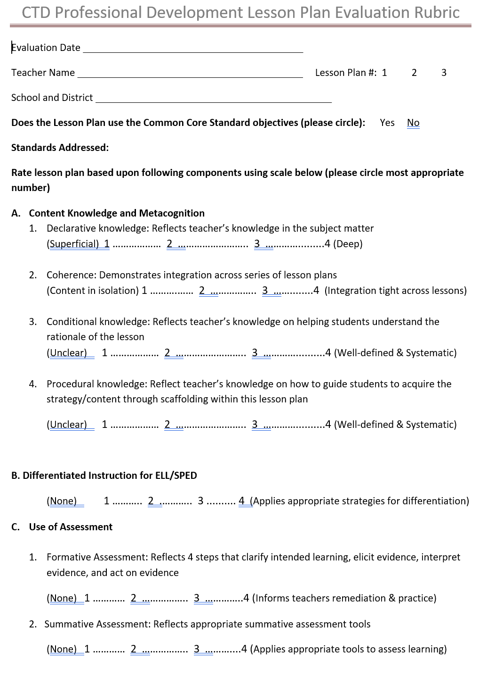
Review Lesson Plans with Evaluation Rubric
In small groups
Review 2 sets of Lesson Plans
Use the Evaluation Rubric to assess
Discuss strengths and weaknesses
Type up feedback notes
Share out

Slide 6
Share Out
Grade 6
Grade 7

Slide 7
Before we exit…
Questions, comments, concerns?

