Slide 1
Module 21 Formative Assessment to Improve Teaching K-12
Washington Student Achievement Council (WSAC)
Project Core/Time/Digital
Winter Institute January 2017
Riki Thompson, PhD
rikitiki@uw.edu
University of Washington Tacoma

Slide 2
Goal
Review types of formative assessment
Discuss conditions and best practices for formative assessment
Apply formative assessment tools to improve teaching
Hmmm…
This sounds like the Declarative Knowledge part of the lesson

Slide 3
Task
This is definitely the
Procedural Knowledge part
Review the steps of formative assessment
Review formative assessment activities from Fall Institute
Introduce materials to assess teaching
Discuss options to improve teaching

Slide 4
Formative Assessment
Make course corrections to one’s teaching
Figure out what I need to learn still

Slide 5
Understanding the Formative Assessment Process Smarter Balanced Assessment Consortium

Slide 6
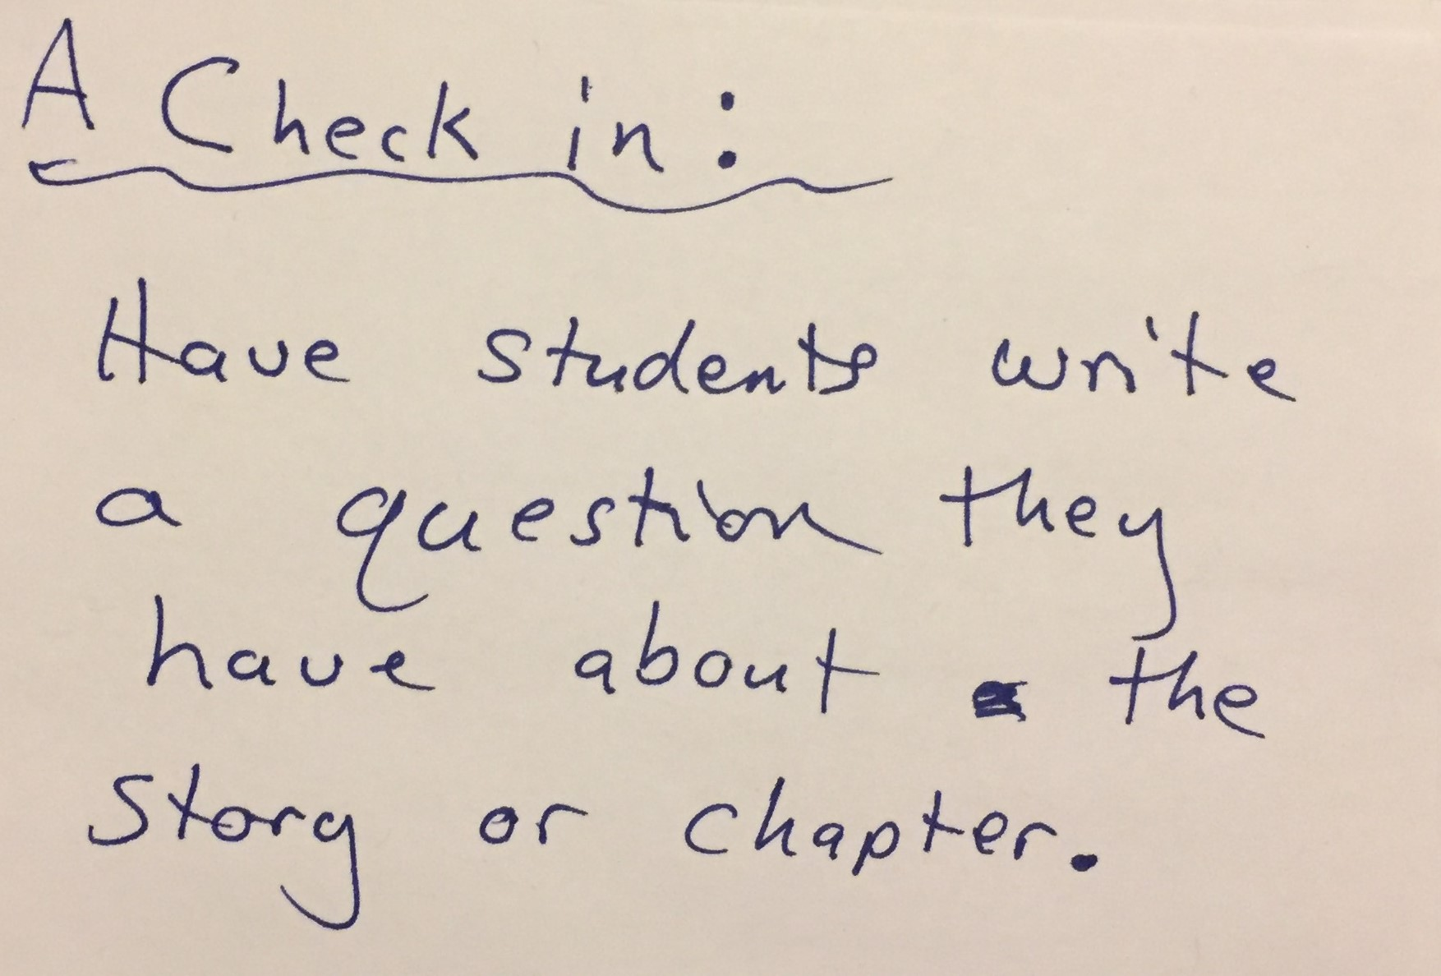
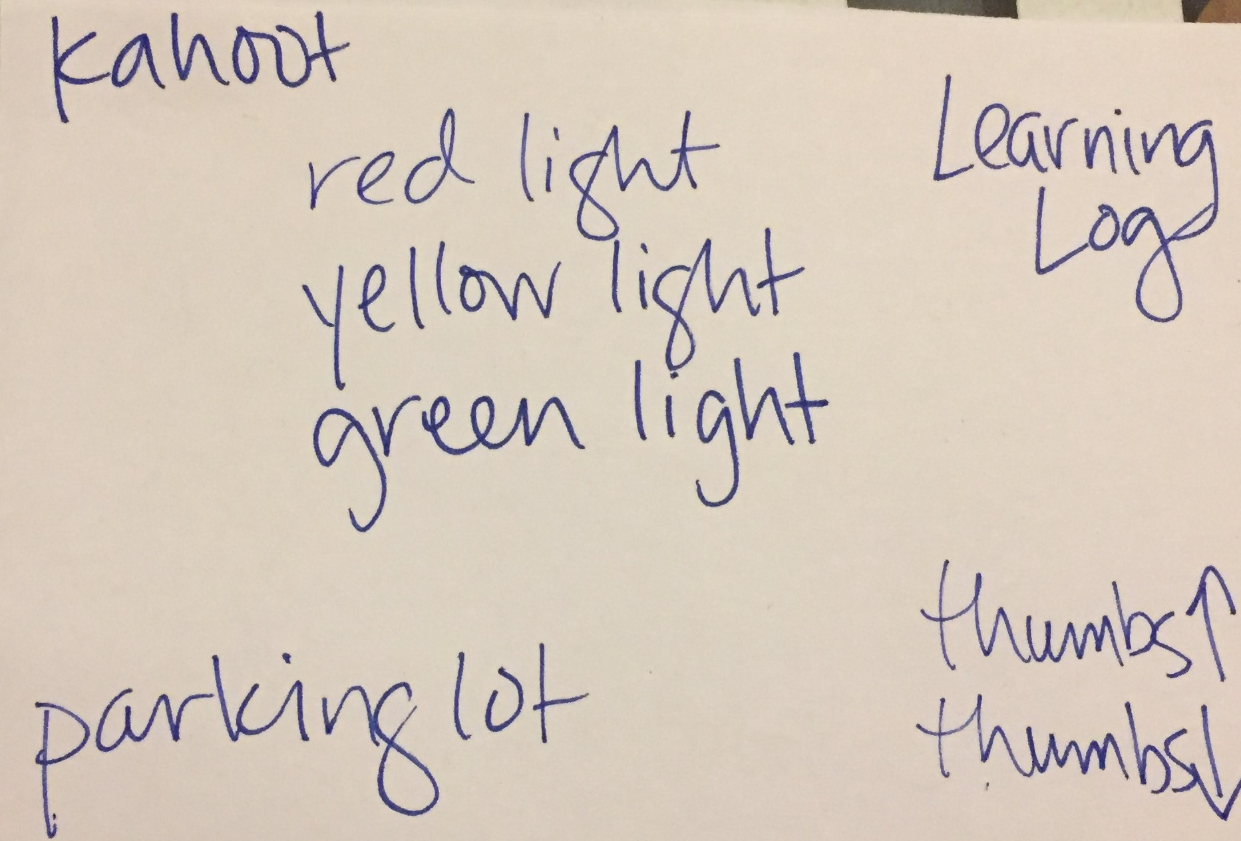
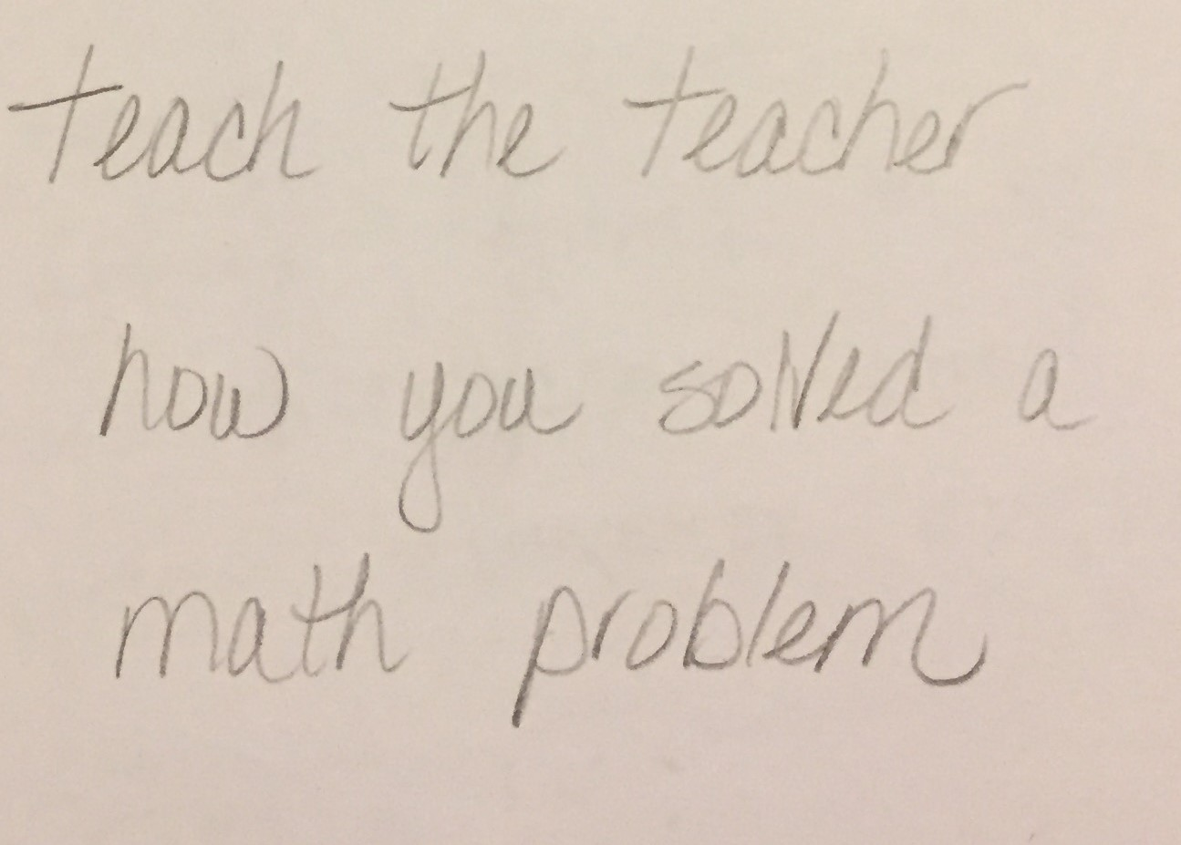
Tools to Assess Learning

Slide 7
Why use Formative Assessment of Teaching?
For the teacher…
For the one observing…
Conditional Knowledge
an observation can provide
useful feedback that might not be revealed through the use of other assessment methods
the experience can provide
an opportunity to learn from seeing a fellow teacher in action

Slide 8
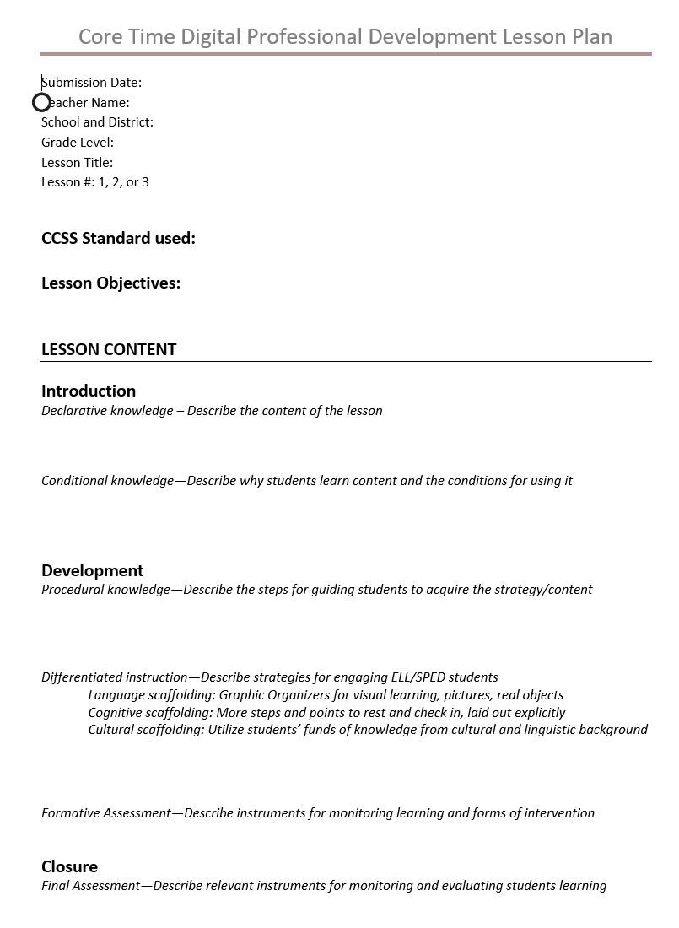
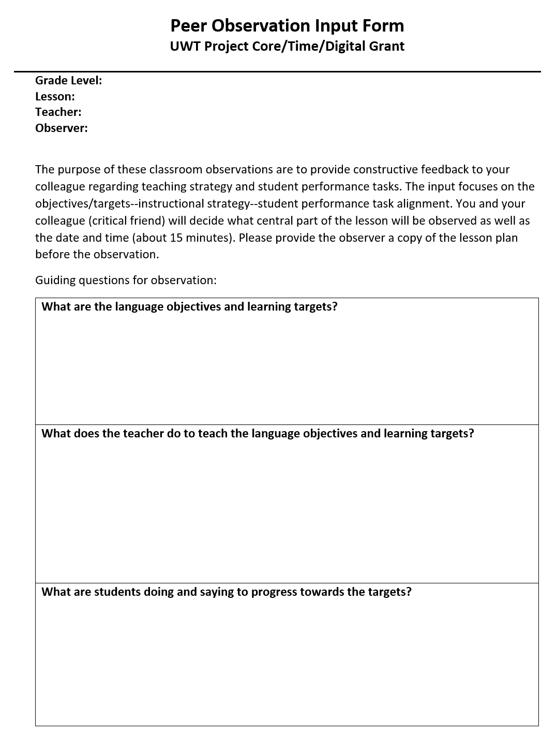
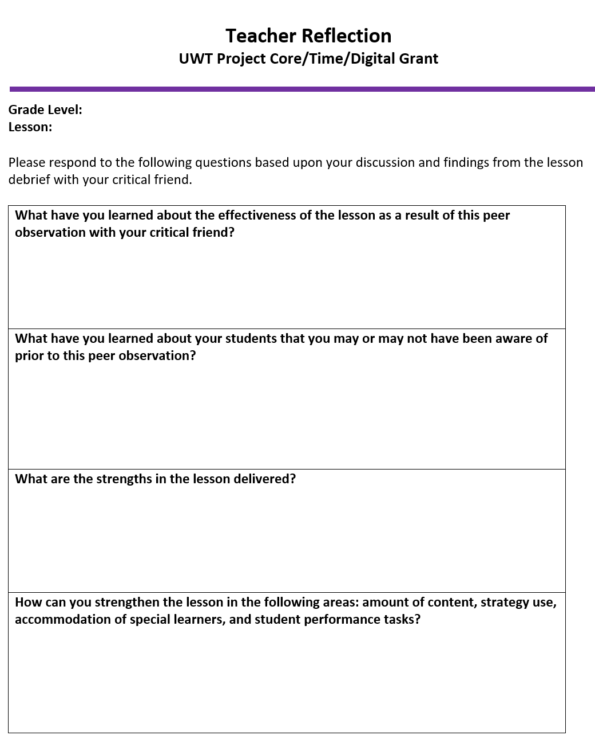
Tools to Assess Teaching
Lesson Plan
Observation
Reflection

Slide 9
Clarify Intended Learning Goals
Develop lesson plan
Share lesson with critical friend in advance
Discuss strengths and challenges of teaching
Ask for specific feedback

Slide 10
Eliciting Evidence
Review lesson plan & materials prior to observation
Observe teacher’s ability to engage students
Consider student questions & performance during lesson

Slide 11
Interpreting the Evidence
Discuss strengths of lesson delivered
Identify effective elements for teaching content
Recognize student affinities & struggles with learning

Slide 12
Acting on Evidence & Making Adjustments
What changes can be made to improve student learning?
Amount of content
Strategy
Differentiation
Funds of knowledge
Assessment Tools

Slide 13
Case Study
Lesson Plan
Observation
Reflection

Slide 14
Lesson Plan

Slide 15
Peer Observation
Observations are most effective when approached as a collaboration meant to benefit all involved
What are the objectives and learning targets?
What does the teacher do to teach the objectives and learning targets?
What are students doing and saying to progress towards the targets?

Slide 16
Teaching Reflection
What have you learned about the effectiveness of the lesson as a result of this peer observation with your critical friend?
What have you learned about your students that you may or may not have been aware of prior to this peer observation?
What are the strengths in the lesson delivered?

Slide 17
Before we exit…
I would like to learn more about…
Please explain more about…
The most important thing I learned today is…
The thing that surprised me the most today was…

Slide 18
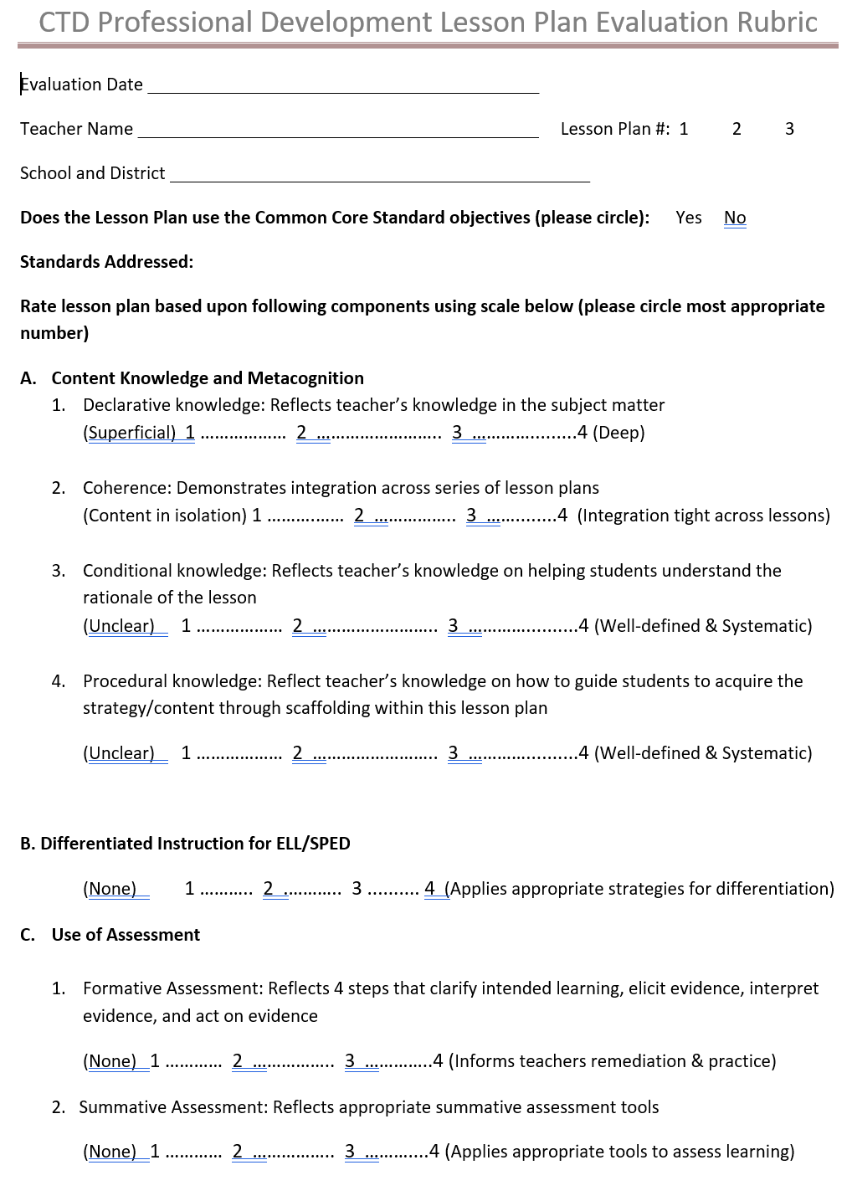
Lesson Plan Template Revisions
Coherence: Demonstrates integration across the series of
3 lesson plans
Procedural knowledge: Reflect teacher’s knowledge on how to guide students to acquire the strategy/content through scaffolding within this lesson plan

Slide 19
Submitting Lesson Plans
Submit lesson plans on Dropbox
For teams, submit only one document (with all names)
Label docs like this:
Subject_Grade_LP#_School_Name(s)
ELA LP1_ Grade8_KettleFalls_ Thompson_ Louie_ Rios.doc

