Slide 1
Strengthening CCSS Content Knowledge and Instructional Strategies
Implementing the 4-step Formative Assessment Process through Solving Equations
(6-HS)
Dr. Mei Zhu
Pacific Lutheran University
zhuma@plu.edu
WASHINGTON STATE
21st Century Grant
Project Core/Time/Digital
October 2016

Slide 2
LEARNING TARGETS
Participants will…
Strengthen CCSS math content knowledge in solving equations (Part 1 – a.m. session)
Discuss instructional strategies and learn the 4-step formative assessment process (Part 2 – p.m. session):
(1) Clarify intended learning;
(2) Elicit evidence;
(3) Interpret evidence; and
(4) Act on evidence.
Notes:
1 min

Slide 3
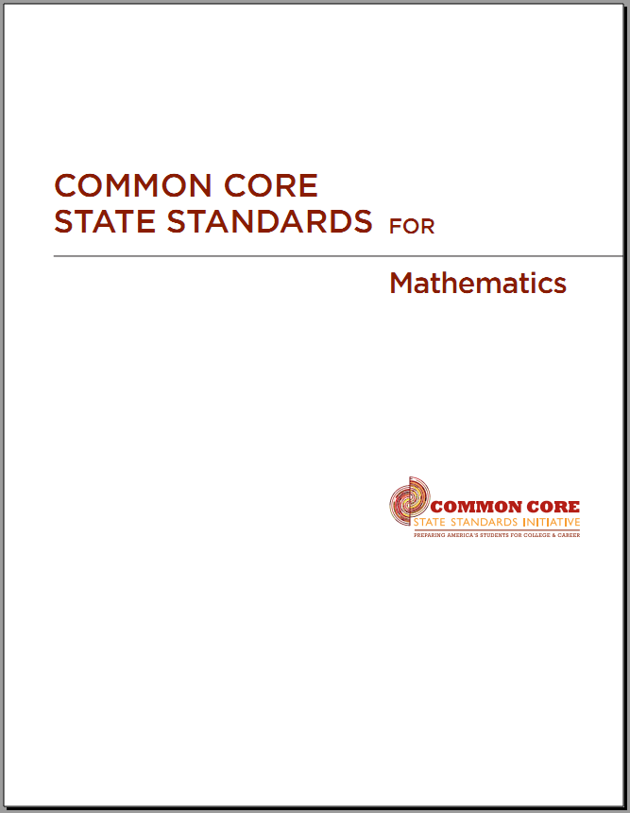




The 3 Shifts in
CCSSM-Math
Focus strongly where the standards focus
Coherence: Think across grades and link to major topics within grades
Rigor: In major topics, pursue with equal intensity:
  Conceptual understanding
  Procedural skill and fluency
  Application

Slide 4
Mathematical Practices 1. Make sense of problems and persevere in solving them 2. Reason abstractly and quantitatively 3. Construct viable arguments and critique the reasoning of others 4. Model with mathematics 5. Use appropriate tools strategically 6. Attend to precision 7. Look for and make use of structure 8. Look for and express regularity in repeated reasoning | Core Ideas K-5 Counting & Cardinality (K) Operations & Algebraic Thinking Number & Operations Fractions (3) Measurement & Data Geometry 6-8 Ratios & Proportional Relationships Number System Expressions & Equations Functions (8) Geometry Statistics & Probability 9-12 Number & Quantity Algebra Functions Modeling Geometry Statistics & Probability

Slide 5
An Overview of Operations, Algebraic Thinking, & Equations, K-HS
Coherence
Focus
Rigor

Slide 6
Operations & Algebraic Thinking-
Increased Coherence, Focus and Rigor
Math Practices | Grade K | Mathematical Concepts
MP1 MP3 | Modeling +, - of numbers within 10 using objects, drawing, and real world problems, etc. | Algebraic thinking, using objects, drawings, verbal expressions, or equations.
MP1 and MP6 | Decomposition of numbers: 5=1+4, 5=2+3, etc 10=1+9, 10=2+8, 10=3+7. | Understand multiple ways of decomposition.
Coherence | Understand addition as putting together and adding to, subtraction as taking apart and taking from. | The meaning addition and subtraction.
Fluency | Addition and subtraction within 5. Composition and decomposition within 10 and move to 11 to 19. | Computational Fluency

Slide 7
Operations & Algebraic Thinking
Math Practices | Grade 1 | Mathematical Concepts
MP1 MP3 | Modeling +, - of numbers within 20 using objects, drawing, and real world problems, etc. 7+8=___, 7+__=15, __+8=15, 5=_-2 | Algebraic thinking, using objects or drawings or verbal expressions or equations to represent known and unknown terms.
MP1 and MP6 | 2+9=9+2 (3+2)+8=3+(2+8) Understanding, fluency, story problems | Commutative property of + a+b=b+a Associative property of + (a+b)+c=a+(b+c)
Coherence | 9+__=12 is equivalent to _=12-9 3+5=8 is equivalent to 5=8-3 | Addition and subtraction are inverse operations.
Fluency, Multiple ways of solving problems | 4+5=10-1, 8+9=16+1, Checking if 8+6=9+5 | Equations
Grade 2: adding & subtracting within 100, fluency, mental math, even/odd numbers, getting ready for multiplication

Slide 8
Operations & Algebraic Thinking
Math Practice | Grade 3 | Mathematical Concepts
MP1 MP2 MP3 MP4 MP5 MP7 MP8 | Understanding and Modeling +−×÷ of numbers within 100 using drawing, and equations with a symbol for the unknown number. Solving 2-step word problem using 4 operations. | Algebraic thinking, using symbols to represent known and unknown terms. Understanding 4 operations in depth. Use of terminology: quotient.
MP1 through MP8 | 2×9=9×2 (3×2)×8=3×(2×8) 2(3+1)=2×3+2×1 Understanding why, fluency, story problems | Commutative property of multiplication: ab=ba Associative property of multiplication: (ab)c=a(bc) Distributive property a(b+c)=ab+ac
Coherence | 9 × ? =27 is equivalent to 27 ÷ 9 = ? | Equations. Multiplication and division are inverse operations.
Fluency, Rigor Multiple ways of solving problems | Fluency of Multiplication and division within 100. Start factorization concept 12=2x6=3x4=4x3…. Mental Math. 4=2x2, What number times itself is 4? | Fluency, factorization, even/odd numbers, pattern. Mental Math. Start developing concepts of square and square root

Slide 9
Operations & Algebraic Thinking
Math Practices | Grade 4 | Mathematical Concepts
MP1 MP2 MP3 MP4 MP5 MP7 MP8 | Understanding and Modeling +−×÷, using drawing, and equations with a symbol for the unknown number. Solving multiple step word problem using 4 operations. | Algebraic thinking, using symbols to represent known and unknown terms. Understanding 4 operations in depth. Estimation and rounding.
MP1 through MP8 | 24=2×2×2×3. 99 is a multiple of 11 since 11x9=99. | Find factors and multiples within 100. Prime number v.s. composite number. Fraction addition/subtraction
Coherence, Fluency, Rigor | Increased depth and fluency from Grade 3. More depth in fractions, etc. | All areas
MP1 through MP8 | 1 1+3 1+3+3 1+3+3+3, … 10th term? odd or even? | Generate and Analyze Pattern. Operations between even numbers, odd and even numbers, and odd numbers

Slide 10
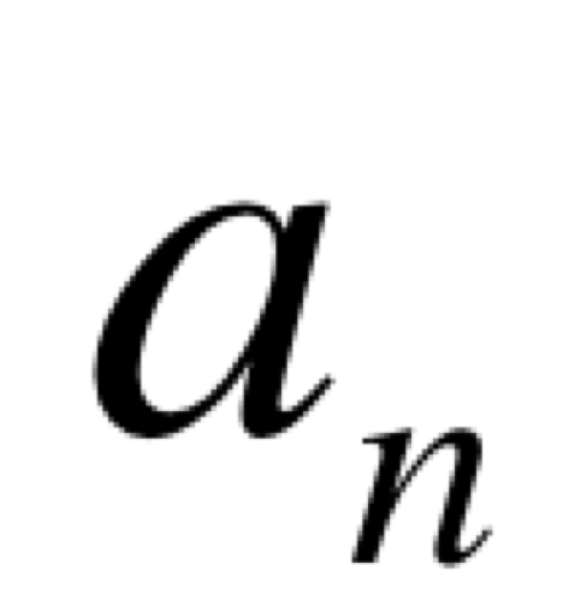
Operations & Algebraic Thinking
Math Practice | Grade 5 | Mathematical Concepts
MP1 MP2 MP3 MP4 MP5 MP7 MP8 | Continue all areas in Grade 4 and add depth | Algebraic thinking, using symbols to represent known and unknown terms. Understanding operations and algebraic properties in depth. Working on fluency.
MP1 through MP8 | 4 × (1081+2093) is ____ | Explain and describe algebraic property much as Distributive Property. Fraction multiplication/division.
Coherence, Fluency, Rigor | Increased depth and fluency from Grade 3. More depth in fractions, etc. | Use of parentheses, brackets, and braces in calculation. Evaluate expressions using these symbols.
MP1 through MP8 | n 0 0+6 0+6+6 0+6+6+6 … … | Generate two sequences using given two given rules. Form ordered pairs using the sequences. Analyze the relationship and graph the ordered pairs on a coordinate plane.

Slide 11
Operations &Equations
Math Practice | Grade 6 | Mathematical Concepts
MP1 MP2 MP3 MP4 MP5 MP7 MP8 | y+y+y is _____ For a cube: V=s³, A=6s² | Algebraic thinking, using symbols to represent known and unknown terms. Understanding operations and algebraic properties in depth. Working on fluency.
MP1 through MP8 | 3 (2+x) is ____ 24x+18y is ____ | Explain and describe algebraic property much as Distributive Property.
Coherence, Fluency, Rigor | Increased depth and fluency. More depth in algebraic sense, etc. | Use of parentheses, brackets, and braces in calculation. Evaluate expressions using these symbols.
MP1 through MP8 | Able to solve equations such as px=q or p+x=q, and inequalities px>q, p+x>q. Able to represent and analyze relationships between dependent and independent | Set up and solve equations/inequalities with unknowns. Take a step towards functions and graphs of function.

Slide 12
Operations & Equations
Math Practice | Grade 7 | Mathematical Concepts
MP1 MP2 MP3 MP4 MP5 MP7 MP8 | Extend +, -, ×, ÷ to all rational numbers, maintaining the properties of operations and the relationships between addition and subtraction, and multiplication and division. | Apply properties of operations to rational numbers including negative numbers, fractions, percentages, and decimals.
MP1 through MP8 | a+0.05a = 1.05a | Explain this in real world situation.
Coherence, Fluency, Rigor | Increased depth and fluency. More depth in algebraic sense, etc. | Use of parentheses, brackets, and braces in calculation. Evaluate expressions using these symbols.
MP1 through MP8 | Able to solve equations such as px+q=r or p(x+q)=r, and inequalities. Able to set up and solve word problems Able to represent and analyze relationships between dependent and independent | Set up and solve equations/inequalities with unknowns using properties of operations. Problems involve all kinds of rational numbers and operations.

Slide 13
Operations &Equations
Math Practice | Grade 8 | Mathematical Concepts
MP1 MP2 MP3 MP4 MP5 MP7 MP8 | Radicals and exponents: 3² × 3⁻⁵ = 3⁻³ = 1/3³ = 1/27. 7 times 10⁸ is about how much more times of 3 times 10⁶ | Apply properties of operations including radicals and exponents to rational numbers including negative numbers, fractions, percentages, and decimals.
MP1 through MP8 | x² = p and x³ = p Scientific notations | Solve and explain this in real world situation.
Coherence, Fluency, Rigor | Increased depth and fluency. More depth in algebraic sense, etc. | Use of parentheses, brackets, and braces in calculation. Evaluate expressions using these symbols.
MP1 through MP8 | Able to set up and solve linear equations. Relate linear equations with proportional relations. Able to set up and solve two linear equations. Graph of linear equations and interpret the two quantities in the relationship. | Set up and solve real world problems and graph linear equations.

Slide 14
Operations &Equations
Math Practice | Grade 9 | Mathematical Concepts
MP1 MP2 MP3 MP4 MP5 MP7 MP8 | Interpret P(1+r)^{n} Recognize x⁴ - y⁴ as (x²)² - (y²)², thus factor as (x² - y²)(x² + y²). | Interpret the structure of expressions.
MP1 through MP8 | Factor a quadratic expression, Complete square 1.15^{t} can be rewritten as (1.15^{1/12})^{12t} ≈ 1.012^{12t} | Write expressions in equivalent forms to solve problems. Operations on real numbers.
Coherence, Fluency, Rigor | Increased depth and fluency. | Polynomials, rational expressions
MP1 through MP8 | System of linear equations (matrix, inverse of matrix), equation for a circle, function y=f(x), Comparison of y=f(x) and y=g(x) graphically, etc. Graph of linear inequalities. | Create equation in two or more variables to represent relationships between quantities; Represent constraints by equations or inequalities, and by systems of equations and/or inequalities, and interpret solutions as viable or nonviable options in a modeling context.

Slide 15
The Cycle of Math – Math Practices
Make Sense
Persevere in Solving Problems
Reason abstractly and quantitatively
Construct viable arguments and critique the reasoning of others
Model with mathematics
Attend to precision
Look for and make use of structure
Look for and express regularity in repeated reasoning
Use appropriate tools strategically

Slide 16
Part 1. CCSS Content Knowledge – Solve Linear Equations with One Variable
Focus, Coherence & Rigor
For each of the given equations provided in the next slide
Rank them in the order from easy to difficult.
Solve them algebraically, and indicate what math properties you have used.
Select 4 problems and solve them using a concrete model (using manipulatives, drawing and/or real world stories).
What can you conclude on the general rules or procedure in solving these equations?

Slide 17
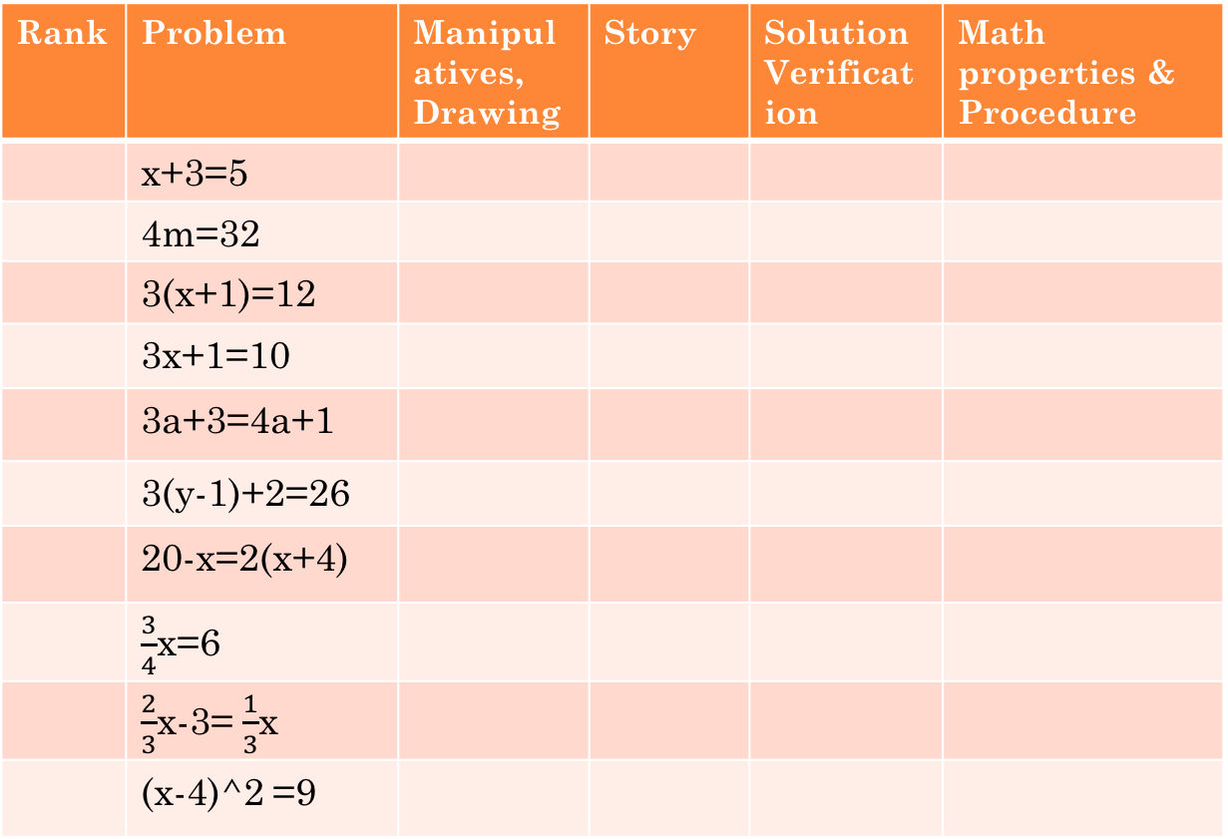
Content Knowledge – 1. algebraic skills
Rank | Problem | Manipulatives, Drawing | Story | Solution Verification | Math properties & Procedure
 | x+3=5
 | 4m=32
 | 3(x+1)=12
 | 3x+1=10
 | 3a+3=4a+1
 | 3(y-1)+2=26
 | 20-x=2(x+4)
 | $\frac{3}{4}$x=6
 | $\frac{2}{3}$x-3= $\frac{1}{3}$x
 | (x-4)^2 =9
6.EE.
A.3, B.7
7.EE.
B.3,
B.4
HSA
REI.
B.4.A
Hands-on equations (teaching manipulatives): http://www.borenson.com/
Online resources: http://nlvm.usu.edu/en/nav/category_g_4_t_2.html
http://www.mathplayground.com/AlgebraEquations.html

Slide 18
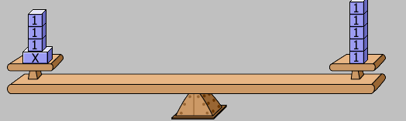

x+3=5
Drawing and using a balance bar
Solution and verification:
Story: Annie had some books, Lenny gave 3 more. Now she has 5 books. How many books did Annie have to start with? Let x = the number of books Annie had at the beginning.
Common sense: x+3 =5, x adds 3 is 5. x should be smaller than 5. x=5-3.
Procedure: the inverse operation of adding 3 is subtracting 3. We subtract 3 on both sides of the equation to solve for x.

Slide 19
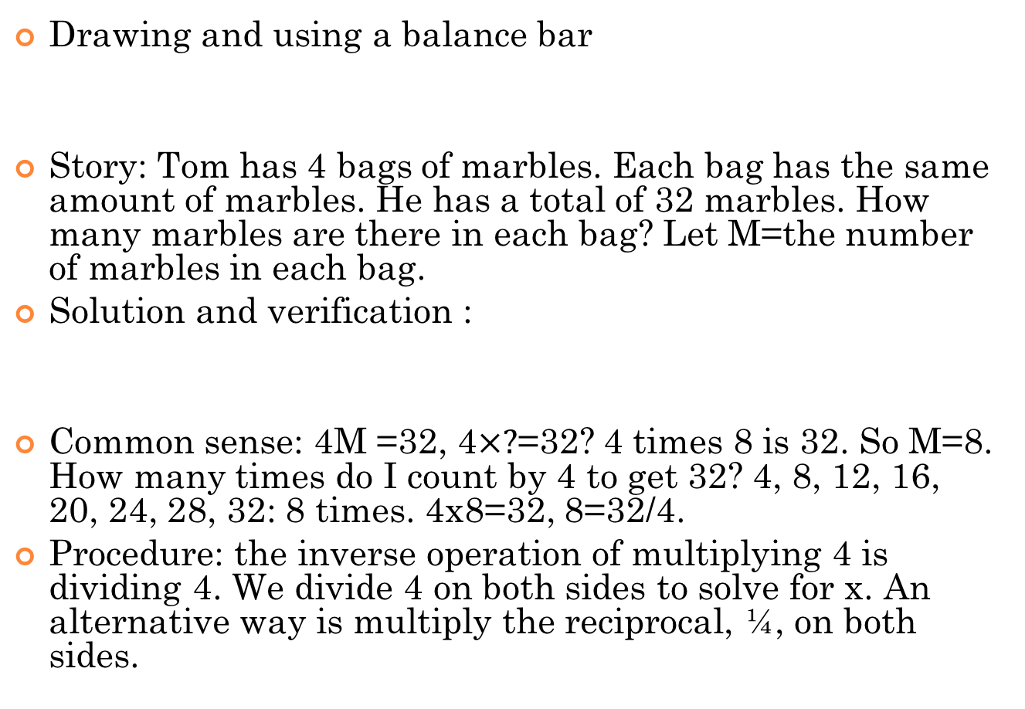
4M=32
Drawing and using a balance bar
Story: Tom has 4 bags of marbles. Each bag has the same amount of marbles. He has a total of 32 marbles. How many marbles are there in each bag? Let M=the number of marbles in each bag.
Solution and verification :
Common sense: 4M =32, 4$×?$=32? 4 times 8 is 32. So M=8. How many times do I count by 4 to get 32? 4, 8, 12, 16, 20, 24, 28, 32: 8 times. 4x8=32, 8=32/4.
Procedure: the inverse operation of multiplying 4 is dividing 4. We divide 4 on both sides to solve for x. An alternative way is multiply the reciprocal, ¼, on both sides.

Slide 20
3(x+1)=12
Drawing and using a balance bar
Solution and verification
Story: Claire bought three bags of lunch. Each bag contains one can of soda and one sandwich. Each can of soda is $1.00. She spent $12.00 total. How much does each sandwich cost? x = the cost of a sandwich.
Common sense: There are 3 groups of (x+1). Total is 12. So each groups is 12/3=4. x+1=4, x=3.

Slide 21
3(x+1)=12
Procedure discussion – should we divide 3 on both sides first or should we subtract 1 on both sides first?
Procedure.
Decide the order of operation for 3(x+1): adding, x+1, in the parentheses first, then times 3.
Perform inverse operation in the reverse order: divide 3 on both sides first, then substract 1 on both sides.
Alternative way: simply first using distributive property: 3x+3=12, subtract 3 from both sides, 3x=9, then divide 3 on both sides, x=3.

Slide 22
3x+1=10 A similar problem
Drawing and using a balance bar
Story: Tammy bought three same type of sandwiches. She also spent $1.00 to buy one can of soda. The total cost is $10.00. How much does each sandwich cost? Let x = the cost of a sandwich.
Discussion: compare 3(x+1)=12 and 3x+1=10
Solution and verification
Procedure discussion
Decide the order of operation for 3x+1: time 3 first, then add 1.
Perform inverse operation in the reverse order: subtract 1 first on both sides first, then divide by 3 on both sides.

Slide 23
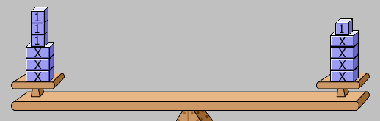
3x+3=4x+1
Drawing and using a balance bar
Solution and verification
Procedure discussion- goal is to solve for x, we move terms so that the terms involving x are on one side and the rest constant terms are the other side of the equation. Perform inverse operations in the correct order.
Story: Max bought 3 apples and 3 bananas. Maddie bought 4 apples and 1 banana. They paid for the same amount. If each banana is $1, how much is each apple? Let x = the cost of an apple.

Slide 24
3(y-1)+2=26
Procedure
Decide the order of operation for 3(y-1)+2:
Perform inverse operation in the reverse order:
Check the answer:
Use a balance bar to check.
Story: Cindy has 3 boxes of cards. Each box has the same number of cards. She gives her brother 1 card from each box, but her friend gives her 2 cards. Now she has 26 cards total. How many cards are there in each box? Let x = the number of cards in each box.

Slide 25
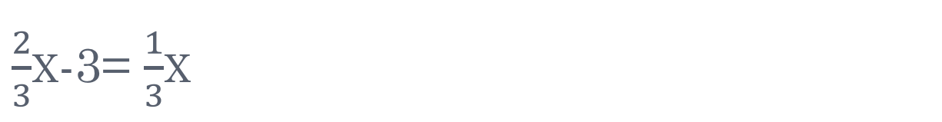
$\frac{2}{3}$x-3= $\frac{1}{3}$x
Procedure: the goal is to solve for x, we move terms so that the terms involving x are on one side and the rest constant terms are the other side of the equation. Perform inverse operations in the correct order.
Check the answer
Use a balance bar to check.
Story: Andy and Chris each got a bag of the same type of candy at a party. Andy has 2/3 of a bag left, and Chris has 1/3 of a bag left. If Andy eats 3 more pieces, they will have the same amount. How many pieces of candy are there in each bag? Let x=the number of pieces of candy in each bag.

Slide 26
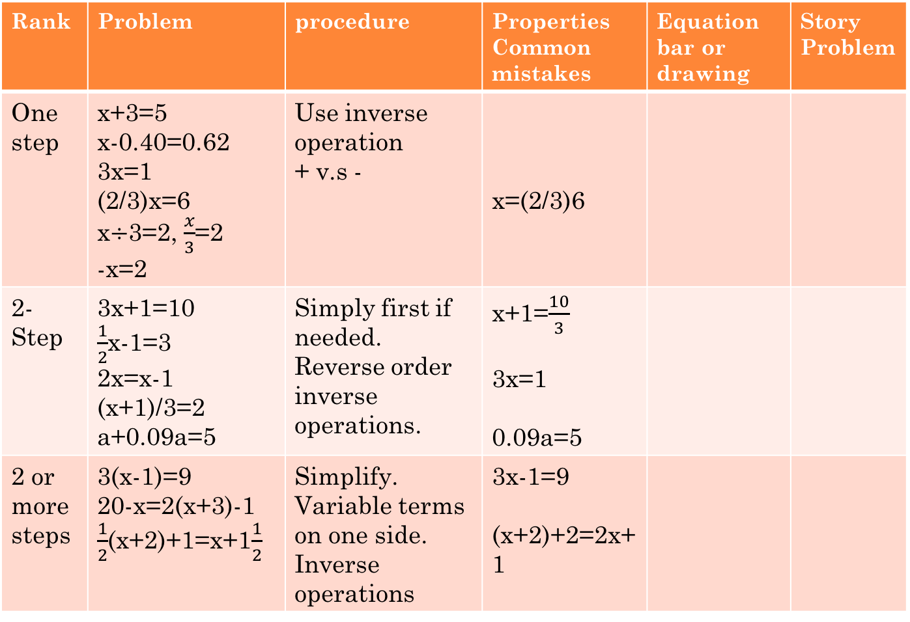
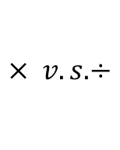
Content Knowledge – Summary (Instructional Sequence and Assessment Chart)
Rank | Problem | procedure | Properties Common mistakes | Equation bar or drawing | Story Problem
One step | x+3=5 x-0.40=0.62 3x=1 (2/3)x=6 x$÷$3=2, $\frac{x}{3}$=2 -x=2 | Use inverse operation + v.s - | x=(2/3)6
2-Step | 3x+1=10 $\frac{1}{2}$x-1=3 2x=x-1 (x+1)/3=2 a+0.09a=5 | Simply first if needed. Reverse order inverse operations. | x+1=$\frac{10}{3}$ 3x=1 0.09a=5
2 or more steps | 3(x-1)=9 20-x=2(x+3)-1 $\frac{1}{2}$(x+2)+1=x+1$\frac{1}{2}$ | Simplify. Variable terms on one side. Inverse operations | 3x-1=9 (x+2)+2=2x+1
$$× v.s.÷$$

Slide 27
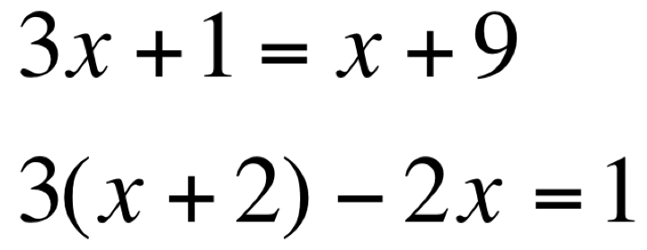
Algebraic Procedure for Solving equations
Summarize the algebraic procedure used to solve the previous problems and use it to solve the followings. Check your answer.
MP 7 and MP8

Slide 28
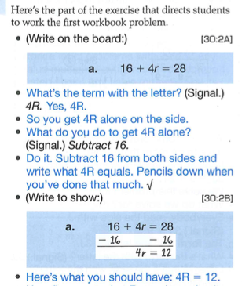
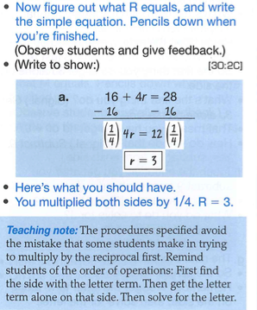
Resource – Essentials for Algebra by S. Engelmann, B. Kelly and O. Engelmann

Slide 29
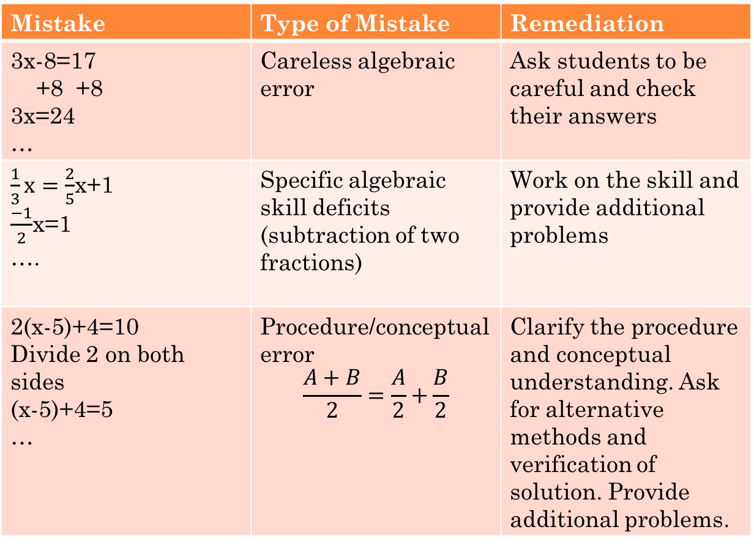
Mistakes – Diagnosis and Remediation
Mistake | Type of Mistake | Remediation
3x-8=17 +8 +8 3x=24 … | Careless algebraic error | Ask students to be careful and check their answers
$\frac{1}{3}x=\frac{2}{5}$x+1 $\frac{−1}{2}$x=1 …. | Specific algebraic skill deficits (subtraction of two fractions) | Work on the skill and provide additional problems
2(x-5)+4=10 Divide 2 on both sides (x-5)+4=5 … | Procedure/conceptual error $$\frac{A+B}{2}=\frac{A}{2}+\frac{B}{2}$$ | Clarify the procedure and conceptual understanding. Ask for alternative methods and verification of solution. Provide additional problems.
Stein etc, 2006

Slide 30
Solving Story Problems using MP1, 2, 3, 4, 6, 7, 8.
Set up and solve the following problems.
Tom buys four packs of football cards to add to the 5 cards Billy gives to him. Now he has the same amount as Billy who owns two packs of cards and 15 loose cards. If all packs have the same number of cards, how many cards are there in each pack?
Kate’s father is 24 years older than Kate. If the sum of their ages is 32. How old is Kate?

Slide 31
Help Steps for Solving Story Problems
Read the problem carefully. Draw a picture if you can.
Underline the sentence that tells what quantity you are solving for. Name this quantity (unknown) using a letter.
Underline the information that you can write the described quantity using numbers and the letter you have named.
Underline the sentence that tells you how one term is equal to another term. Use this sentence to help you write an equation.
Solve the equation and check your answer.
Use a complete sentence to conclude your answer.

Slide 32
Part 2. Lesson Plans Guidelines
Focus, Coherence and Rigor.
Introduction
Declarative knowledge – Describe the content of the lesson
Conditional knowledge—Describe why students learn content and the conditions for using it
Development
Procedural knowledge—Describe the steps for guiding students to acquire the strategy/content
Differentiated instruction—Describe strategies for engaging ELL/SPED students
Formative Assessment.
Closure
Final Assessment—Describe relevant instruments for monitoring and evaluating students learning.
Notes:
Modeling Problems -> Ratio -> patterns developed (equivalent ratios, fraction expressions, etc) -> Solve problems (unit price, rate) -> more problems such as proportional relationships ->

Slide 33
Design your lesson plan base on the needs of your students
Differentiated instruction—Describe strategies for engaging ELL/SPED students
Goal: Alignment with Common Core State Standards
Emphasis #1 Balancing conceptual understanding and procedural fluency .
Emphasis #2 Maintaining high cognitive demand using high-cognitive-demand math tasks and maintaining the rigor of mathematical tasks throughout lessons and units.
Emphasis #3 Developing beliefs that mathematics is sensible, worthwhile, and doable.
Emphasis #4 Engaging students in the eight CCSS mathematical practices

Slide 34
Guidelines for ELL and SPED Students
Focus on mathematical reasoning as well as on language development.
Draw on multiple resources available in classrooms – such as objects, drawings, graphs, and gestures – as well as home languages and experiences outside of school.
Support all students, regardless of their proficiency in English, cultural, racial and economical backgrounds. When students can participate in discussions in a safe classroom environment they grapple with important mathematical content.
- Moschkovich 1995, 2002, 2007

Slide 35
Five Recommendations for Teaching ELS by J. Moschkovich
Focus on students’ mathematical reasoning, not accuracy in using language. (Accuracy will eventually come with ample time of practices).
Shift to a focus on mathematical discourse practices, move away from simplified views of language.
Recognize and support students to engage with the complexity of language in math classrooms.
Treat everyday language and experiences as resources, not as obstacles.
Uncover the mathematics in what students say and do.
Video by the author - http://ell.stanford.edu/publication/mathematics-common-core-and-language

Slide 36
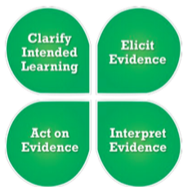
Part 2. Lesson Plans Guidelines
SBAC 4-step formative assessment process:
Clarify intended learning
Elicit evidence
Interpret evidence
Act on evidence
Notes:
Modeling Problems -> Ratio -> patterns developed (equivalent ratios, fraction expressions, etc) -> Solve problems (unit price, rate) -> more problems such as proportional relationships ->

Slide 37
the 4-step Formative Assessment
Step 1. Clarifying Intended Learning
Define learning goals clearly using student-friendly language as such “I can …”.
Provide clear success criteria that defining the evidence for determining how students progressing towards learning goals.

Slide 38
the 4-step Formative Assessment
Step 2. Eliciting Evidence
Gather evidence of learning using different ways depending on students’ needs, interest and learning styles.
Use multiple sources of evidence to draw accurate conclusions about student learning – in relation to learning goals and success criteria.

Slide 39
the 4-step Formative Assessment
Step 3. Interpreting the Evidence
Determine where each student is in relation to learning goals, what he/she understands or doesn’t understand.
Evidence is interpreted on an ongoing basis throughout instruction, it is not a single event. Students can also independently analyze evidence of their own learning, though they benefit from sharing and discussing their interpretations with teachers and peers (MP 3). By doing so, accountable feedback are provided.

Slide 40
the 4-step Formative Assessment
Step 4. Acting on Evidence.
Teachers and students use actionable feedback to determine next steps to continue to move learning forward.
The steps may not be the same for all students and must take into consideration each student’s readiness, interests, and learning preferences.

Slide 41
Lesson Plan – Introduction
Declarative knowledge – Describe the content of the lesson:
CCSS Math Content 7.EE.B.4:
Solve word problems leading to equations of the form px + q = r and p(x + q) = r, where p, q, and r are specific rational numbers. Solve equations of these forms fluently. Compare an algebraic solution to an arithmetic solution, identifying the sequence of the operations used in each approach. For example, the perimeter of a rectangle is 54 cm. Its length is 6 cm. What is its width?
Math Practices: 1. Make sense of problems and persevere in solving them. 2. Reason abstractly and quantitatively. 3. Construct viable arguments and critique the reasoning of others. 4. Model with Mathematics. 6. Attend to precision 7. Look for and make use of structure. 8. Look for and express regularity in repeated reasoning.

Slide 42
Lesson Plan - Introduction
Conditional knowledge—Describe why students learn content and the conditions for using it: through this lesson students strengthen and extend their understanding of order of operations, inverse operations, and procedure of solving equations. They will review distributive property and operations of real numbers including rational numbers. They will gain understanding of the procedure of solving equations using drawing, balance bar, common sense and story problems. They will be able to summarize how to solve equations in the form of px+q=r and p(x+q)=r. This will help them get ready for solving multiple-step equations.

Slide 43
Learning goals – Formative Assessment Step 1 – Clarify Learning goals
I can solve equations such as 2x+4=10 and 2(x+4)=5.
I can describe the difference between 2x+4 and 2(x+4), and I know how to expand 2(x+4) using the distributive law.
I can solve equations of the form px + q = r and p(x + q) = r, where p, q, and r are specific rational numbers.
I can solve word problems by setting up an unknown, write an equation, and solve it.

Slide 44
Design your lesson plan base on the needs of your students
Use drawing, balance bars, etc, to help ELL and SPED students visualize the concepts.
Demonstrate clear board work to allow ELL students and students with learning disabilities to see what you are saying.
Create story problems that relate to your students’ life and cultural background.
Create a safe and collaborative learning environment. Allow students work in groups with mixed language, cultural, mathematical and racial backgrounds so they can help each other succeed.

Slide 45
Lesson Plan – Development of Materials Embedded with Formative Assessment Steps
Review and Pre-evaluation, can students solve one step problems learned previously? – Step 2. Elicit Evidence.
Give students some 1-step problems to solve, such as, x+3=5, x-0.40=0.30, 3x=2, (2/3)x=4.
Students and teacher observe common and individual mistakes. Determine the type(s) of the mistakes, algebraic or conceptual. - Step 3. Interpreting the Evidence.
Correct algebraic mistakes. For conceptual mistakes, use various strategies (manipulatives, drawing, equation bar, story problems) to clarify the concept - Step 4. Act on Evidence.
Summarize and write down the procedure for solving equations with one step: inverse operation.

Slide 46
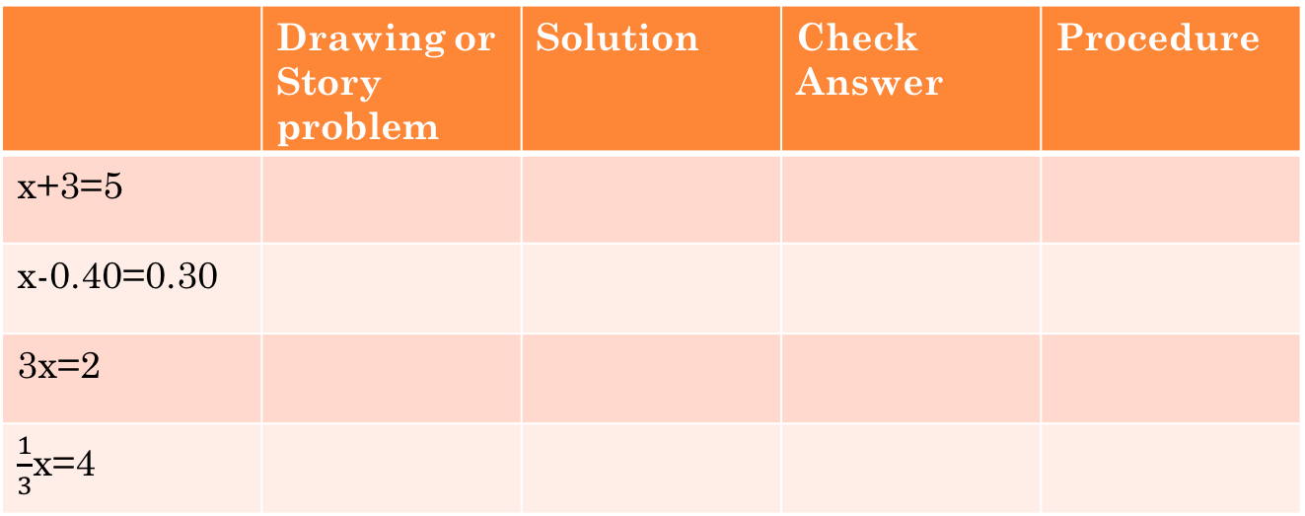
Provide Problems and Demonstrate your detailed work for at least one problem (see Part 1 for examples).
 | Drawing or Story problem | Solution | Check Answer | Procedure
x+3=5
x-0.40=0.30
3x=2
$\frac{1}{3}$x=4
Summary of the procedure for solving 1-step problems.
Depending on the level of your students, you can change
the difficulty level of coefficients. Depending on time, you can
also make story problems for some of these problems.

Slide 47
Progress to
I can solve equations such as 2x+4=10 and 2(x+4)=10. I can describe the difference between 2x+4 and 2(x+4), and I know how to expand 2(x+4) using the distributive law.
Give the students a chance to try to solve the problems – Step 2.
Observe common and individual mistakes. - Step 3.
Step 4.
Show the correct algebraic steps with the support with explanation, supported with drawing, balance bar, etc.
Use drawing and stories to show the difference between 2x+4 and 2(x+4).
Discuss distributive property using 2(x+4).
Summarize the procedure for solving multiple step problems. Decide the order of operations, perform reversed order of inverse operations one step at a time to solve the equation.

Slide 48
Demonstrate your detailed work
 | 2(x+4)=10 | 2x+4=10
Graph
Solution
Check
Procedure
(For examples, see Part 1.)
Use two real world situations to show the difference between
2(x+4)=10 and 2x+4=10.
Review distributive property. Use an alternative method to solve 2(x+4)=10.
Summarize the procedure.

Slide 49
Progress to
I can solve equations of the form px + q = r and p(x + q) = r, where p, q, and r are specific rational numbers.
Ask students to give some examples of px + q = r and p(x + q) = r and address any confusions – Steps 2 to 4.
Have students solve similar problems with increasing difficulty by letting p, q, r be larger numbers, negative numbers, fractions, decimals, etc. Follow through Steps 2 to 4, re-enforce procedure skills and conceptual understanding.
When a mistake occurs, check the type of the mistake and go back to the appropriate level to clarify any misconception. Provide additional problems as needed.

Slide 50
Provide a few examples here

Slide 51
Diagnosis and Remediation of Mistakes
Identify the types of mistakes by checking students work and interviewing students:
motivational problem, or lack of confidence,
careless mistake,
specific algebraic skill,
procedure or conceptual problem.
Address each mistake differently, work on the specific skill or conceptual understanding. Teacher provides reteaching through board and/or worksheet presentations, as well as one on one teaching opportunities.
Provide additional problems for specific student at specific level and check their answers.

Slide 52
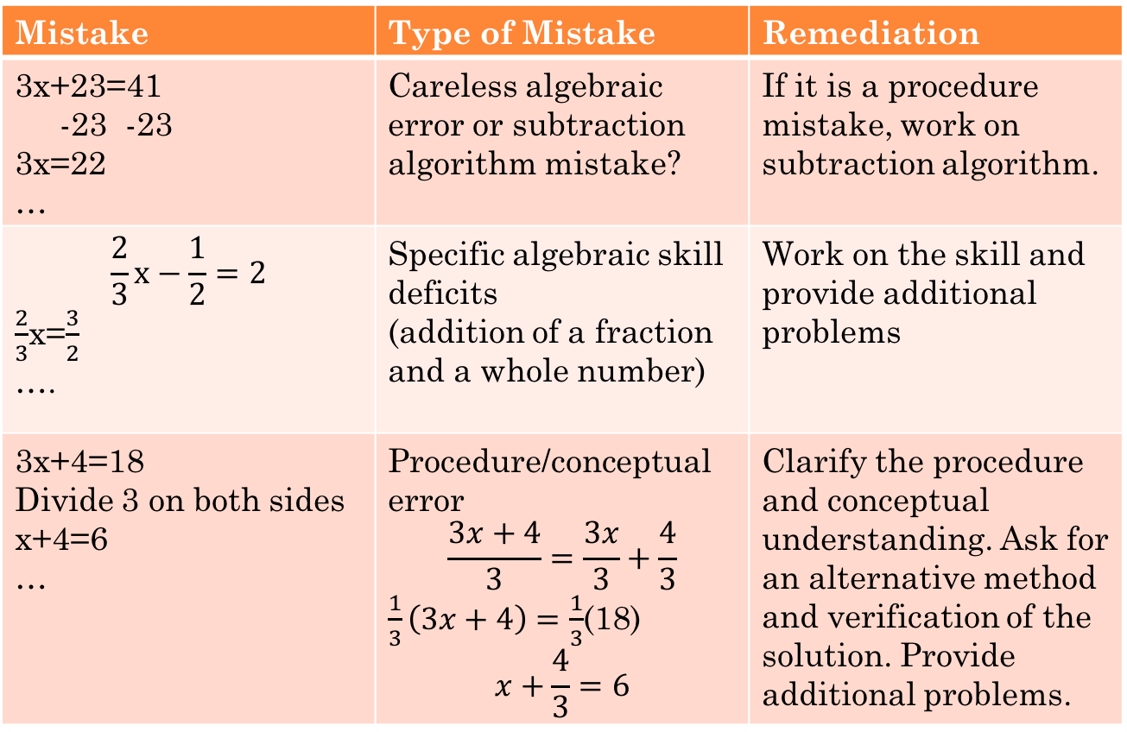
Mistakes – Diagnosis and Remediation
Mistake | Type of Mistake | Remediation
3x+23=41 -23 -23 3x=22 … | Careless algebraic error or subtraction algorithm mistake? | If it is a procedure mistake, work on subtraction algorithm.
$$\frac{2}{3}x−\frac{1}{2}=2$$ $\frac{2}{3}$x=$\frac{3}{2}$ …. | Specific algebraic skill deficits (addition of a fraction and a whole number) | Work on the skill and provide additional problems
3x+4=18 Divide 3 on both sides x+4=6 … | Procedure/conceptual error $$\frac{3x+4}{3}=\frac{3x}{3}+\frac{4}{3}$$ $\frac{1}{3}\left(3x+4\right)=\frac{1}{3}$(18) $$x+\frac{4}{3}=6$$ | Clarify the procedure and conceptual understanding. Ask for an alternative method and verification of the solution. Provide additional problems.

Slide 53
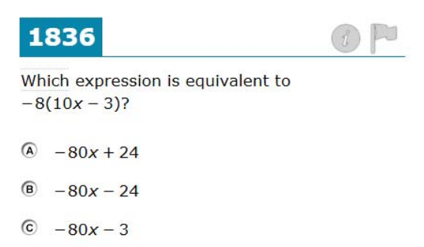
Additional Problem on Distributive Property

Slide 54
Progress to Application Problems
I can solve word problems by setting up an unknown, write an equation, and solve it.
Teachers can demonstrate how to solve word problems using helpful steps.
Read the problem carefully. Draw a picture if you can.
Underline the sentence that tells what quantity you are solving for. Name this quantity (unknown) using a letter.
Underline the information that you can write the described quantity using numbers and the letter you have named.
Underline the sentence that tells you how one term is equal to another term. Use this sentence to help you write the equation.
Solve the equation.
Use a complete sentence to conclude your answer.

Slide 55
Example 1. The perimeter of a rectangle is 54 cm. Its length is 6 cm. What is its width?
Example 2. The soup and sandwich combo is on sale. Maria paid $32 for 4 combos for her friends and herself. If each cup of soup in the combo is $3, how much does each sandwich in the combo cost?

Slide 56
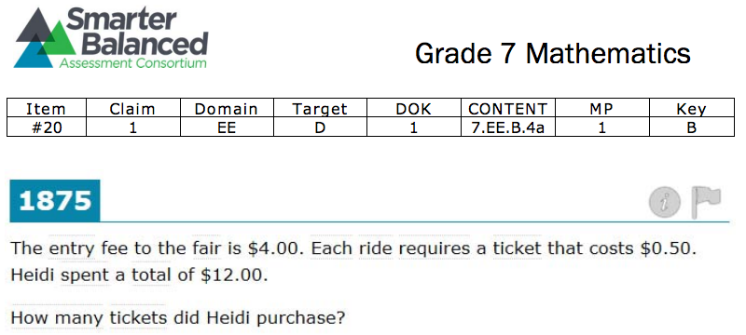
Example 2. Anna planning

Slide 57
Lesson Plan – Closure, Final Assessment
Have students to summarize the procedures of solving px+q=r and p(x+q)=r.
Provide student with additional problems to do on their own and assess their work through Steps 2-4, if time allows.
Additional assessment through exit ticket, homework, and quizzes.

Slide 58
Smarter Balanced Digital Library
https://www.smarterbalancedlibrary.org
Reference: Understanding Steps to Solving Equations. Author: Mathematics Assessment Project (MAP) Owner: MARS, Shell Center, University of Nottingham

Slide 59
Writing Algebraic Expressions
Area of rectangle = _ _ _ _ _ _ _ _ _ _ _ _

Slide 60
Writing Algebraic Expressions
Area of rectangle = _ _ _ _ _ _ _ _ _ _ _ _

Slide 61
Writing Algebraic Expressions
Area of rectangle = _ _ _ _ _ _ _ _ _ _ _ _

Slide 62
Which Equations Describe The Story?
A pencil costs $2 less than a notebook. A pen costs 3 times as much as a pencil. The pen costs $9 Which of the four equations opposite describe this story? | Let x represent the cost of notebook.

Slide 63
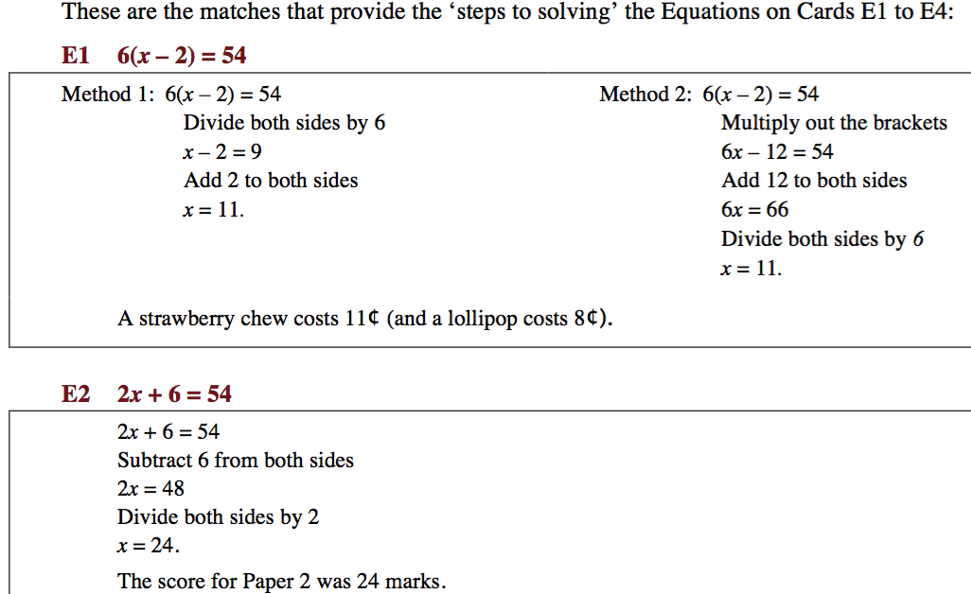

Slide 64
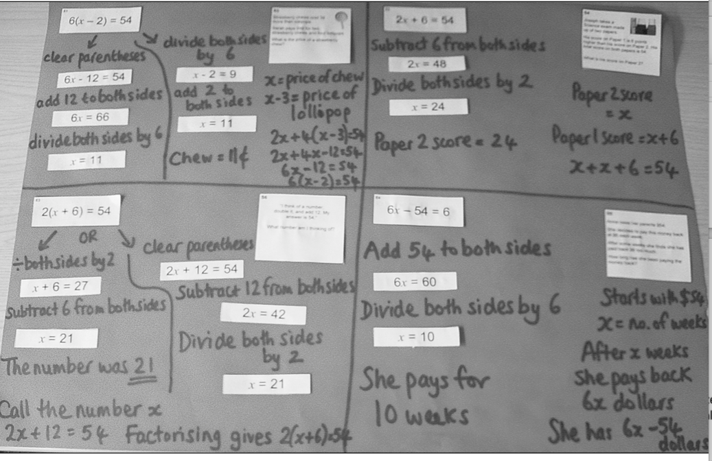

Slide 65
References :
http://www.readwritethink.org/professional-development/strategy-guides/using-think-pair-share-30626.html
http://nlvm.usu.edu/en/nav/grade_g_2.html
http://www.corestandards.org/Math/
http://www.k12.wa.us/corestandards/
NCTM. Principles to Actions: Ensuring Mathematical Success for All. 2014. NCTM.
http://de.portal.airast.org/wp-content/uploads/2014/09/G8_Practice-Test-Scoring-Guide-5.14.14-Final.pdf
http://rpdp.net/admin/images/uploads/resource_9838.pdf
Billstein, Libeskind, Lott. A problem Solving Approach to Mathematics, 8th ed, 2014. Pearson.
Engelmann, Kelly, Engelmann. 2008. Essentials for Algebra, a direct approach. SRA McGraw Hill.
Stein, Kinder, Silbert, and Carnine. 2006. Designing Effective Mathematics Instruction, A direct Instruction approach. 4th ed. Pearson Merrill Prentice Hall.
Judit Moschkovich, Mathematics, the Common Core, and Language: Recommendations for Mathematics Instruction for ELs Aligned with the Common Core http://ell.stanford.edu/publication/mathematics-common-core-and-language.
Judit Moschkovich, Mathematics, the Common Core, and Language: Recommendations for Mathematics Instruction for ELs Aligned with the Common Core http://ell.stanford.edu/publication/mathematics-common-core-and-language

