Slide 1

Since Time Immemorial Curriculum
Train-the-Trainers Session
A Component of UW-Tacoma Project Core/Time/Digital 16-17
Special Thanks to OSPI Office of Native Education, Michael Vendiola, Joan Banker, and Laura Lynn for Providing Training Materials
Presented By: Crystal Florez & Peggen Frank

Slide 2
Welcome
Please sign in.
Pick up your packet.
Take a few moments to draw your own sacred space, a place which has special meaning and significance to you or your family.
Notes:
10 mins

Slide 3
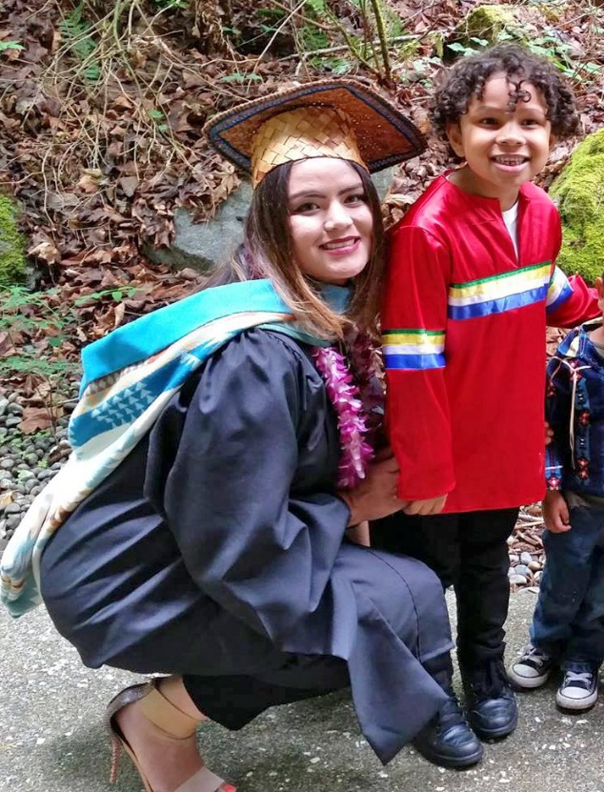
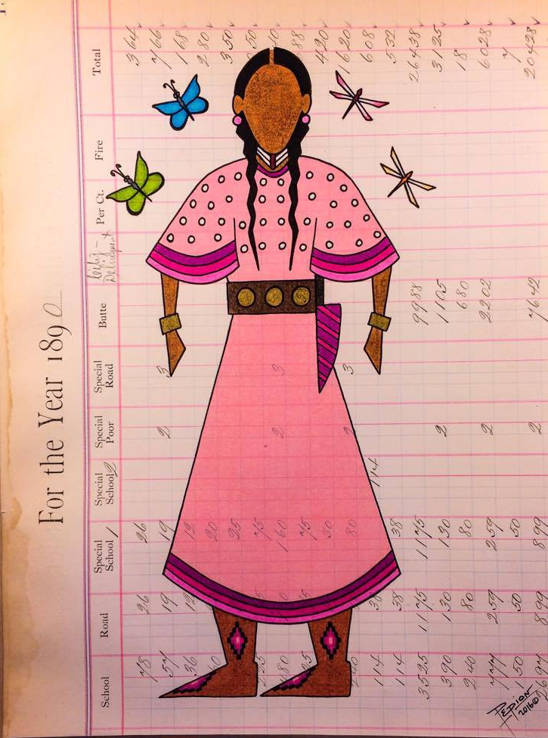
Introductions
Crystal Florez, MPA
White Earth Ojibwe
crflorez@uw.edu
Peggen Frank, MPA
Northern Arapaho/ Oglala Lakota
peggenfrank@gmail.com
Notes:
3 mins per presenter (total 6 mins)

Slide 4

That’s Me
I’m eager to learn!
Notes:
5-10mins max Peggen Lead

Slide 5
STI Train-the-Trainer Objectives
Understand the requirements of SB5433.
Deepen understanding of the impacts of tribal sovereignty.
Know the structure and resources of the STI lessons and units.
Become familiar with the structure of the STI curriculum website.
Identify lessons to implement with your students.
Plan and identify next steps for collaboration with local tribe(s).
Notes:
2 mins Crystal

Slide 6
Since Time Immemorial
BINGO
Sign your name in the center square.
Sign only one square for another person.
Learn as you go.
Going for a blackout, but call out when you have a BINGO in any direction.
Notes:
15 mins P&C

Slide 7
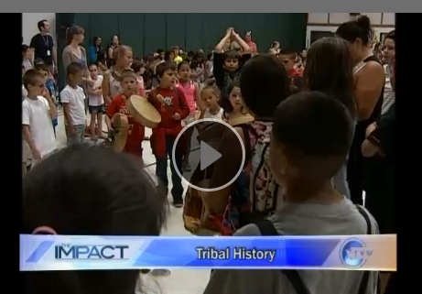
SB 5433
Notes:
17 mins

Slide 8
Foundation
Treaty obligation* meets tragic educational policy
Notes:
C

Slide 9
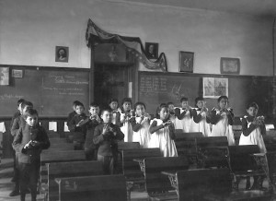
Miseducation of Native People
Native children survived mass genocide in the name of civilization
Boarding school era
  Children removed & placed in residential schools, far from their homes
Public schools emphasize a one size fits all
  Eurocentric paradigm
Ignores diversity of worldviews & ways of knowing.
“Kill the Indian, and Save the Man”
—Capt. Richard H. Pratt on the Education of Native Americans
From Where the Sun Rises:
Addressing the Educational Achievement of Native Americans in Washington State
CHiXapkaid (Dr. Michael Pavel), et. al
Notes:
Dr. Michael Pavel is a Skokomish Nation tribal member. He’s a Professor of Native American Studies in Education at the University of Oregon.
He specializes in higher education w/emphasis on improving Native postsecondary access and achievement.
His published work brings attention to the intersection of Native culture and educational attainment/ achievement.
He also brings to our attention the Mis-education of Native People.
In From Where the Sun Rises, Dr. Pavel contextualizes Native achievement (read bullet points)
“We found that the health and wellbeing of our youth and their families are primary concerns due the historical circumstances that conspired against Native American educational achievement.”

Slide 10
Miseducation of Native People
History of miseducation of Native people is well documented
  Meriam Report (1928)
  Indian Nations at Risk (1991)
  People with Disabilities on Tribal Lands 3 (National Council on Disability, 2003)
  A Quiet Crisis: Federal Funding and Unmet Needs in Indian Country (U.S. Commission on Civil Rights, 2003)
  National Indian Education Association’s Preliminary Report on Leave No Indian Child Behind (Beaulieu, Sparks, & Alonzo, 2005)
  Native Youth Report (Executive Office of the President, 2014)
  Native Nations and American Schools (National Indian Education Association, 2016)
“Kill the Indian, and Save the Man”
—Capt. Richard H. Pratt on the Education of Native Americans
From Where the Sun Rises:
Addressing the Educational Achievement of Native Americans in Washington State
CHiXapkaid (Dr. Michael Pavel), et. al
Notes:
10 mins- Crystal

Slide 11
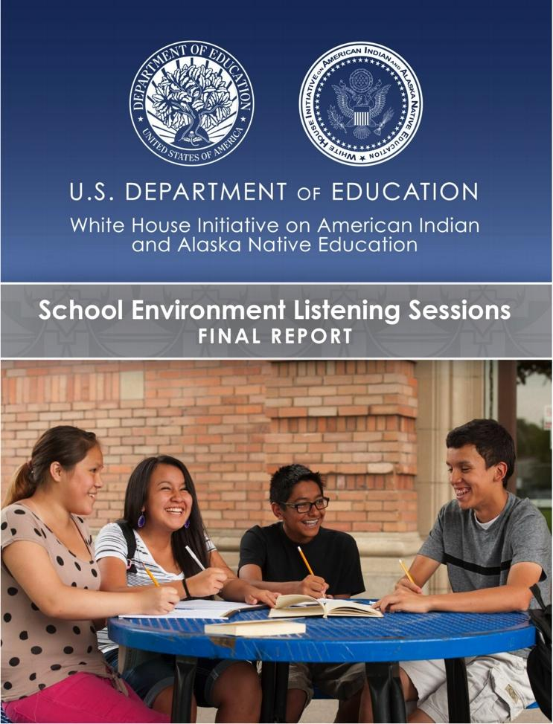
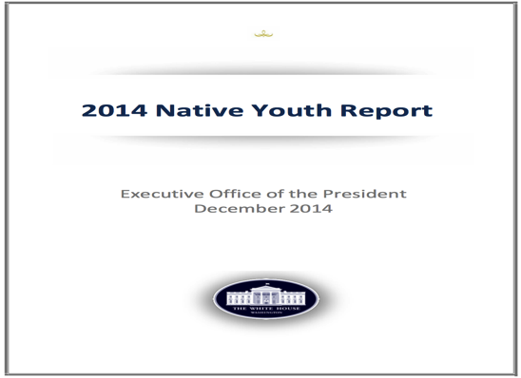
Current Federal Reports Mirror Continuing Issues
2014 Native Youth Report
Executive Office of the President
December 2014
2015 School Environment Listening Sessions
WHIAIANE
October 2015
Notes:
skip

Slide 12
What is currently taught in schools?
“Shear's research looked at [all 50] state history standards available in the 2011-2012 school year. She found that nearly 87 percent of state history standards failed to cover Native American history in a post-1900 context, and that 27 states did not specifically name any individual Native Americans in their standards at all.”—Huffington Post, 11/26/14
Manifesting Destiny: Re/ presentations of Indigenous Peoples in K–12 U.S. History Standards
Sarah B. Shear, Ryan T. Knowles, Gregory J. Soden & Antonio J. Castro
Notes:
2mins (crystal)

Slide 13
Government-to-Government
According to the U.S. Constitution, what is the “supreme law of the land”?
Notes:
Don’t need to answer now, but be thinking about it later on…
Peggen (30 sec)

Slide 14
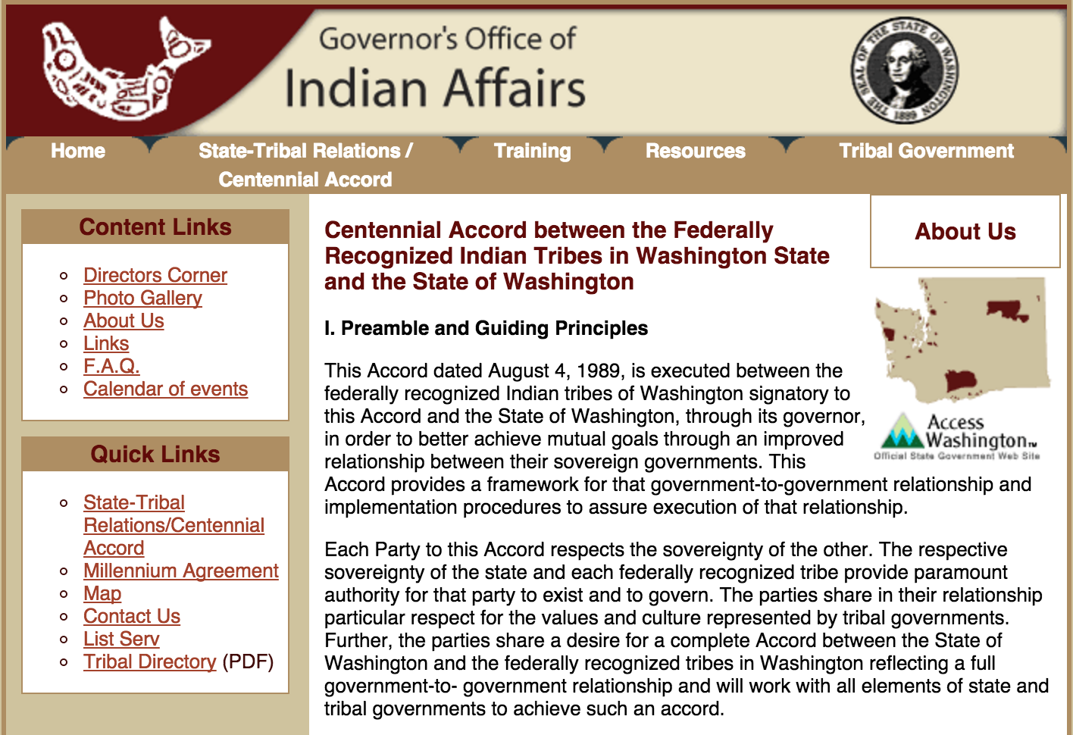
1989 CENTENNIAL ACCORD &
1999 MILLENNIAL AGREEMENT
Honoring Government-to-government Relationships
“…comprehensive educational effort to promote understanding of the government to government relationship…”—1989 Centennial Accord
“Educating the citizens of our state, particularly the youth who are our future leaders, about the tribal history, culture, treaty rights, contemporary tribal and state government institutions and relations and the contribution Indian Nations to the State of Washington to move us forward on the Centennial Accords promise…”—1999 Millennial Agreement
Notes:
5mins (Peggen)
http://goia.wa.gov/Government-to-Government/Data/CentennialAccord.htm

Slide 15
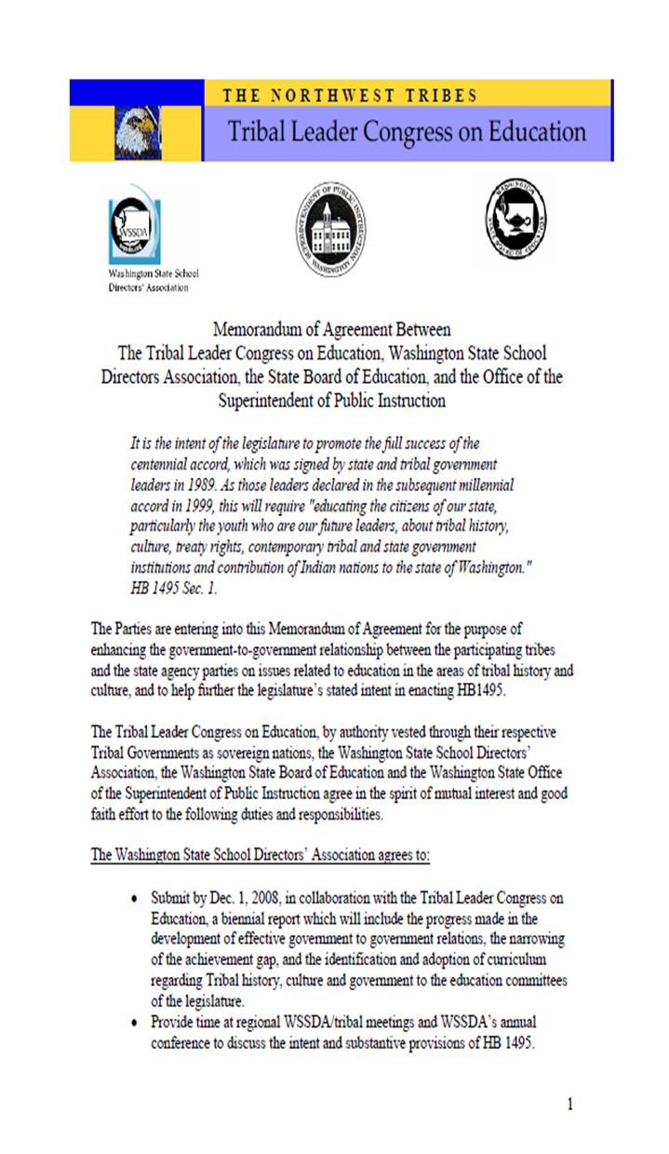
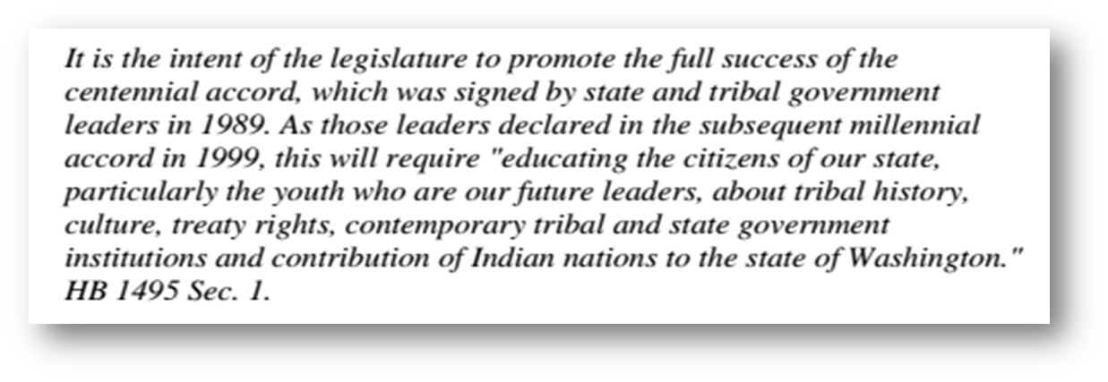


House Bill 1495|passed 2005
Notes:
5 minutes Crystal

Slide 16
Senate Bill 5433
‘Requiring Washington’s tribal history, culture, and government to be taught in the common schools.’
“Encouraged” vs. “Required”
Provides more balanced history of the State of Washington
Focuses on ‘Since Time Immemorial’ Curriculum as a free State provided, Tribal vetted resource for teachers
Signed into law on May 8, 2015
Notes:
2 minutes (crystal)

Slide 17

From Where the Sun Rises
Barriers to Native Student Success (pp. 40-45)
Lack of stability and continuity
Disconnection across several areas in education
  Education and culture
  Parents and teachers
  Education policies that force children to assimilate or leave school
  Culture and assessment
  Teachers and students
Poverty
Absenteeism
Mobility and transitions
Family issues
Stereotypes, discrimination and racism
From Where the Sun Rises:
Addressing the Educational Achievement of Native Americans in Washington State
CHiXapkaid (Dr. Michael Pavel), et. al
Notes:
5 mins Peggen

Slide 18
Benefits of Teaching Native History, Language, and Culture in All Schools
Native students…
Increase comfortability for Native students in school
Assist in keeping Native culture alive
Promote positive Native identity and sense of pride
Increase Native American youth and families’ awareness about themselves and their culture
Protect Native American rights
All students…
Increase respect, understanding and awareness for Native people and culture, and the hardship they have faced
Reduce/eliminate stereotypes and ignorance about Native Americans
Demonstrates that schools value Native culture
Increase communication and understanding between Native American youth, families, and school community
Source: From Where the Sun Rises: Addressing the Educational Achievement of Native Americans in Washington State
CHiXapkaid (Dr. Michael Pavel), et. al
Notes:
5 mins Peggen

Slide 19
Partnering with
Local Tribes
SB 5433
Sec 2….when a district reviews or adopts its social studies curriculum, it shall incorporate curricula about history, culture and government of the nearest federally recognized Indian tribe or tribes, so that students can learn about the unique heritage and experience of their closest neighbor.
Notes:
3 mins (crystal)

Slide 20
Guiding Principals
1. Teach with a multiple perspectives approach.
2. Focus on the tribal group(s) closest to the school first.
3. Deal with real life, sometimes controversial issues.
4. Connect the head with the heart with the hands for learning.
5. Recognize that culture is dynamic and always evolving.
6. Stress the resiliency of Native cultures, despite intentional oppression and neglect.
7. Emphasize that co-responsibility for change involves developing allies who know how to take action.
Notes:
2 mins (Crystal)

Slide 21
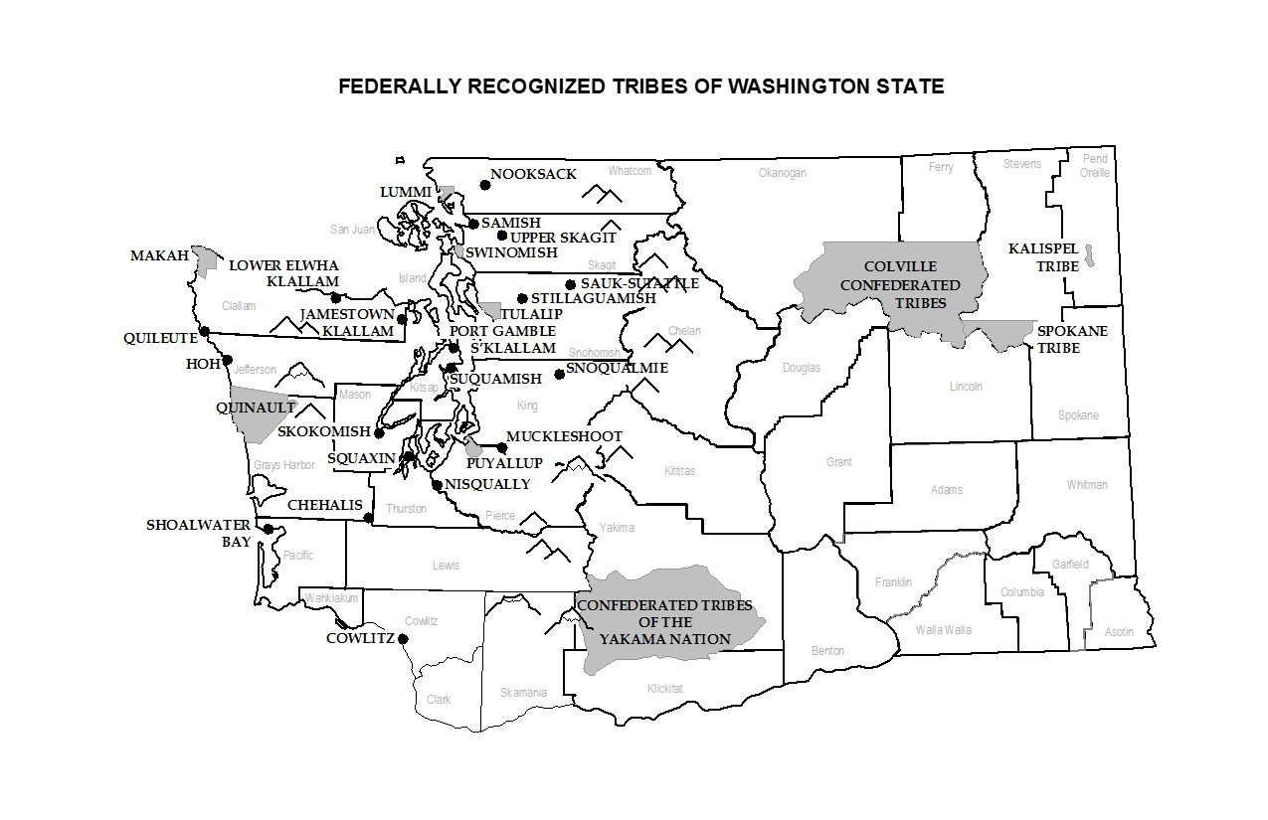
Notes:
2 mins (Peggen)

Slide 22
20 MINUTE
BRAIN BREAK
Notes:
2 mins (Peggen)

Slide 23

Sacred Spaces Lesson
Notes:
15 minutes (P&C)

Slide 24
Connect Head With Heart With Hands For Learning
Head - factual information
Heart - attitude and feelings
Hands - what you do
Notes:
1 min ©

Slide 25
History, despite its wrenching pain, cannot be unlived, but if faced with courage, need not be lived again.
Maya Angelou
President Clinton’s Inauguration
Notes:
30 sec ©

Slide 26
Co-Responsibility
Speaking out for social justice
Moving beyond our narrow self-interests
Embracing community-building and stewardship for others
Sharing in the problem-solving responsibility
Focusing on systemic change
Has social action as its outcome!
Notes:
1 min (P)

Slide 27
Tribal Relationship Building
WSSDA Recommendations
Toolkit
OSPI Directive to School Districts
Tribal Contact Information
Notes:
1 min (P)

Slide 28
Closing
Next Steps/ Share Out/ Commitment
Develop timeline for relationship building with Tribe and School District involvement

Slide 29
Deepening Our Understanding of Tribal Sovereignty
What do we know about
tribal sovereignty?
Think, pair, share

Slide 30
Powers Inherent to Sovereigns
To determine form of government
To make and enforce laws
To define conditions for citizenship in the nation
To regulate domestic and international trade
To impose and collect taxes
To regulate property use
To regulate domestic relations of its members (marriage, divorce, etc.)
To appropriate monies
To establish a monetary system
To make war and peace
To form alliances with other nations through treaties, contracts, or agreements

Slide 31
Right or Privilege
Activity

Slide 32
Sovereignty affects every issue Tribes face, such as…
Language
Education
Environmental Protection
Healthcare
Safety and Security ( including civil and criminal jurisdiction)
Taxation
Economic Development

Slide 33
Essential Questions
1. How does physical geography affect Northwest tribes’ culture, economy, and where they choose to settle and trade?
2. What is the legal status of the tribes who negotiated or who did not enter into United States treaties?
3. What were the political, economic, and cultural forces that led to the treaties?
4. What are the ways in which tribes respond to the threats and outside pressure to extinguish their cultures and independence?
5. What do local tribes do to meet the challenges of reservation life? What do these tribes, as sovereign nations, do to meet the economic and cultural needs of their tribal communities?

Slide 34
Grade Level Goals
Elementary Outcomes
By the time Washington State students leave elementary school, they will:
Understand that over 500 independent tribal nations exist within the United States today, and that they interact with the United States, as well as each other, on a government-to-government basis;
Understand tribal sovereignty is "a way that tribes govern themselves in order to keep and support their ways of life";
Understand that tribal sovereignty predates treaty times;
Understand how the treaties that tribal nations entered into with the United States government limited their sovereignty; and
Identify the names and locations of tribes in their area.
Middle School Outcomes
By the time Washington State students leave middle school, they will understand:
that according to the US Constitution, treaties are "the supreme law of the land" consequently treaty rights supersede most state laws;
that Tribal sovereignty has cultural, political, and economic bases;
that Tribes are subject to federal law and taxes, as well as some state regulations;
that Tribal sovereignty is ever-evolving and therefore levels of sovereignty and status vary from Tribe to Tribe; and
that there were and are frequent and continued threats to Tribal sovereignty that are mostly addressed through the courts.
recognize landmark court decisions and legislation that affected and continue to affect Tribal sovereignty;
understand that Tribal sovereignty protects Tribes' ways of life and the development of their nations;
understand that Tribal, state, and federal agencies often work together toward the same goal;
explain the governmental structure of at least one Tribe in their community; and
distinguish between federally and non-federally recognized Tribes.
High School Outcomes
By the time Washington State students leave high school, they will:

Slide 35

I Can Do That!

Slide 36
STI Tribal Sovereignty Curriculum Structure
Essential Questions
Five Outcomes
Levels 1-2-3
Alignment with ELA CCSS
Curriculum Based Assessments

Slide 37
STI Aligned Required Civics CBAs
4th: Whose Rules?
8th: Constitutional Issues
11th and 12th: Checks and Balances, Constitutional Issues

Slide 38
General Considerations
An understanding of tribal sovereignty is key to understanding many controversial issues involving American Indians.
Tribal sovereignty is best understood in the context of lessons on politics and government.
Concepts related to tribal sovereignty can be introduced as early as preschool.

Slide 39
Navigating the
“Since Time Immemorial” Website
http://www.k12.wa.us/IndianEd/TribalSovereignty/default.aspx
www.indian-ed.org
Network:
Password:

Slide 40
Scavenger Hunt Activity
1. Work individually or in pairs.
2. Write down where you found resources/answers.

Slide 41
Treaties and Treaty Responsibilities
Treaties are formal, negotiated agreements between governments.
Each party takes on certain responsibilities and obligations, which limit the exercise of sovereignty for both parties.

Slide 42
Powers Retained by Tribes
Right to form a government
Right to determine tribal membership
Right to regulate tribal lands
Right to regulate individually owned lands
Right to tax
Right to maintain law and order
Right to regulate conduct of non-members
Right to regulate domestic relations
Right to engage in and regulate commercial activity

Slide 43
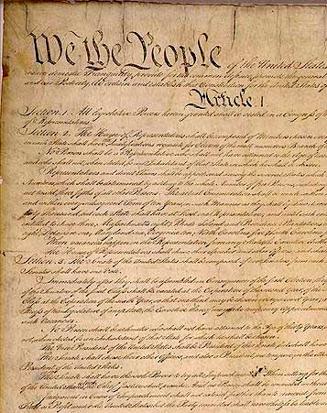
United States Constitution, Article I
Section 8: The congress shall have the Power to lay and collect taxes, Duties, Imposts and Excises, to pay the debts and to provide for the common Defense and general Welfare of the United States; but all Duties, Imposts and Excises, shall be uniform throughout the United States;
To borrow Money on the credit of the United States;
To regulate Commerce with foreign Nations’ and among the several states, and with the Indian Tribes…

Slide 44
United States Constitution, Article VI
“This Constitution, and the laws of the United States which shall be made in pursuance thereof; and all treaties made, or which shall be made, under the authority of the United States, shall be the supreme law of the land; and the judges in every state shall be bound thereby, anything in the Constitution or laws of any State to the contrary notwithstanding.”

Slide 45
Did you know?
February 12, 1974
U.S District Court Judge George Hugo Boldt handed down his decision in United States v. Washington.
Judge Boldt ruled that treaties negotiated between the tribes of the Puget Sound and the United States, remained fully in force, that the tribes were and continue to be sovereign governments with authority to regulate salmon harvesting, and that tribes had the right to harvest 50% of all salmon in the Pacific Northwest.

Slide 46
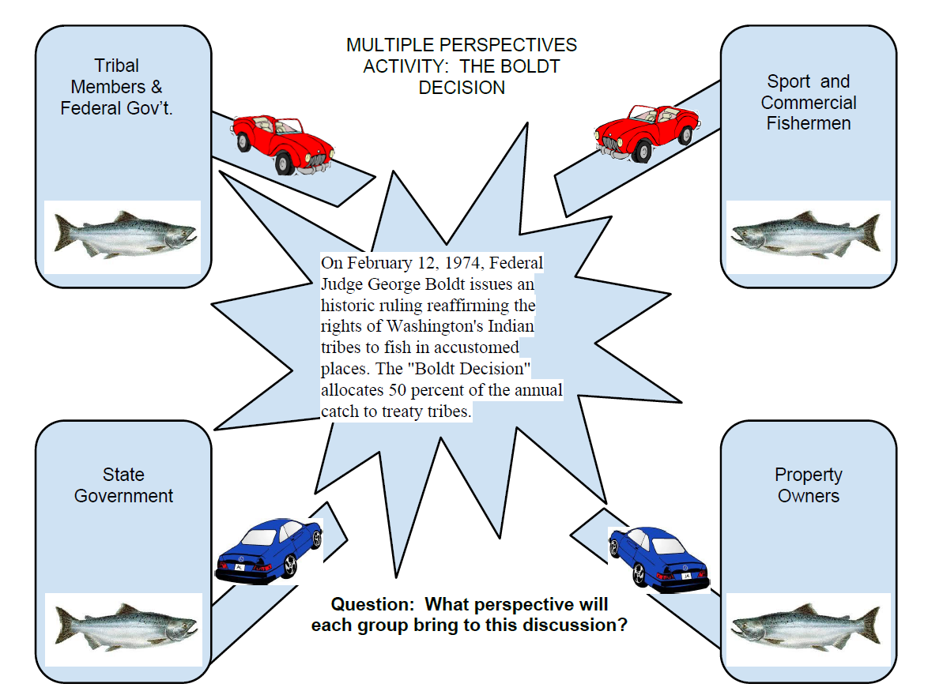
Multiple Perspectives

Slide 47
Boldt Decision Role Play
What concerns will your group have about the Boldt decision?
What perspective will your group bring to the discussion of fairness?
What other issues could be explored using the multiple perspectives approach?

Slide 48
Did you know?
February 12, 1974
U.S District Court Judge George Hugo Boldt handed down his decision in United States v. Washington.
Judge Boldt ruled that treaties negotiated between the tribes of the Puget Sound and the United States, remained fully in force, that the tribes were and continue to be sovereign governments with authority to regulate salmon harvesting, and that tribes had the right to harvest 50% of all salmon in the Pacific Northwest.

Slide 49
Truth is an eternal conversation
about things that matter.
-Parker Palmer

Slide 50
Canons of Treaty Law
Treaties are interpreted as contracts….
If unclear or ambiguous, interpreted by the courts in favor of the Tribes because Tribes have granted privileges to the U.S. government.
Liberally construe the meaning as the Tribes would interpret the treaty.
Interpreted as Tribes interpreted at the time when treaty signed.
-Charles Wilkinson, University of Colorado

Slide 51
Misconceptions of Treaties in Washington State
Initiative 456, approved November 6, 1984
“….No citizen shall be denied equal access to and use of any resource on the basis of race, sex, origin, cultural heritage, or by and through any treaty based upon the same.”
Federal law supersedes state law and thus this state law is illegal.

Slide 52
Retroactively Asserting Tribal Sovereignty
SHB 2080 (2014)
Vacating Convictions for Certain Tribal Fishing Activities
Every person convicted prior to January 1, 1975, of violating any statute or rule regarding the regulation of fishing activities…who claimed to be exercising a treaty Indian fishing right, may apply to the sentencing court for vacation of the applicant’s record of the misdemeanor, gross misdemeanor, or felony conviction for the offense. If the person is deceased, a member of the person’s family or an official representative of the tribe of which the person was a member may apply to the court on behalf of the deceased person.

Slide 53
Lesson Planning
Planning considerations….
  Integration into existing curriculum.
  Common Core State Standard alignment.
  Connection to the Local Tribe(s).
  STI Guiding Principles.
  Curriculum-Based Assessment.
  Additional resources.

Slide 54
“Repatriating Ourselves”

Slide 55
Since Time Immemorial
BINGO
Sign your name in the center square.
Sign only one square for another person.
Learn as you go.
Going for a blackout, but call out when you have a BINGO in any direction.

Slide 56
Since Time Immemorial
BINGO
What?
So what?
Now what?

Slide 57
Closing
Next Steps/ Share Out/ Commitment
Evaluations

Slide 58
Thank you for your creativity and commitment!
Special thanks to OSPI Office of Native Education and all of those who came before us.
Please stay in touch:
Crystal Florez, MPA (Ojibwe)
crflorez@uw.edu
Peggen Frank, MPA
(Lakota/Arapaho)
pfrank@salmondefense.org

