Slide 1
The Formative Assessment Process
Dr. Belinda Louie
Karlyn Davis-Welton, M Ed
Fall Institute 2016

Slide 2
Project Goal
Smarter Balanced Digital Library and Formative Assessment:
To increase the subject matter knowledge and standards-based
teaching skills.

Slide 3
Learning Goals
Participants will…
Evaluate selected resources and discuss its application.
Gain a better understanding of the formative assessment process and how it relates to our instructional practices and assessments.

Slide 4
Success Criteria
Participants can…
Identify the 4 attributes of the formative assessment process.
Evaluate and determine each individual part of the formative assessment process.

Slide 5
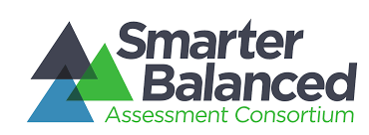

Slide 6
Digital Library
Online collection of high-quality instructional and professional learning resources contributed by educators for educators.
Resources are aligned with the intent of the Common Core State Standards and help educators implement the formative assessment process to improve teaching and learning.
Incorporates collaboration features to provide educators opportunities to comment on and rate resources and share their expertise with colleagues across the country in online discussion forums

Slide 7
Formative Assessment Process
Deliberate process used by teachers and students during instruction
Provides actionable feedback that is used to adjust ongoing teaching & learning strategies to improve students’ attainment of curricular learning targets/goals.

Slide 9
Clarify Intended Learning
Helps students and teachers understand the expectations and goals for their work together.
Learning targets focus on what students will learn, not on what they will do.
Success criteria are observable and measurable behaviors that let both teacher and student know whether a learning target has been reached (e.g., rubrics and modeling what an exemplar might look like).

Slide 11
Elicit Evidence
Interactions with students by using …
Appropriate questioning strategies
Focused observations of students
Looking at student work and analyzing it.

Slide 13
Interpret Evidence
Once evidence is elicited, it must be interpreted to determine where students are in relation to the learning target and success criteria.

Slide 15
Act on Evidence
Based on the interpretation of the evidence, feedback should be provided to students or adjustments to instruction can be made to keep learning on track.
Adjustments to instruction may include providing mini-tutorials for some students, planning flexible student group work, or other instructional modifications based on evidence.

Slide 17
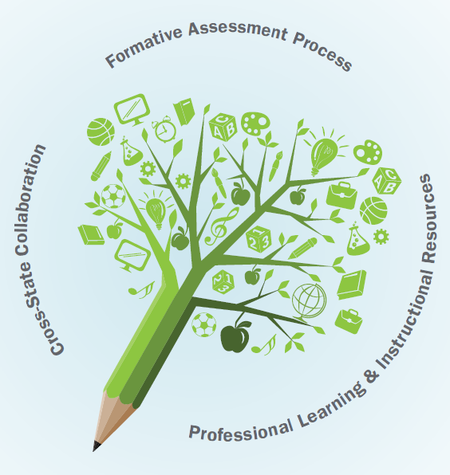
How do we define formative assessments?

Slide 19
Formative assessment is defined as assessment carried out during the instructional process for the purpose of improving teaching or learning. (Shepherd, et al., 2005, p.75)

Slide 20
An assessment activity can help learning if it provides information to be used as feedback by teachers, and by their pupils in assessing themselves and each other, to modify the teaching and learning activities in which they are engaged. Such assessment becomes ‘formative assessment’ when the evidence is actually used to adapt teaching work to meet learning needs (Black, Harrison, Lee, Marshall, & Wiliam, 2003, p.2).

Slide 21
Video: Embeds 4 Attributes
This module features live action footage from a high school classroom at Mount Pleasant Community High School in Mount Pleasant, Iowa. The teacher, April Pforts, uses real-world examples of congruent figures to engage students in identifying how congruent figures are everywhere and the importance they have in shaping the world.

Slide 22
An example of the 4 Attributes
Video: “Congruence: Clarify Intended Learning”
https://www.smarterbalancedlibrary.org/content/geometry-congruence-clarify-intended-learning

Slide 23
Formative Assessment Process Attributes
Let’s review
Video: Understanding the Formative Assessment Process
From Digital Library
https://www.smarterbalancedlibrary.org/content/understanding-formative-assessment-process

Slide 25
Web Links & Resources
https://www.teachingchannel.org/blog/2015/01/30/formative-assessment-practices-sbac/
https://www.smarterbalanced.org/wp-content/uploads/2015/09/Formative-Assessment-Process.pdf

