Slide 1
Module 6b Culturally Responsive Questioning Strategies
Belinda Louie, PhD, PI
Professor of Education, UWT
Project Core/Time/Digital
October 20-22, 2016

Slide 2
Project Goals: Goal 1.1b Improve teachers’ standard-based teaching skills by (i) Using research-based instructional strategies, (v) Differentiating instructional strategies for students with special needs and ELLs at different English proficiency levels, (vii) Connecting with students’ cultural and community assets. Session Goals: Improve teachers’ standard-based teaching skills by (1) Using questioning, a research-based instructional strategy, (2) Differentiating instruction for special education and EL students, (3) Utilizing students’ Funds of Knowledge to connect with students’ cultural and community assets. (4) Bridging opportunity gap for students of color, ELLs, students in poverty, and special education students.

Slide 3
Oh, don’t worry; we wouldn’t dare say that we are as wonderful as these other people who tell you how important they are! But they are only comparing themselves with each other, using themselves as the standard of measurement. How ignorant! II Corinthians 10: 12

Slide 4
- Patterns of language use in any community are in accord with and mutually reinforce other cultural patterns and ways of social interaction. - Factors involved in preparing children for school-oriented, mainstream success are deeper than differences in formal structures of language. Shirley Brice Heath (1983), Ways with Words

Slide 5
Ways with Words
Language use in community
Ways of social interaction
Interactions between oral and written language

Slide 6
The purpose of this presentation is to help educators understand children’s ways with words and to support educators to bring these cultural ways with words into classrooms.

Slide 8
“Roadville” and “Trackton”
Roadville and Trackton are two communities that are located only a few miles apart in the Piedmont Carolinas. Both communities are closely tied to the textile mills which employ members of both communities.

Slide 9
“Roadville” Roadville is a white working-class community of families steeped for generations in the life of the textile mills.

Slide 10
“Trackton” is a black working-class community whose older generations grew up farming the land but whose current members work in the textile mills.

Slide 11
The Children of Roadville and Trackton
Roadville Children
Trackton Children

Slide 12
“The Townspeople” The Townspeople are the ‘mainstream’ blacks and whites who hold power in the school and workplaces of the region. The children of Roadville and Trackton go to school in town.

Slide 13
In groups of 3, analyze the questioning patterns of Roadville and Trackton. Compare their questioning patterns with that of the mainstreamed townspeople, who ask who, what, when, where, why, and how questions at home and at school.

Slide 14
Questioning in Trackton

Slide 15
Questioning in Roadville

Slide 17
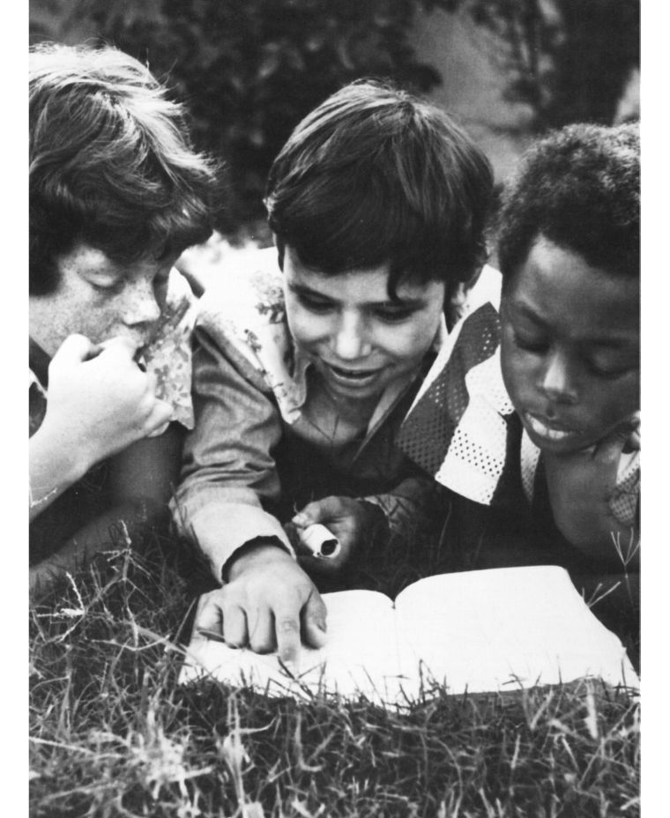
Warm Spring Indians (Philips 1983)

Slide 18
Warm Spring Indian Children - At home, children learn by engaging in long periods of observation, silent listening and watching. (vs. elaborate verbal instructions) - Children then participate in small tasks under adult supervision - Children then take it upon themselves to test the skill unsupervised and alone, without other people around. (vs. learning through public mistakes as in class discussion) - Many adults assume the responsibilities for care and instruction of children. Children thus become accustomed to interacting with and following the instructions and orders of many people (vs. teacher)

Slide 19
In groups of 3, analyze the questioning patterns of the Warm Spring Indians. Compare their questioning patterns with that of the mainstreamed townspeople, who ask who, what, when, where, why, and how questions at home and at school.

Slide 20
Asian Students

Slide 21
Beckman-Brito 2003: For Asian Students - Asking questions in class was considered impolite and disrespectful. Therefore, they rarely ask questions during class time. . - Asking questions for clarification may indicate to the teacher that the student believes the teacher is at fault and has not taught well. - Asking questions is also a poor reflection on the students. They do not want to appear ignorant. -Questioning is not considered as a way of learning. “Listening to teacher” is the mode of learning (Liu & Littlewood, 1997)
Notes:
CLASSROOM ETIQUETTE: A CROSS-CULTURAL STUDY OF CLASSROOM BEHAVIORS Kristina Beckman-Brito (2003). Arizona Working Papers in SLAT

Slide 22
In groups of 3, analyze the questioning patterns of Asian students. Compare their questioning patterns with that of the mainstreamed townspeople, who ask who, what, when, where, why, and how questions at home and at school.

Slide 23
Questioning as a Speech Act A speech act is an utterance that serves a function in communication. “The level of speech acts mediates immediately between the usual levels of grammar and the rest of a speech event or situation in that it implicates both linguistic form and social norms,” Dell Hymes (1974)

Slide 24
Culturally Responsive Questioning Strategies 1. Create a situation that students have to ask questions. 2. Provide a persona for students to ask questions. 3. Give students authority/permission to ask questions. 4. Encourage students to ask a wide genres of questions beyond their comfort zone.

Slide 25
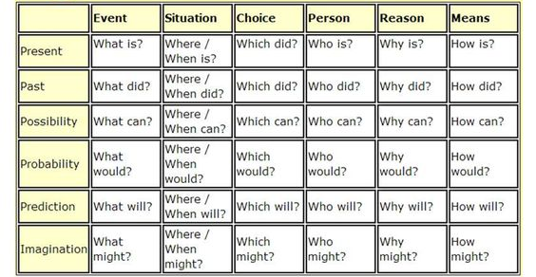

Slide 26
Instructional steps:
Teach students different questioning types.
Give students the reasons and the authority to ask questions.
Put students in roles that need to ask questions.

Slide 27
Birthday Surprises: Ten Stories to Unwrap collected by Johanna Hurwitz
At Hurwitz's invitation 10 well-known children's authors have written pieces based on a single premise: a young person finds an empty box among his or her birthday gifts.

Slide 28
Evening news
Reporter
What
When
Where
Why
How
What if
Giver
?
?
Recipient
?
?
?
?
?
?

Slide 31
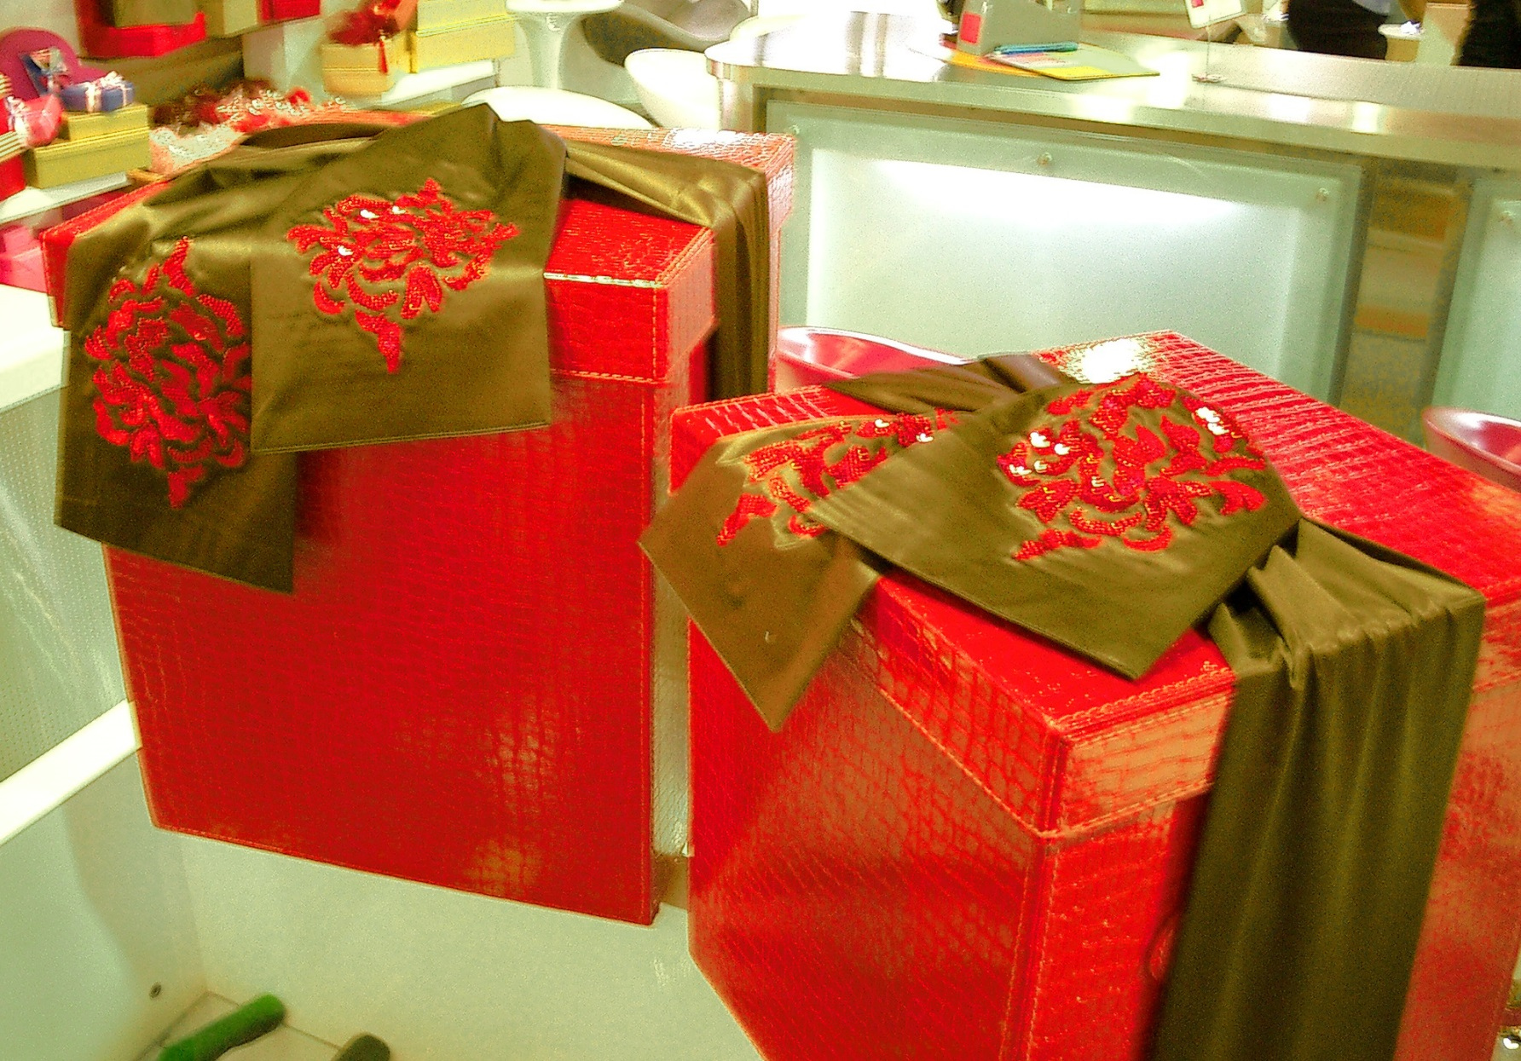

Slide 32
