Slide 1
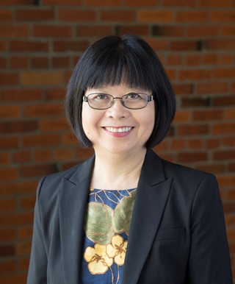
Module 6a Funds of Knowledge
Belinda Louie, PhD, PI
Professor of Education, UWT
Project Core/Time/Digital
October 20-22, 2016

Slide 2
Project Goals: Goal 1.1b Improve teachers’ standard-based teaching skills by (v) Differentiating instructional strategies for students with special needs and ELLs at different English proficiency levels, (vii) Connecting with students’ cultural and community assets. Session Goals: Improve teachers’ standard-based teaching skills by (1) Differentiating instruction for special education and EL students, (2) Utilizing students’ Funds of Knowledge to connect with students’ cultural and community assets. (3) Bridging opportunity gap for students of color, ELLs, students in poverty, and special education students.

Slide 3
Funds of knowledge are cultural practices and experiences that students have accumulated in their households with siblings, peers, friends, parents, and communities. The knowledge is not only valuable to students’ lives, but can assist teachers to make relevant and meaningful connections to classroom curriculum.
Notes:
“Tapping into the Funds of Knowledge of Culturallay and Linguistically Diverse Students and Families” (2011) Amaro-Jimenez and Semingson. NABE News.

Slide 4
Some Research Highlights
González, Moll, & Amanti. (2005).
Families have abundant knowledge that programs can learn and use in their family engagement efforts.
Students bring with them funds of knowledge from their homes and communities that can be used for concept and skill development.
Classroom practices sometimes underestimate and constrain what children are able to display intellectually.
Teachers should focus on helping students find meaning in activities, rather than learn rules and facts.
Group discussions around race and class should promote trust and encourage dialogue.

Slide 5
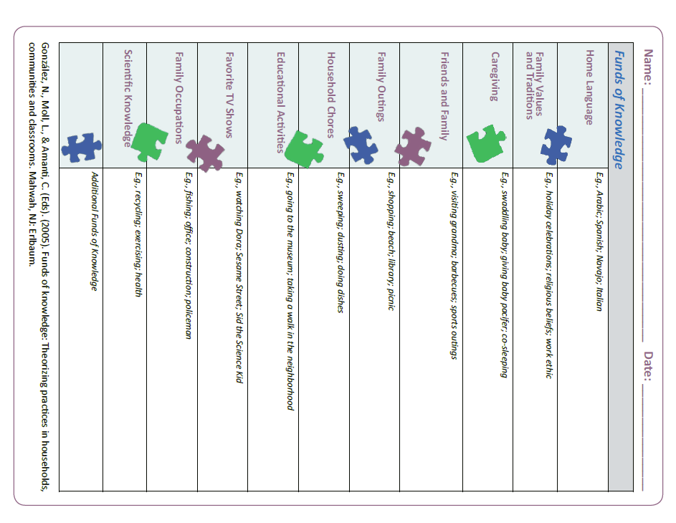

Slide 8
“Using Students’ Lived Experiences in an Urban Science Classroom: An Elementary School Teacher’s Thinking” by Bhaskar Rajupadhyay. (2005) - Application of scientific concepts in students’ lives “Bridging Funds of Distributed Knowledge: Creating Zones of Practices in Mathematics.” Andrade, Civil, & Moll (2009) - Math events in students’ lives

Slide 9
FAMILY LITERACY PROJECT: Bilingual Picture Books by English Learners. Louie & Davis-Welton. (2015)

Slide 10
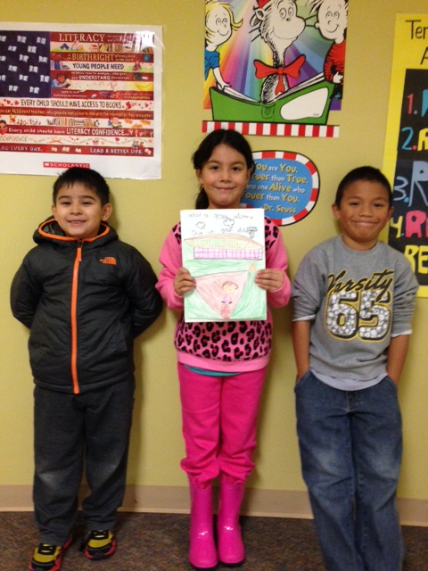
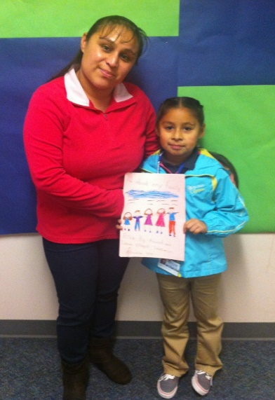
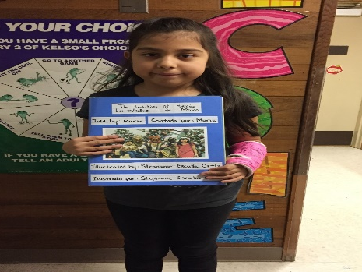
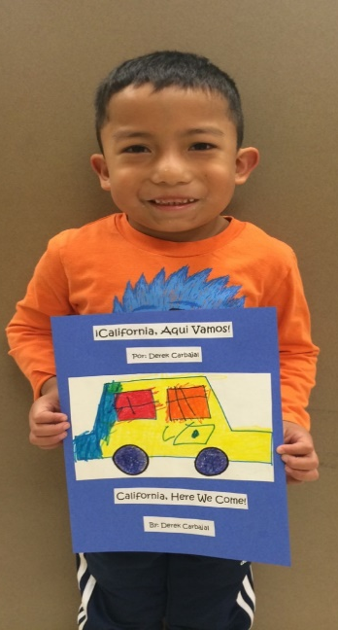
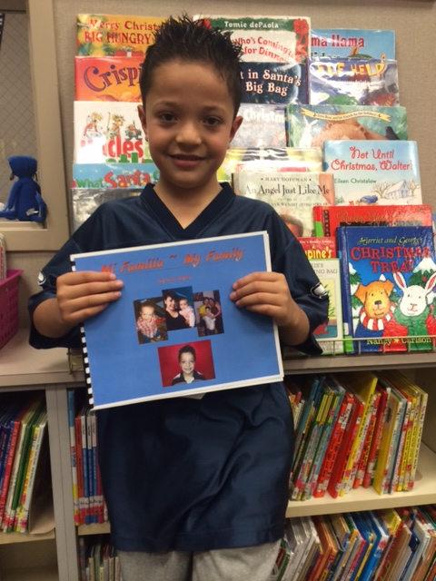

Slide 11
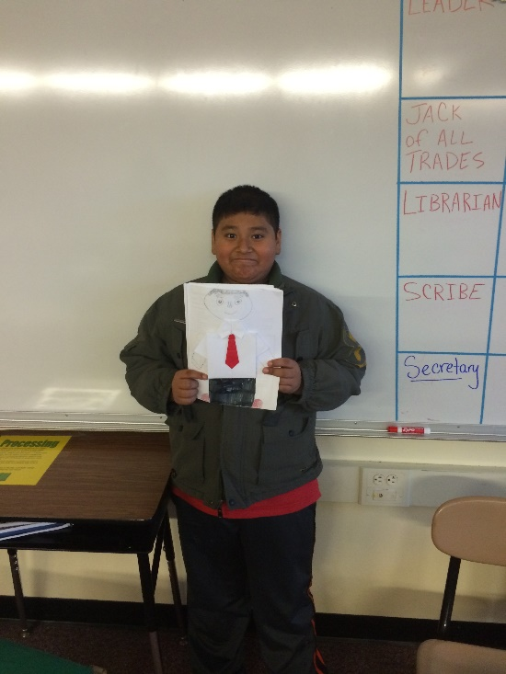
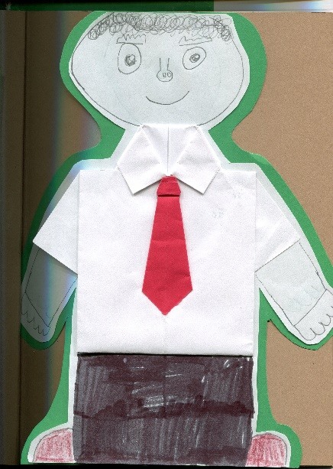

Slide 13
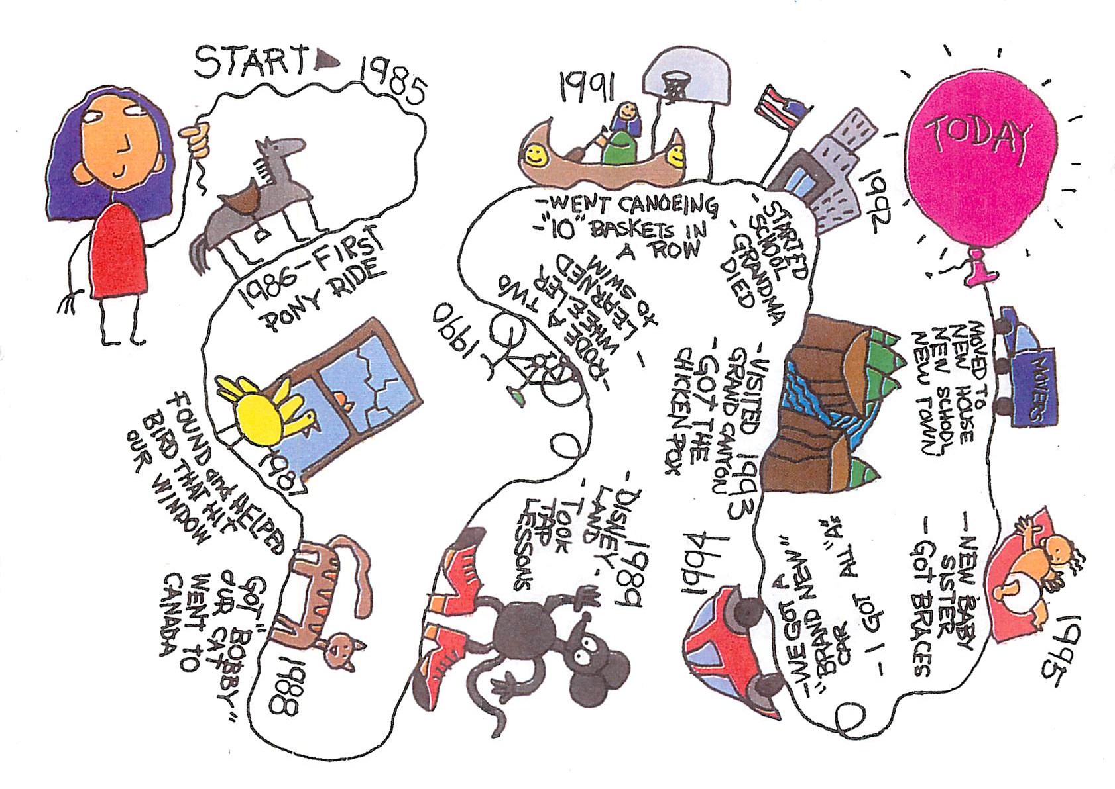

Slide 14
Are you ready to draw personal life line?

