Slide 1
ELA CCSS (ELA sec.)
WASHINGTON STATE 21st Century Grant
Project Core/Time/Digital
October 21, 2016
Riki Thompson, PhD
rikitiki@uw.edu
University of Washington Tacoma

Slide 2
Project Goals
Increase subject matter knowledge and standards-based teaching skills of CCSS in ELA
Increase subject matter knowledge and standards-based teaching skills for Smarter Balanced Digital Library
Practice integrating formative assessment into lesson plan construction
Identify ways to differentiate instruction and address opportunity gaps

Slide 3
Session goals
Work closely with Common Core Standards for ELA
Collaboratively build a lesson plan for Writing in History/Social Studies
Develop metacognitive lesson planning skills
Develop formative assessment tools for writing
Practice using the Smarter Balanced Digital Library

Slide 4
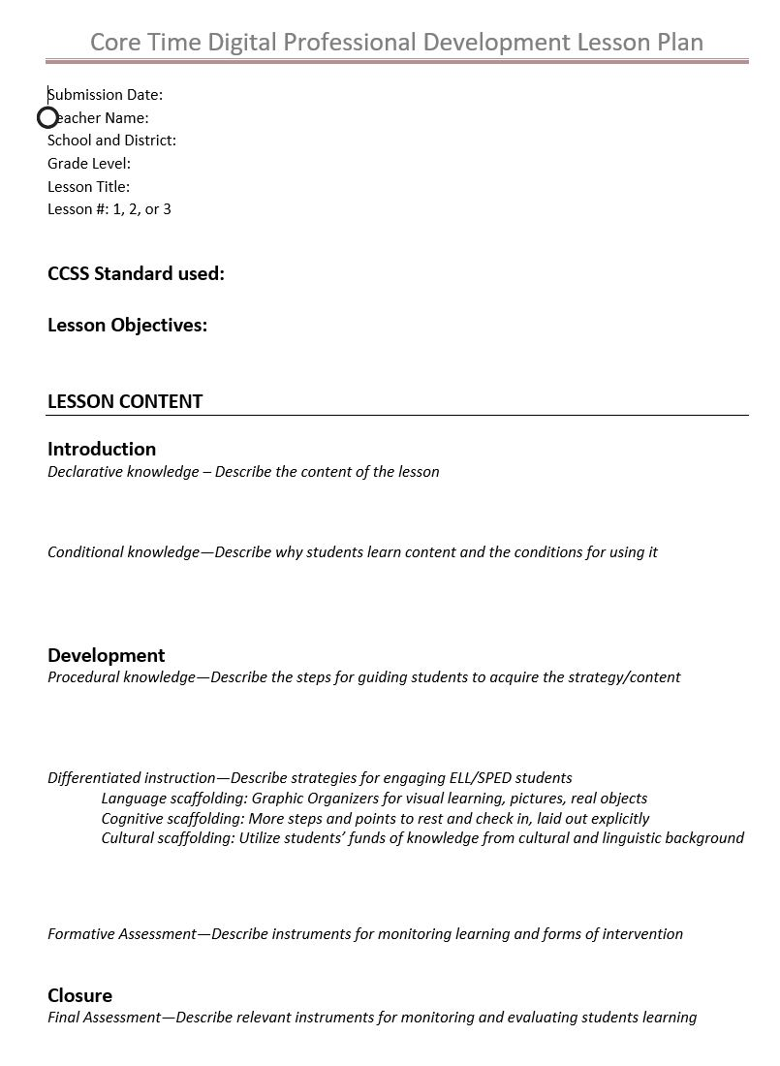
Foundations for learning
Metacognitive Lesson Planning
Assessment Strategies

Slide 5
Strengthening Writing in the Disciplines
Using the skeleton lesson plan on writing about the civil war to
Brainstorm activities that will help students to learn to integrate content according to the standards.
Develop activities to foster a writing process that encourages drafting, feedback, revision, and editing.

Slide 6
Foundations

Slide 7
Lesson Objectives
Students will be able to make a formal argument that recognizes multiple perspectives while also taking a position on whether to go to war. Successful arguments will use evidence to support claims and show attention to audience and counter-arguments, and use a draft process that includes feedback and revision to improve writing.
What CCSS would be applicable?
What strands apply?

Slide 8
Writing for History/Social Studies
What standards apply?

Slide 9
Writing Process
What standards apply?

Slide 10
Applying CCSS

Slide 11
Foundations for learning
Metacognitive Lesson Planning
Assessment Strategies

Slide 12
Metacognitive Lesson Planning
Declarative knowledge
Conditional knowledge
Procedural knowledge
Differentiation

Slide 13
Declarative knowledge
What → Describe the content of the lesson
This assignment teaches students how to write an argument essay…
An argument is….
An argument must have these main elements…

Slide 14
Declarative knowledge
This assignment teaches students how to write an argument essay using examples from a social studies lesson on the civil war. An argument is a reason or set of reasons given with the aim of persuading others that an action or idea is right or wrong. An argument must have three main elements: a position, evidence to support one’s position, and concessions to opposing viewpoints. According to the philosopher Aristotle, when people make arguments (in spoken or written form), they rely on ethos (persona), pathos (emotional appeals), and logos (logic) to persuade their audience.
An argument in history…

Slide 15
Conditional knowledge
Why/When → Why students learn content & conditions for use
We use arguments to…
Arguments are especially useful when…
We also use arguments to…

Slide 16
Conditional knowledge
We use arguments to express opinions, support a cause, and persuade others to agree with us. Arguments are especially useful when we want to try and convince others to make a change or take a stand. We also use arguments to examine multiple sides of a topic, anticipate questions, and prove something/someone wrong. Arguments can also be used to stir up sympathy for a cause or get people interested in a topic.
We use arguments in social studies…

Slide 17
Procedural knowledge
How→ Describe the steps for guiding students to acquire the strategy/content
First we will brainstorm, etc.
Next, we will…
Then we will check in…
Next, we will…
Finally, we will…

Slide 18
Procedural knowledge
First we will brainstorm and freewrite to…
Next, we will begin to draft our arguments so that..
Then we will check in with fellow writers to…
Next, we will consider feedback and make revisions…
After revising, we will share our work again to…
Finally, we will edit and publish…

Slide 19
Differentiated instruction
Options→Describe strategies for engaging ELL/Special Ed students
Language scaffolding: Graphic Organizers for visual learning, pictures, real objects
Cognitive scaffolding: More steps and points to rest and check in, laid out explicitly
Cultural scaffolding: Utilize students’ funds of knowledge from cultural and linguistic background

Slide 20
Differentiated instruction
For ELL students, I will use…
For Special Education students, I will….
To address opportunity gaps and create cultural scaffolding, I will…
After learning about STI, I will integrate…

Slide 21
Metacognitive Lesson Planning
What Declarative knowledge – Describe the content of the lesson
Why/When Conditional knowledge—Describe why students learn content & conditions for use
How Procedural knowledge—Describe the steps for guiding students to acquire the strategy/content
Options Differentiated instruction—Describe strategies for engaging ELL/SPED students

Slide 22
Foundations for learning
Metacognitive Lesson Planning
Assessment Strategies

Slide 23
Assessment Strategies

Slide 24
Formative Assessment
IDEA card
Graphic organizers
Outlines
Exit slips
Drafts

Slide 25
Formative Assessment
Describe instruments for monitoring and what you hope that teachers and students will gain from this tool

Slide 26
Summative Assessment
Types of evidence used in summative assessments include:
Instruments for evaluating student learning
Essay
Report
Problem Sets
Presentations
Graphic Organizers
Performance task
SBAC interim assessment
Rubrics
Performance assessment

Slide 27
Summative Assessment
Describe instruments for assessing and why the tool(s) is the effective.

Slide 28
Using the Digital Library
In small groups, go into the Digital Library and pick an ELA lesson plan to work with.
Apply your understanding of lesson plan construction and revise the lesson to fit our template.
You can download an electronic copy of the template from Dropbox at: UWT Team Instructor’s Materials>Riki
Identify missing components and integrate these into your lesson plan.
Compare what you found with your neighbors.
Post your lesson plans in Dropbox.
Foundational
CCSS standards
Lesson Objectives
Metacognitive
Declarative knowledge
Conditional knowledge
Procedural knowledge
Differentiation
Assessment
Formative
Summative

Slide 29
Before we exit…
Pick the prompt that most resonates with you about this session
I would like to learn more about…
Please explain more about…
The most important thing I learned today is…
The thing that surprised me the most today was…

