Slide 1
Lesson Plan Construction (K-12)
WASHINGTON STATE 21st Century Grant
Project Core/Time/Digital
October 2016
Riki Thompson, PhD
rikitiki@uw.edu
University of Washington Tacoma

Slide 2
Goals
Understand how to use and train teachers to use metacognitive lesson planning
Understand formative and summative assessment
Understand the key components of formative assessment that are integral to Smarter Balanced Assessment System
Introduce Smarter Balanced Digital Library for lesson plan development

Slide 3
Task
We are taking a metacognitive approach to take trainers through lesson plan development.
As we examine sample lesson plans and create new ones,
We will focus on the what, how, why and when, as well as alternatives and options for teaching.
Lesson plans will prompt teachers to explain their lesson plans in terms of these four categories, demonstrating their knowledge and providing an explicit roadmap for students and other teachers.
Notes:
An especially effective way to assess knowledge and learning is to ask students to reflect on their knowledge, explicitly and intentionally. The use of metacognitive reflection can be extremely helpful in gauging what students understand and how deeply. For the Core Time Digital institute, we are taking a metacognitive approach to take trainers through lesson plan development. As we examine sample lesson plans and create new ones, we will focus on the what, how, why and when, as well as alternatives and options for teaching. Lesson plans will prompt teachers to explain their lesson plans in terms of these four categories, demonstrating their knowledge and providing an explicit roadmap for students and other teachers.

Slide 4
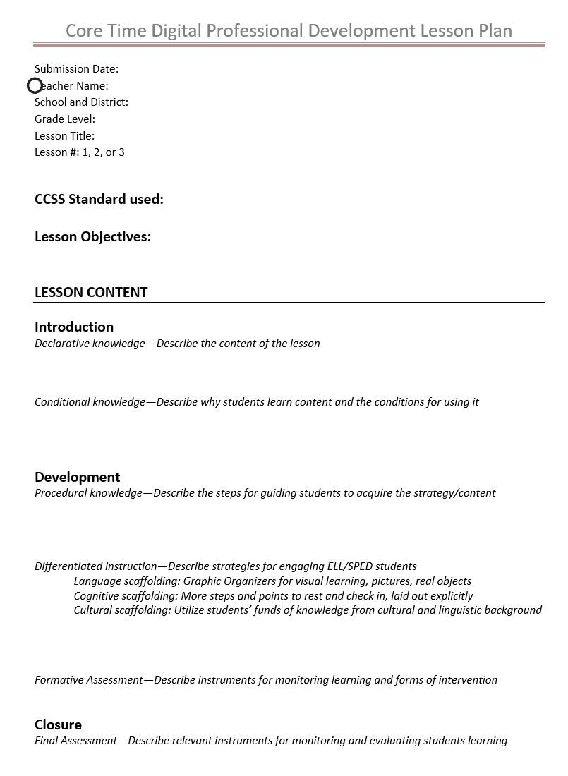
Foundations for learning
Metacognitive Lesson Planning
Assessment Strategies

Slide 5
Foundations

Slide 6
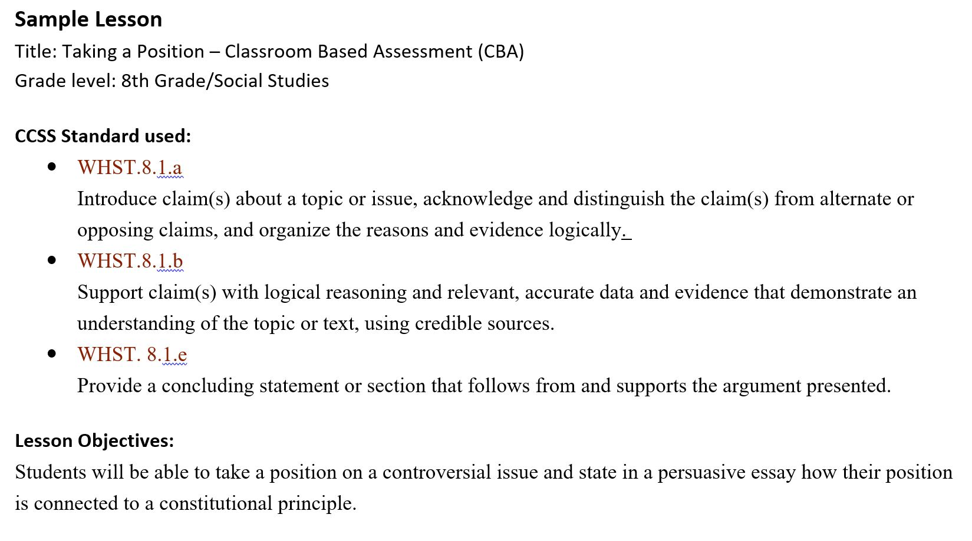

Slide 7
Metacognition
Thinking about thinking
Reflecting on one’s knowledge and process improves learning

Slide 8
Metacognitive Lesson Planning
Declarative knowledge
Conditional knowledge
Procedural knowledge
Differentiation

Slide 9
Declarative knowledge
What → Describe the content of the lesson
This assignment teaches students how to write an argument essay…
An argument is….
An argument must have these main elements…

Slide 10
Conditional knowledge
Why/When → Why students learn content & conditions for use
We use arguments to…
Arguments are especially useful when…
We also use arguments to…

Slide 11
Procedural knowledge
How→ Describe the steps for guiding students to acquire the strategy/content
First we will brainstorm, etc.
Next, we will…
Then we will check in…
Next, we will…
Finally, we will…

Slide 12
Differentiated instruction
Options→Describe strategies for engaging ELL/Special Ed students
Language scaffolding: Graphic Organizers for visual learning, pictures, real objects
Cognitive scaffolding: More steps and points to rest and check in, laid out explicitly
Cultural scaffolding: Utilize students’ funds of knowledge from cultural and linguistic background

Slide 13
Metacognitive Lesson Planning
What Declarative knowledge – Describe the content of the lesson
Why/When Conditional knowledge—Describe why students learn content & conditions for use
How Procedural knowledge—Describe the steps for guiding students to acquire the strategy/content
Options Differentiated instruction—Describe strategies for engaging ELL/SPED students

Slide 14
Foundations for learning
Metacognitive Lesson Planning
Assessment Strategies

Slide 15
Assessment Strategies: Formative and Summative
Instruments for monitoring and evaluating learning

Slide 16
Formative Assessment
Monitor student learning & provide ongoing feedback
used by instructors to improve their teaching
recognize where students are struggling and address problems immediately
used by students to improve their learning
identify strengths and weaknesses and target areas that need work

Slide 17
Tips for Formative Assessment
low stakes= low or no point value
Examples
Concept maps to represent understanding of a topic
One or two sentences identifying the main point of a story
A rough draft for early feedback

Slide 18
Check in
What is formative assessment?

Slide 19
Understanding the Formative Assessment Process Smarter Balanced Assessment Consortium

Slide 20
Step 1. Clarifying Intended Learning
The teacher identifies the instructional goal, communicates the goal to students, and provides the criteria by which learning will be assessed so each student and the teacher knows whether the student is successfully progressing toward the goal.
Define learning goals clearly using student-friendly language as such “I can …”.

Slide 21
Step 2. Eliciting Evidence
After a period of instruction, the teacher checks for students’ understanding.
This could be the first draft of an essay, a ticket out the door, an answer to a question on a white board, pair-and-share observations, or a paragraph on how to solve a mathematics problem.

Slide 22
Step 3. Interpreting the Evidence
The teacher and each student interpret the evidence and reflect on the student’s progress toward the learning goal.
Evidence is interpreted throughout instruction, checking in throughout the process. Students can also analyze evidence of their own learning, but also benefit from discussing interpretations with others.

Slide 23
Step 4. Acting on Evidence
The teacher makes adjustments to the ongoing instructional activities, while students also adjust their procedures for learning.
The teacher and students continue to use strategies that work and eliminate strategies that are not effective

Slide 24
Check in
What is are the four components of formative assessment?

Slide 25
Self-Assessment

Slide 26
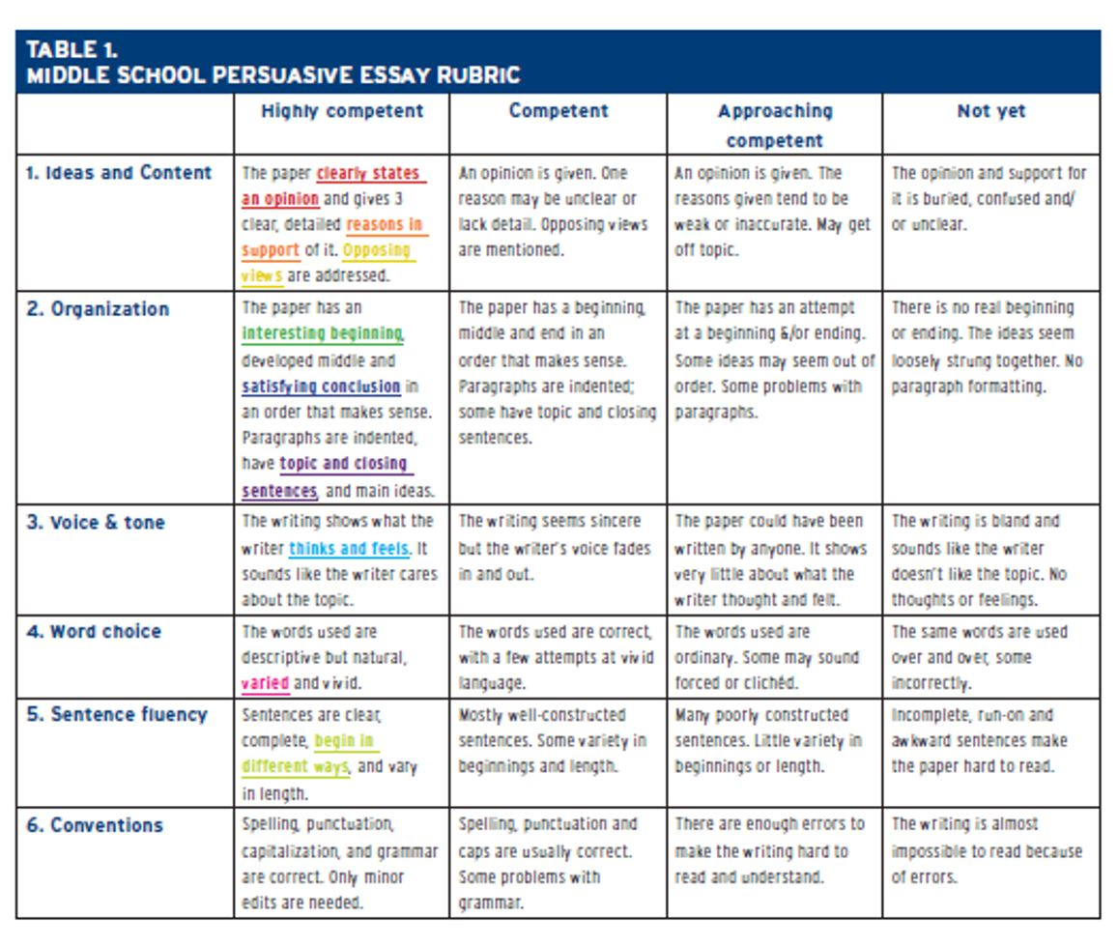
Smarter Balanced Digital Library
A Colorful Writing Self-Assessment | Author: Georgia Brooke, Heidi Andrade Ed.D.
Owner: A Jobs for the Future Project: Students at the Center

Slide 27
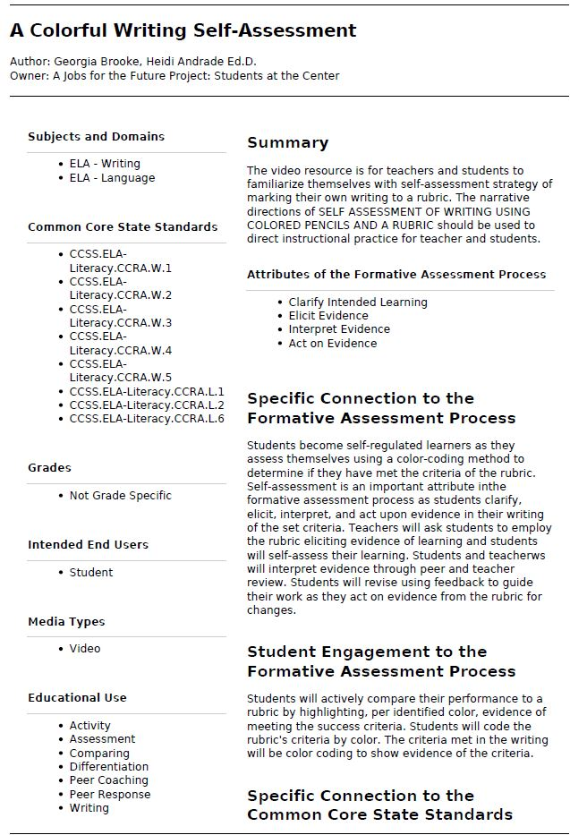

Slide 28
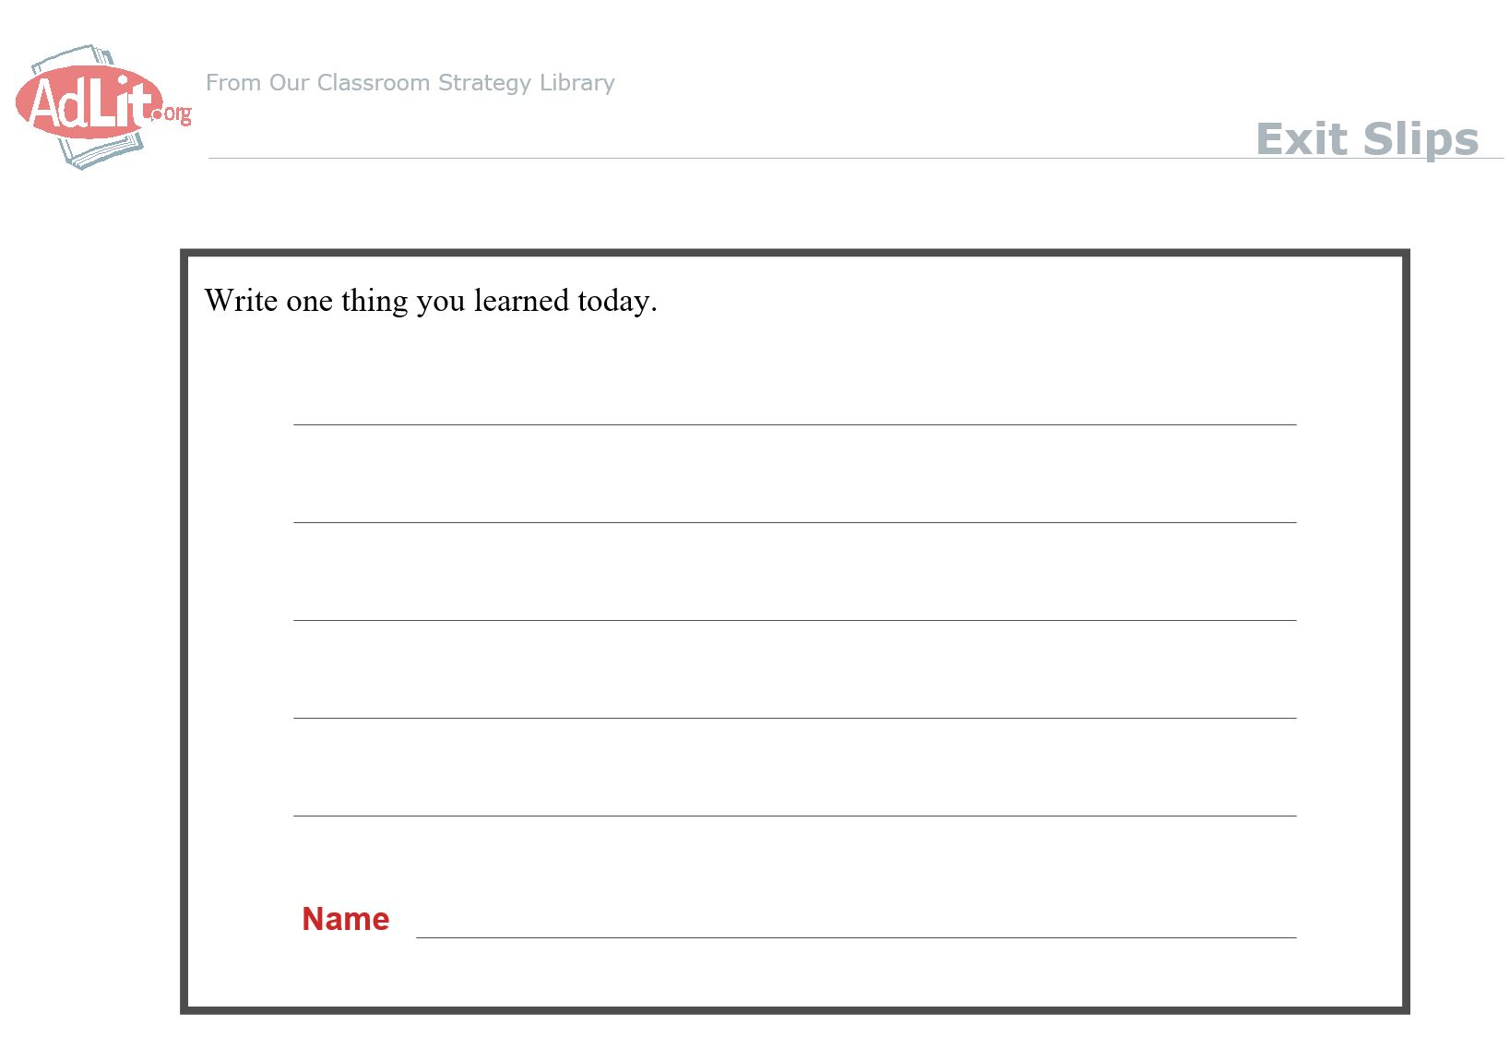
Exit Slips
Exit Slips help students reflect on what they have learned and express what or how they are thinking about the new information.
Exit Slips easily incorporate writing into your content area classroom and require students to think critically.
(AdLit.org, http://www.adlit.org/strategies/19805/)

Slide 29
Tips for Exit Slips
Types of prompts
Other exit prompts include
Document learning
Ex. Write one thing you learned today.
Ex. Discuss how today's lesson could be used in the real world.
Emphasize the process of learning
Ex. I didn't understand…
Ex. Write one question you have about today's lesson.
Evaluate the effectiveness of instruction
Ex. Did you enjoy working in small groups today?
I would like to learn more about…
Please explain more about…
The most important thing I learned today is…
The thing that surprised me the most today was…
I wish…
Fisher, D., and Frey, N. (2004). Improving Adolescent Literacy: Strategies at Work. New Jersey: Pearson Prentice Hall.

Slide 30
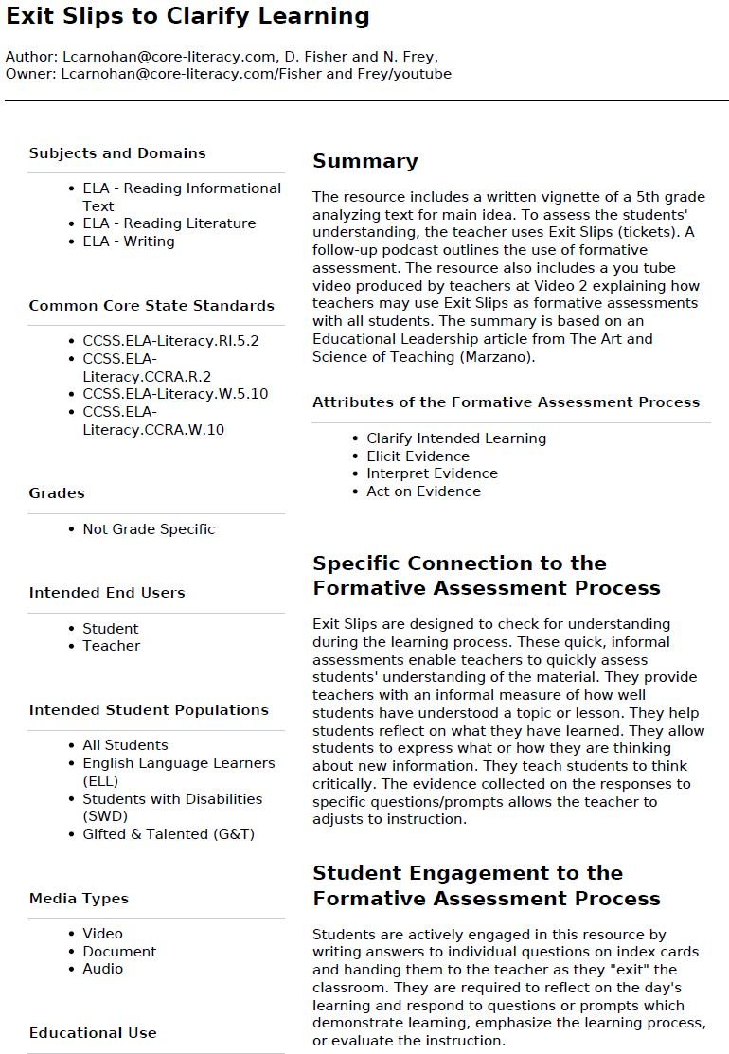

Slide 31
Check in
What are some of your formative assessment strategies?

Slide 32
Final Assessment
Types of evidence used in summative assessments include:
Instruments for evaluating student learning
Essay
Report
Problem Sets
Presentations
Graphic Organizers
Performance task
SBAC interim assessment
Rubrics
Performance assessment

Slide 33
Lesson Plan Analysis
Pick a lesson plan to analyze (ELA, Math, Science)
Apply your understanding of lesson plan construction to a sample lesson plan
Identify components from our lesson plan template & take notes on the sample
Compare what you found with your neighbors
Foundational
CCSS standards
Lesson Objectives
Metacognitive
Declarative knowledge
Conditional knowledge
Procedural knowledge
Differentiation
Assessment
Formative
Summative

Slide 34
Before we exit…
Pick the prompt that most resonates with you about this session
I would like to learn more about…
Please explain more about…
The most important thing I learned today is…
The thing that surprised me the most today was…

