Slide 1
Strengthening CCSS Content Knowledge & Instructional Strategies Implementing the 4-step Formative Assessment Process Using Place value and Decimals (K-5)
Dr. Mei Zhu
Pacific Lutheran University
zhuma@plu.edu
WASHINGTON STATE
21st Century Grant
Project Core/Time/Digital
October 2016

Slide 2
LEARNING TARGETS
Participants will…
Strength CCSS math content knowledge in place value and decimals.
Discuss instructional strategies and learn the 4-step formative assessment process:
(1) Clarify intended learning;
(2) Elicit evidence;
(3) Interpret evidence; and
(4) Act on evidence.
Notes:
1 min

Slide 3
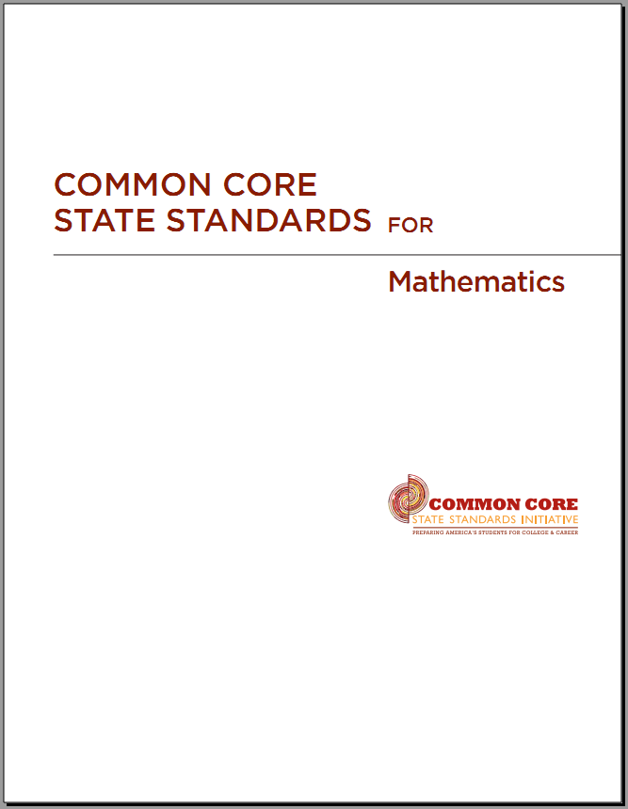
The 3 Shifts in CCSSM-Math
Focus strongly where the standards focus
Coherence: Think across grades and link to major topics within grades
Rigor: In major topics, pursue with equal intensity:
Conceptual understanding
Procedural skill and fluency
Application

Slide 4
Mathematical Practices 1. Make sense of problems and persevere in solving them 2. Reason abstractly and quantitatively 3. Construct viable arguments and critique the reasoning of others 4. Model with mathematics 5. Use appropriate tools strategically 6. Attend to precision 7. Look for and make use of structure 8. Look for and express regularity in repeated reasoning | Core Ideas K-5 Counting & Cardinality (K) Operations & Algebraic Thinking Number & Operations Fractions (3) Measurement & Data Geometry 6-8 Ratios & Proportional Relationships Number System Expressions & Equations Functions (8) Geometry Statistics & Probability 9-12 Number & Quantity Algebra Functions Modeling Geometry Statistics & Probability

Slide 5
An Overview of Operations, Algebraic Thinking, Place Value & Decimals, K-5
Coherence
Focus
Rigor

Slide 6
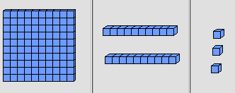
Vocabulary: Place Value and Face Value
Place value assigns a value to a digit depending on its placement in a numeral.
E.g. 123.
The 1 is has place value “hundreds” (100). The face value for the “hundreds” is 1.
The 2 has place value “tens” (10). The face value for the “tens” is 2.
The 3 has place value “units” or “ones” (1). The face value for the “units” is 3.
Expanded form:
123 = 1 $×100+2×10+3×1.$
http://nlvm.usu.edu/en/nav/grade_g_3.html
Base ten blocks: 1 flat, 2 longs and 3 units

Slide 7
Place Value – Number & operation in base 10
Grad K | Grade 1 | Grade 2
Work with numbers 11-19 to gain foundations for place value. | Count to 120, starting at any number less than 120. Read and write numerals and represent a number of objects with a written numeral. | Count within 1000; skip-count by 5s, 10s, and 100s.
 | Understand that the two digits of a two-digit number represent amounts of tens and ones. E.g, 74. | Understand that the three digits of a three-digit number represent amounts of hundreds, tens, and ones.
 | Compare two two-digit numbers based on meanings of the tens and ones digits, recording the results of comparisons with the symbols >, =, and <. | Compare two three-digit numbers based on meanings of the hundreds, tens, and ones digits, using >, =, and <.
 | Use place value understanding and properties of operations to add and subtract within 100 using concrete models and skills | Use place value understanding and properties of operations to add and subtract within 1000. More fluency.

Slide 8
Place Value – Number & operation in base 10
Grad 3 | Grade 4 | Grade 5
Use place value understanding to round whole numbers to the nearest 10 or 100. | Generalize place value understanding for multiple digit of numbers. Use decimal notation for fractions with denominators 10 or 100. For example, rewrite 0.62 as 62/100 | Read, write and compare decimals to thousandths. 347.392 = 3 × 100 + 4 × 10 + 7 × 1 + 3 × (1/10) + 9 × (1/100) + 2 × (1/1000).
Fluently add and subtract within 1000 using strategies and algorithms based on place value, properties of operation. | Use place value understanding and properties of operations to perform multi-digit arithmetic: add, subtract/divide up to 4 digits | Perform add/subtract/multiply/divide multi-digit whole numbers with decimals to hundredth, using drawing concrete model, standard algorithm.
Multiply one-digit whole numbers by multiples of 10 e.g., 9 × 80, 5 × 60). | Compare two decimals to hundredths by reasoning about their size. | (Grade 6. Fluently add, subtract, multiply, and divide multi-digit decimals using the standard algorithm for each operation.)

Slide 9
The Cycle of Math – Math Practices
Make Sense
Persevere in Solving Problems
Reason abstractly and quantitatively
Construct viable arguments and critique the reasoning of others
Model with mathematics
Attend to precision
Look for and make use of structure
Look for and express regularity in repeated reasoning
Use appropriate tools strategically

Slide 10
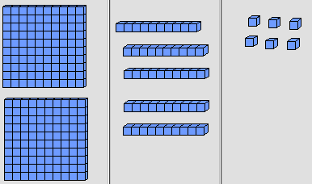
Part 1. Focus, Coherence and Rigor
Introduce place value concept early on. Present a number using place value and face value.
Early grades – K-2: Use drawings and/or manipulatives to present numbers in term of place value.
K: 16 = 10 + 6 Grade 2: 256=200+50+6
1 ten + 6 units 2 hundreds+5 tens and 6 units
( is 1 unit.)
Grade 3: Introducing the base ten expanded form of whole number: $256=2×100+5×10+6$

Slide 11
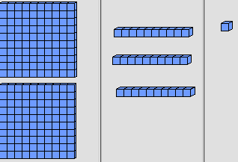
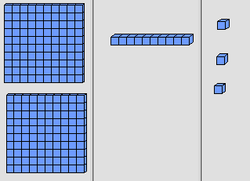
Part 1. Focus, Coherence and Rigor
Be able to name the place value of each digit of a number, and to compare the sizes of two numbers.
K: 13 and 16.
G1: 120 and 102, 78 and 87, 93 and 95.
G2: 231 and 213, 422 and 242, 1002 and 209.
G3: 4951 and 5000.
Be able to verbalize the strategy: compare each number from the highest place value to the lowest place value. The number has the first larger face value of the same place value is the larger number.

Slide 12
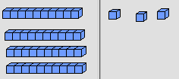
Part 1. Focus Coherence and Rigor
Addition and subtraction.
Grades 2 & 3 . Use drawings and/or manipulatives representing place value to add and subtract.
Grade 3. Develop algorithms for addition and subtraction. Common mistake: 43-26= 23.
Grade 3. Proficiency in using algorithms for addition and subtraction with in 1000.
tens units
4 3
- 2 6
Line each digit up in the correct place value column
3 13
- 2 6
Start from the lowest place value, 3<6, regroup
= 1 7

Slide 13
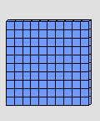
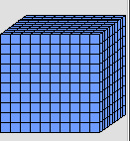
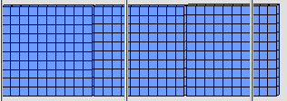
Part 1. focus, Coherence and Rigor
Multiplication.
Grade 3: Be able to rationalize the result of 10$×$10, 30$×$10, 100$×$10, 2$×$100 etc.
$10.×10=100.$ $30.×10=300.$ $100.×10=1000.$
$2.×100=200.$, $12.×100=1200, 123.×100=123000.$
When a number is multiplied by 10, every digit of that number is going up one place value (moving the decimal to the right by 1 digit).
When a number is multiplied by 100, every digit of that number is going up two place value (moving the decimal to the right by 2 digits).

Slide 14
Part 1. focus, Coherence and Rigor
Grade 4.
Use place value understanding and properties of operations to perform multi-digit arithmetic: add, subtract/divide up to 4 digits.
Generalize place value understanding for multiple digit of numbers. Use decimal notation for fractions with denominators 10 or 100. For example, rewrite 0.62 as 62/100.
Compare two decimals to hundredths by reasoning about their size.

Slide 15
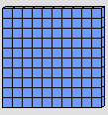
Part 1. focus, Coherence and Rigor
Multiple ways of representing decimals.
This flat is 1 unit. Shade $\frac{1}{10}, \frac{1}{100}, \frac{62}{100}$.
$0.62= \frac{62}{100}$ = $\frac{6}{10} + \frac{2}{100}$
=62 $×$($\frac{1}{100})$ = 6$×\frac{1}{10}$ + $2×\frac{1}{100}$
=62 hundredths = 6 tenths + 2 hundredths
$0.62= \frac{62}{100}$ = $\frac{60+2}{100}$ =$\frac{60}{100}+\frac{2}{100}$ = $\frac{6×10}{10×10}+\frac{2}{100}=$ $\frac{6}{10} +\frac{2}{100}$

Slide 16
Part 1. Focus Coherence and Rigor
Grade 5.
Read, write and compare decimals to thousandths: 347.392 = 3 × 100 + 4 × 10 + 7 × 1 + 3 × (1/10) + 9 × (1/100) + 2 × (1/1000).
Perform add/subtract/multiply/divide multi-digit whole numbers with decimals to hundredth, using drawing concrete model, standard algorithm.

Slide 17
Part 1. Focus Coherence and Rigor
SBAC Practice Problems

Slide 18
Part 1. Focus Coherence and Rigor
https://www.smarterbalanced.org/wp-content/uploads/2015/11/G5_Practice_Test_Scoring_Guide_Math.pdf

Slide 19
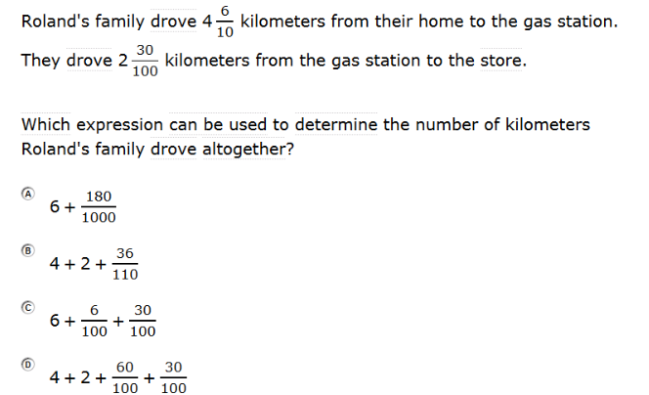
Part 1. Focus Coherence and Rigor
Grade 5.
https://www.smarterbalanced.org/wp-content/uploads/2015/11/G5_Practice_Test_Scoring_Guide_Math.pdf

Slide 20
Decimals - Designing Effective Mathematics Instruction, 4th ed. 2006 – Stein, Kinder, Silbert and Carnine
Terms and Concepts- Decimal fractions, decimals, mixed decimal. – building vocabulary for success.
Instructional Sequence and Assessment Chart – coherence, logical and cognitive progression, and assessment chart.
Directive Approach - step by step instructions.
Diagnosis and Remediation – examples of mistakes, diagnosis and strategies of correcting them.

Slide 22
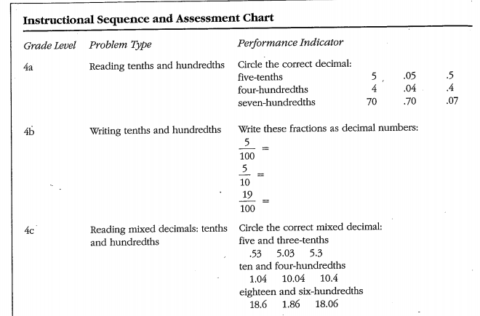

Slide 23
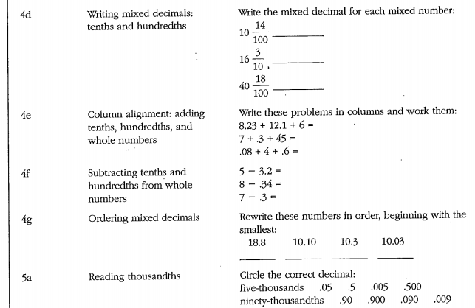

Slide 28
Part 2. Lesson Plans Guidelines
Focus, Coherence and Rigor.
Introduction
Declarative knowledge – Describe the content of the lesson
Conditional knowledge—Describe why students learn content and the conditions for using it
Development
Procedural knowledge—Describe the steps for guiding students to acquire the strategy/content
Differentiated instruction—Describe strategies for engaging ELL/SPED students
Formative Assessment.
Closure
Final Assessment—Describe relevant instruments for monitoring and evaluating students learning.
Notes:
Modeling Problems -> Ratio -> patterns developed (equivalent ratios, fraction expressions, etc) -> Solve problems (unit price, rate) -> more problems such as proportional relationships ->

Slide 29
Design your lesson plan base on the needs of your students
Differentiated instruction—Describe strategies for engaging ELL/SPED students
Goal: Alignment with Common Core State Standards
Emphasis #1 Balancing conceptual understanding and procedural fluency .
Emphasis #2 Maintaining high cognitive demand using high-cognitive-demand math tasks and maintaining the rigor of mathematical tasks throughout lessons and units.
Emphasis #3 Developing beliefs that mathematics is sensible, worthwhile, and doable.
Emphasis #4 Engaging students in the eight CCSS mathematical practices

Slide 30
Guidelines for ELL and SPED Students
Focus on mathematical reasoning as well as on language development.
Draw on multiple resources available in classrooms – such as objects, drawings, graphs, and gestures – as well as home languages and experiences outside of school.
Support all students, regardless of their proficiency in English, cultural, racial and economical backgrounds. When students can participate in discussions in a safe classroom environment they grapple with important mathematical content.
- Moschkovich 1995, 2002, 2007

Slide 31
Five Recommendations for Teaching ELS by J. Moschkovich
Focus on students’ mathematical reasoning, not accuracy in using language. (Accuracy will eventually come with ample time of practices).
Shift to a focus on mathematical discourse practices, move away from simplified views of language.
Recognize and support students to engage with the complexity of language in math classrooms.
Treat everyday language and experiences as resources, not as obstacles.
Uncover the mathematics in what students say and do.
Video by the author - http://ell.stanford.edu/publication/mathematics-common-core-and-language

Slide 32
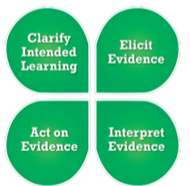
Part 2. Lesson Plans Guidelines
SBAC 4-step formative assessment process:
Clarify intended learning
Elicit evidence
Interpret evidence
Act on evidence
Notes:
Modeling Problems -> Ratio -> patterns developed (equivalent ratios, fraction expressions, etc) -> Solve problems (unit price, rate) -> more problems such as proportional relationships ->

Slide 33
the 4-step Formative Assessment
Step 1. Clarifying Intended Learning
Define learning goals clearly using student-friendly language as such “I can …”.
Provide clear success criteria that defining the evidence for determining how students progressing towards learning goals.

Slide 34
the 4-step Formative Assessment
Step 2. Eliciting Evidence
Gather evidence of learning using different ways depending on students’ needs, interest and learning styles.
Use multiple sources of evidence to draw accurate conclusions about student learning – in relation to learning goals and success criteria.

Slide 35
the 4-step Formative Assessment
Step 3. Interpreting the Evidence
Determine where each student is in relation to learning goals, what he/she understands or doesn’t understands.
Evidence is interpreted on an ongoing basis throughout instruction, it is not a single event. Students can also independently analyze evidence of their own learning, though they benefit from sharing and discussing their interpretations with teachers and peers (MP3). By doing so, accountable feedback are provided.

Slide 36
the 4-step Formative Assessment
Step 4. Acting on Evidence.
Teachers and students use actionable feedback to determine next steps to continue to move learning forward.
The steps may not be the same for all students and must take into consideration each student’s readiness, interests, and learning preferences.

Slide 37
Lesson Plan – CCSS Learning goals
CCSS Math Content 5.NBT.B.7:
“Add, subtract, multiply, and divide decimals to hundredths, using concrete models or drawings and strategies based on place value, properties of operations, and/or the relationship between addition and subtraction; relate the strategy to a written method and explain the reasoning used.”
Math Practices: 1. Make sense of problems and persevere in solving them. 2. Reason abstractly and quantitatively. 3. Construct viable arguments and critique the reasoning of others. 6. Attend to precision 7. Look for and make use of structure. 8. Look for and express regularity in repeated reasoning.

Slide 38
Lesson Plan - Introduction
Declarative knowledge – Describe the content of the lesson: subtract decimals to hundredths, using concrete models or drawings and strategies based on place value, properties of operations, and/or the relationship between addition and subtraction; relate the strategy to a written method and explain the reasoning used.
Math Practices: 1. Make sense of problems and persevere in solving them. 2. Reason abstractly and quantitatively. 3. Construct viable arguments and critique the reasoning of others. 6. Attend to precision 7. Look for and make use of structure. 8. Look for and express regularity in repeated reasoning.

Slide 39
Lesson Plan - Introduction
Conditional knowledge—Describe why students learn content and the conditions for using it: through this lesson students strengthen their understanding of the place value concept and the relationship between decimal numbers and fractions, and extend subtraction algorithm for whole numbers to decimals and mixed decimals.
This prepares them to achieve fluency on operations of real numbers at higher grades.
Students should have prerequisites of previous content knowledge, see CCSS contents, examples of this presentation and the instructional sequence by Strein, etc, 2006.

Slide 40
Student Learning goals - Formative Assessment Step 1 Clarifying Intended Learning
I can subtract two numbers with decimals using
concrete models or drawings,
strategies based on place value, and
subtraction algorithm.
I understand and can explain why the algorithm works.

Slide 41
Design your lesson plan base on the needs of your students
Use drawing, base ten blocks, etc, to help ELL and SPED students visualize the concepts.
Demonstrate clear board work to allow ELL students and students with learning disabilities to see what you are saying.
Create story problems that relate to your students’ life and cultural background.
Create a safe and collaborative learning environment. Allow students work in groups with mixed language, cultural, mathematical and racial backgrounds so they can help each other succeed.

Slide 42
Lesson Plan – Development Embedded with Formative Assessment Steps
Review and Pre-evaluation, can students subtract two whole numbers? – Step 2. Elicit Evidence.
Give students some problems to solve, such as, 65$−$23, 335$−$28, 255$−163$, etc.
Demonstrate step by step calculation, e.g. 255-163, see next slide. Students and teacher observe common and individual mistakes.
Determine the type(s) of the mistakes, algebraic or conceptual. - Step 3. Interpreting the Evidence.
Correct algebraic mistakes. For conceptual mistakes – place value or algorithm mistakes, use various strategies (manipulatives, drawing, etc) to clarify the concept - Step 4. Act on Evidence.
Summarize the subtraction algorithm.

Slide 43
100’s 10’s 1’s
Place each digit under the correct place value in column style
Billstain,
Libeskind,
Lott, 2013

Slide 44
Use a lots of drawings, visual objects, math expressions to demonstrate the terms
Stein etc
2006

Slide 45
Progress to
I can subtract two decimals by drawing and using algorithm.
Demonstrate how and also give the students a chance to solve the problems such as: 0.34-0.21, 0.54-0.26, 0.34-0.2 – Step 2. See next slide.
Observe common and individual mistakes. - Step 3.
Step 4.
Show the correct algebraic steps with the support with explanation, supported with drawing, etc.
Summarize the procedure for subtracting two decimals.

Slide 46
0.53-0.26
Algorithm
One’s tenth’s hundred’s (line each digit up in the
correct place value column
0. 5 3
- 0. 2 6 (3<6, regroup)
0. 4 13
- 0 . 2 6
= 0. 2 7
Using place-value expanded form
0.53 = 5($\frac{1}{10})+3(\frac{1}{100})$
-) 0.26 = 2($\frac{1}{10})+6\left(\frac{1}{100}\right)$
0.53 = 4($\frac{1}{10})+$10($\frac{1}{100})+3(\frac{1}{100})$
-) 0.26 = 2($\frac{1}{10})+6\left(\frac{1}{100}\right)$
--------------------------------------
=2($\frac{1}{10})+$7($\frac{1}{100})$
=0.27
By using fractions: 0.53-0.26= $\frac{53}{100}−\frac{26}{100}=\frac{53−26}{100}=\frac{27}{100}=0.27$

Slide 47
Progress to another higher level
I can subtract two mixed decimals by drawing and algorithm.
Demonstrate how to use the subtraction algorithm and provide students opportunities to solve the problems by themselves. Examples: 5.34-3.12, 2.55-1.63, 110.5-89.45, 3-0.87, 321.5-215.61 – Step 2. (Develop your example here.)
Observe common and individual mistakes. - Step 3.
Step 4.
Show the correct algebraic steps with the support with explanation, supported with drawing, etc.
Summarize the procedure for subtracting two mixed decimals.

Slide 48
Diagnosis and Remediation of Mistakes
Identify the types of mistakes by check each student’s work and interview him and her:
motivational problem, or lack of confidence,
careless mistake,
specific algebraic skill,
procedure or conceptual problem.
Address each mistake differently, work on the specific skill or conceptual understanding. Teacher provides reteaching through board and/or worksheet presentations, as well as one on one teaching opportunities.
Provide additional individualized problems for each student and check the answers.
ADJUST YOUR LESSON PLAN ACCORDINGLY TO YOUR STUDNETS’ NEEDS

Slide 49
Diagnosis and Remediation of Mistakes
Error Pattern | Diagnosis | Redediation Procedure
4.5-3=2.2 4-.3=1 | Component skill error. Student didn’t convert whole number to mixed decimal number. Or when use algorithm, the place-value columns did not line up correctly. | Teach student write whole number as mixed numbers. Put each digit under the correct place-value column. Have student draw a picture of the calculation.
414.25 -)205.31 =111.14 | Strategy/Algorithm error, when 2<3, 4<5, regroup the tenths and single units face values. | Clarify how to use the algorithm, use a simpler problem with graphs to demonstrate the reason. Allow more practices.
3.5-1.05=2 | Component skill. Student is unclear of 5 tenths and 5 hundredths. | Work on understanding decimals and also converting 5 tenths to 50 hundreds. Go over the algorithm.

Slide 50
Progress to Applications
Example 1. Daisy had $7.52 cents, she spent $5.99 to purchase a book, how many money does she have now?
Example 2. Jose has $23.60 and would like to buy a concert ticket at $25. How much more money does he need to buy the ticket?
Which problem is more difficult?
Is there any alternative way to solve each problem?
How do you make it easier or more difficult?

Slide 51
SBAC Practice Problems

Slide 52
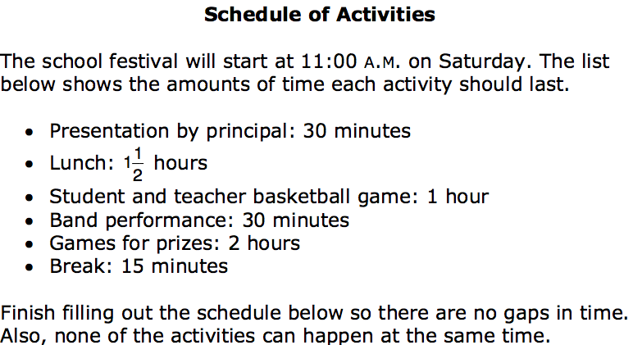
http://www.rcoe.us/educational-services/files/2013/11/asmt-sbac-math-gr5-sample-items.pdf

Slide 53
Lesson Plan – Closure, Final Assessment
Have students summarize the procedure for subtraction.
Provide them with additional problems to do on their own and assess their work through Steps 2-4, if time allows.
Additional assessment through exit ticket, homework, and quizzes.

Slide 54
Smarter Balanced Digital Library Resources
4th Grade Division Mistake Detectives. Place Value and Algorithm. Author: Carol Kohn Owner: Carol Kohn
Equivalent Forms of Decimals. Author: Illustrative Mathematics Owner: Illustrative Mathematics
TASK: Rearranging Digits to Understand Place Value. Author: Rhandy Siordia Owner: Rhandy Siordia
https://www.smarterbalancedlibrary.org

Slide 55
References :
http://www.readwritethink.org/professional-development/strategy-guides/using-think-pair-share-30626.html
http://nlvm.usu.edu/en/nav/grade_g_2.html
http://www.corestandards.org/Math/
http://www.k12.wa.us/corestandards/
NCTM. Principles to Actions: Ensuring Mathematical Success for All. 2014. NCTM.
http://de.portal.airast.org/wp-content/uploads/2014/09/G8_Practice-Test-Scoring-Guide-5.14.14-Final.pdf
http://rpdp.net/admin/images/uploads/resource_9838.pdf
Billstein, Libeskind, Lott. A problem Solving Approach to Mathematics, 8th ed, 2014. Pearson.
Engelmann, Kelly, Engelmann. 2008. Essentials for Algebra, a direct approach. SRA McGraw Hill.
Stein, Kinder, Silbert, and Carnine. 2006. Designing Effective Mathematics Instruction, A direct Instruction approach. 4th ed. Pearson Merrill Prentice Hall.
Billstein, Libeskind, and Lott, 2013. A Problem Solving Approach to Mathematics for elementary teachers. 11th ed. Pearson.
Dolan, Williamson, and Muri, 2013. Mathematical Activities for Elementary School Teachers. Pearson.

